Slide 1
Invasive Pests and pathways

Slide 2
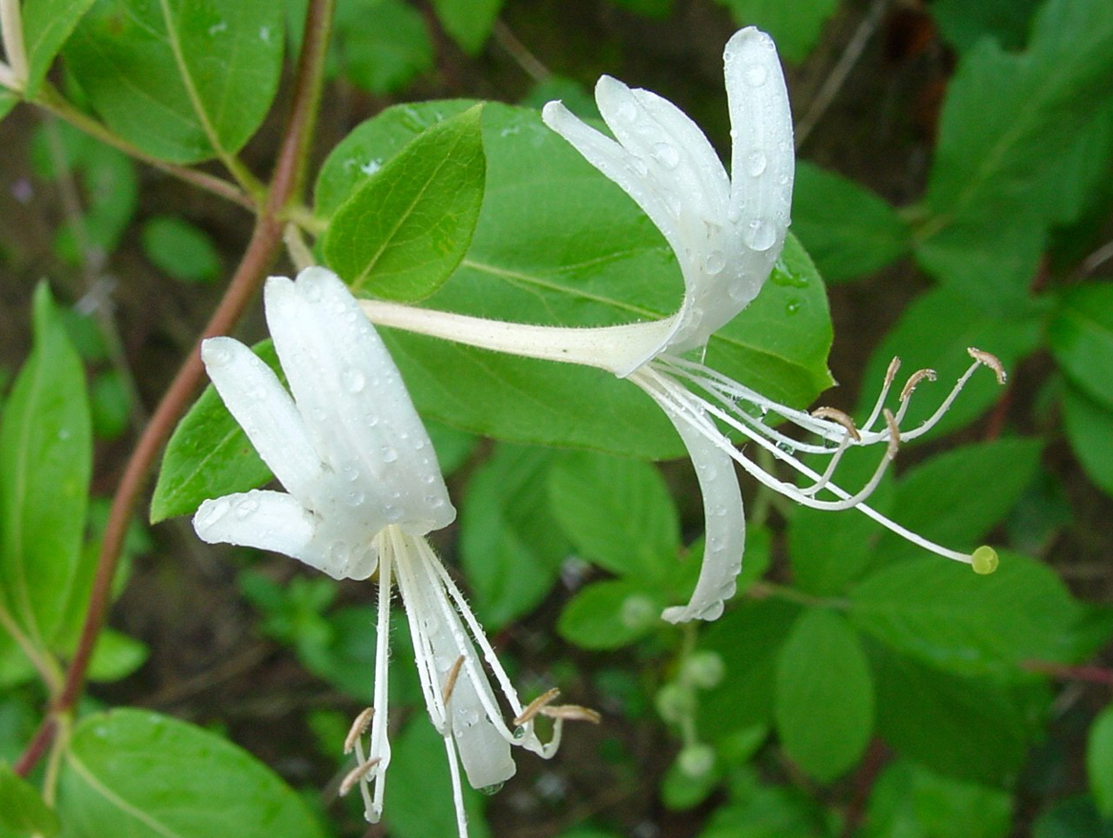
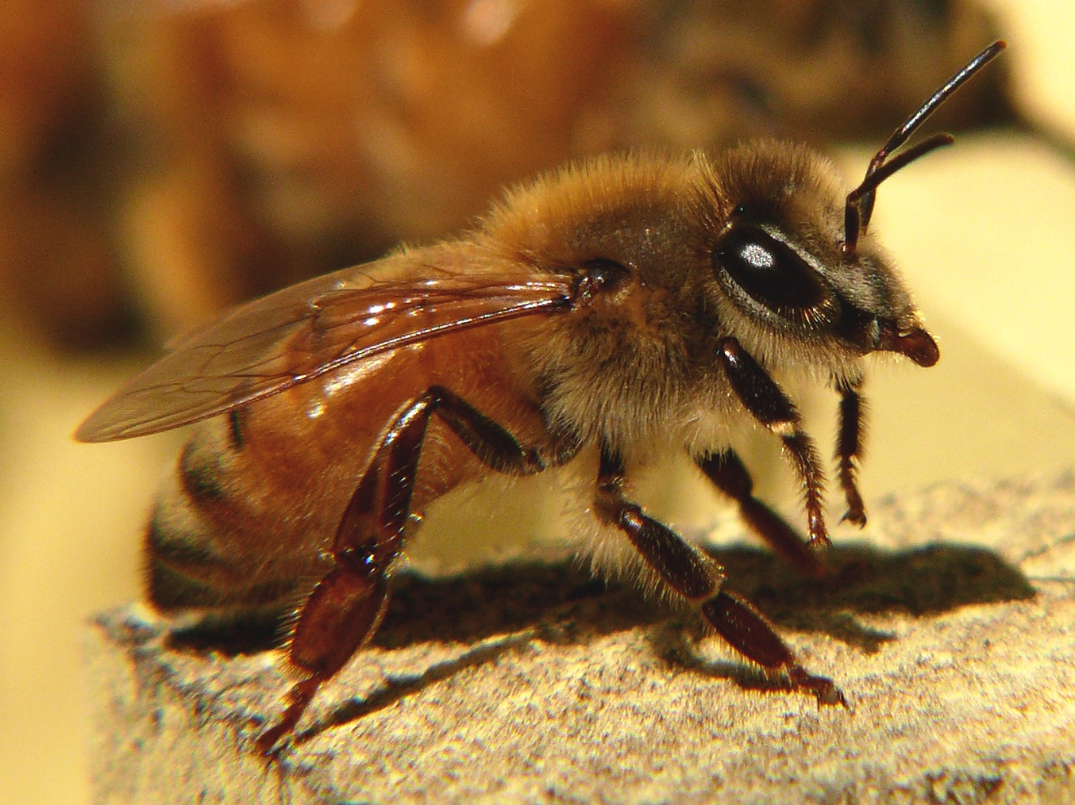
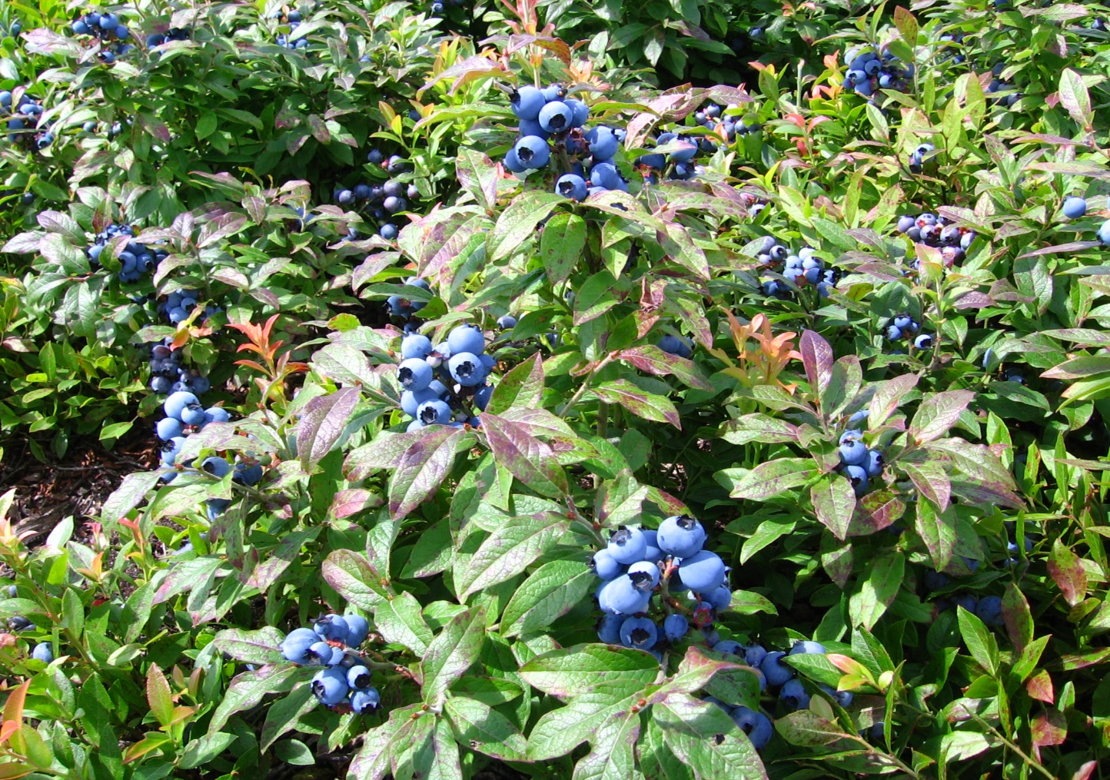
What Is The Difference?
Native? Introduced? Invasive?
What about non-native and exotic?
Japanese honeysuckle
Honeybee
Blueberry
Photo: (Left) – )- Chuck Bargeron, University of Georgia, Bugwood.org, #1150068; (Middle and Right) – Wikimedia Commons.
Notes:
Native, Introduced, Invasive, Non-native, exotic? I guess having all these different words helps keep dictionaries in business, but for everyone else it can get pretty confusing pretty quick and a lot of times they get used interchangeably. So, the first thing we do is review some of the vocabulary that scientists and decision-makers use when discussing plant pests.
This slide contains a picture of each one, a native, introduced and invasive species. Do you know which one is which? You can go ahead and put your answers in the chat, and I’ll go over the answer through the talk.

Slide 3
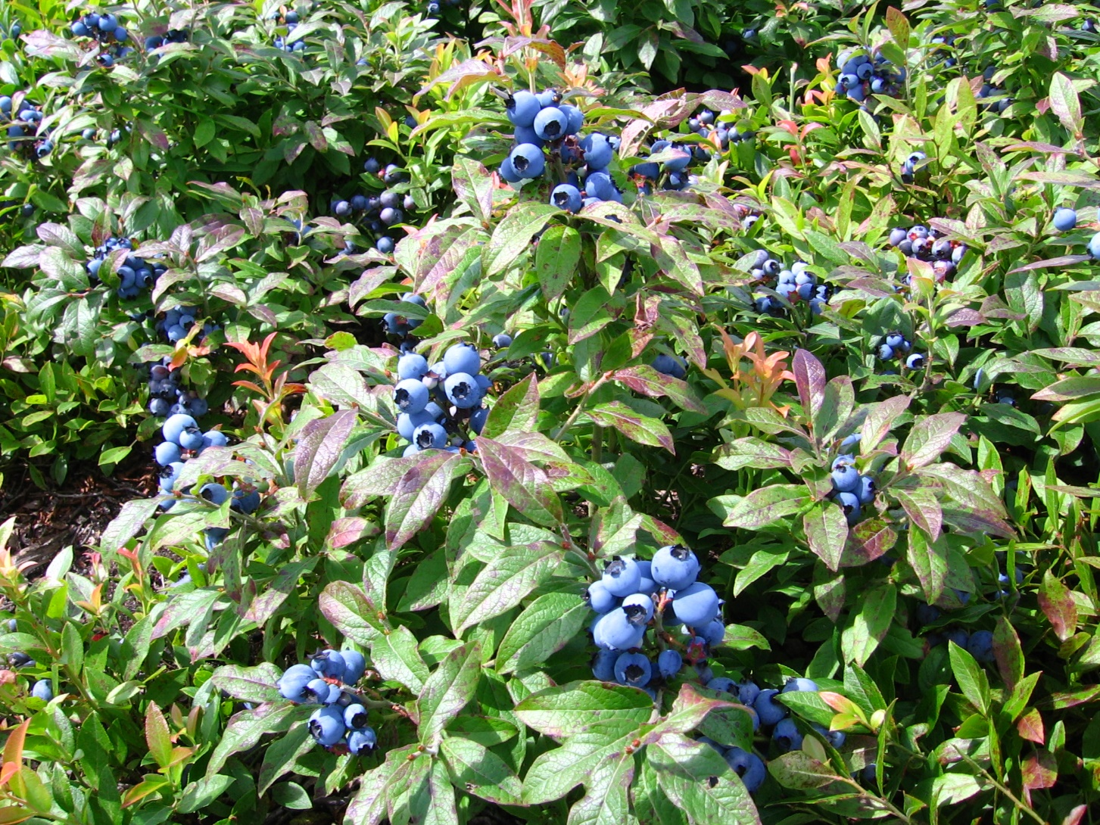
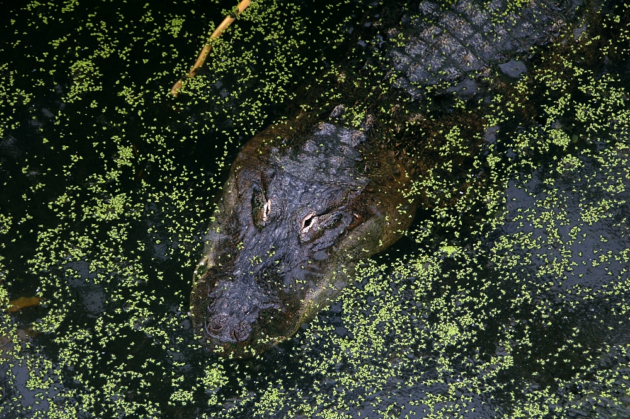
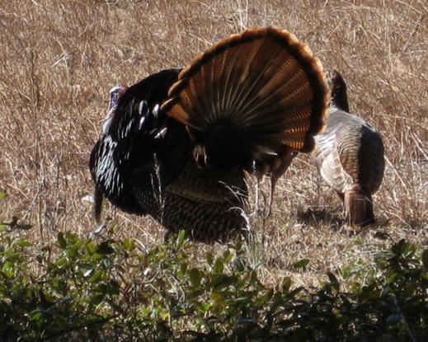
Native
  Organisms that occur in an ecosystem as a result of only natural processes, with no human intervention.
Blueberry
Alligator
Wild turkey
Photos: (Left and middle) – Wikimedia Commons; (Right) - Jennifer A. Hamel, University of Florida.
Notes:
So native species are organisms which means any plants, animals or even fungi and bacteria whose presence in an ecosystem is the result of only natural processes and is not the result of human intervention. So, anyone guessed native for blueberry good job! They are native to the Continental US along with wild turkeys and of course alligators.

Slide 4
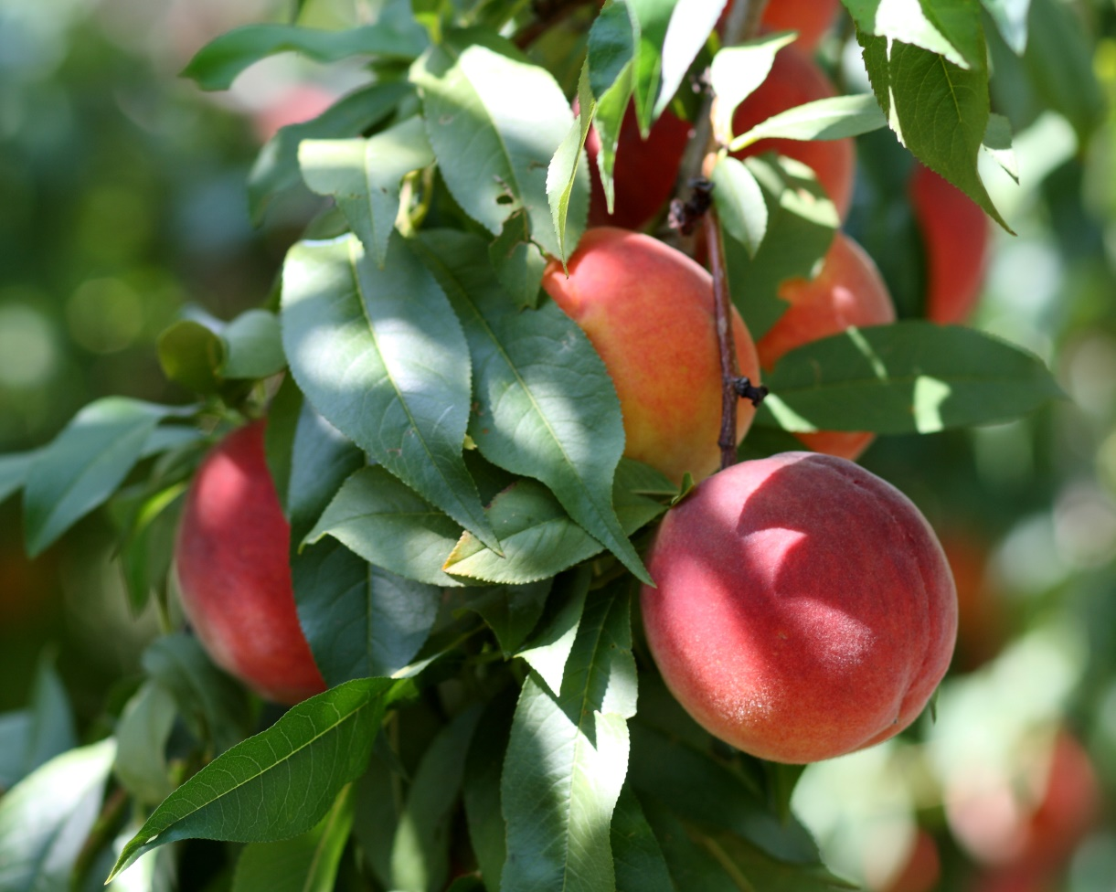

Introduced
  Organisms that are introduced to a new ecosystem where they become established and survive
  AKA Exotic, Non-native
  Usually introduced via human intervention
  Can have beneficial or detrimental effects on environment
Peaches
Honeybee
Photos: Wikimedia Commons
Notes:
As the word suggests introduced species are organisms that originate in one region but are introduced to another region where they become acclimated and “established” in the new region.
Establishment means the organism can survive and reproduce on its own allowing it to maintain a stable population in the new area. Humans are of then the source of the introduction which is to can be accidental or intentional.
Another important point for introduced species is they can have either beneficial or detrimental effects on the environment.
Peaches (from Asia) and honeybees are both examples of introduced species that are considered to be beneficial. Honeybees were introduced from Europe, but their pollination has beneficial effect on the environment and especially for humans, as a lot of crop including blueberries rely on pollination services from managed honeybee colonies.

Slide 5
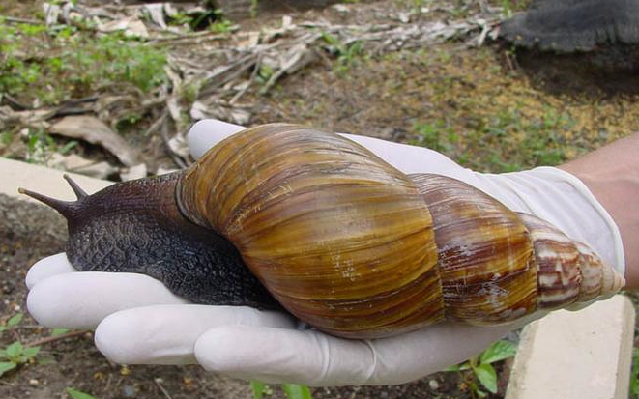
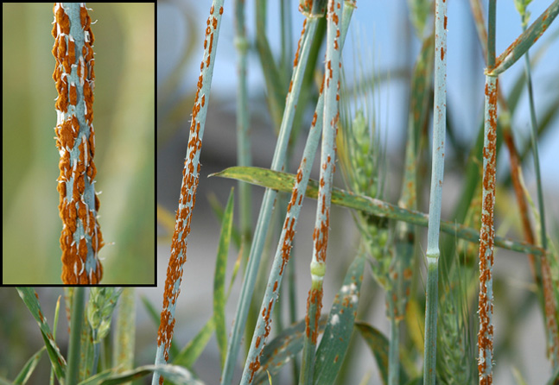
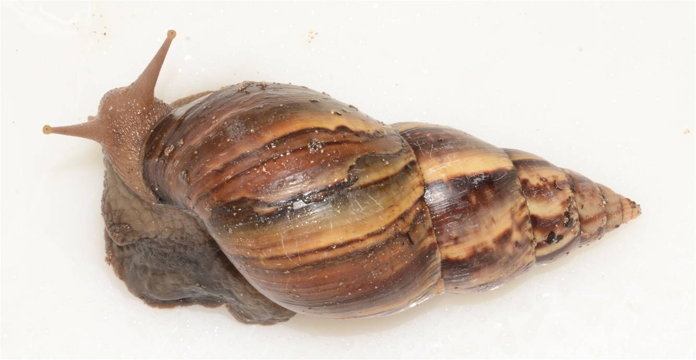
Invasive
  Organisms that are introduced to an ecosystem where they establish and survive, causing harm.
  Usually introduced via human intervention
  Only have detrimental effects (economic, ecological, and/or human health)
Japanese honeysuckle
Giant African land snail
Wheat stem rust
Photos: (Left)- Chuck Bargeron, University of Georgia, Bugwood.org, #1150068
(Middle)- Pest and Diseases Image Library, Bugwood.org, #5502140; (Right) - USDA-ARS Photo, http://www.ars.usda.gov/Main/docs.htm?docid=9910
Notes:
So now for Invasive. The National Invasive Species Council defines invasive species as being not native to the ecosystem (i.e. introduced) and whose introduction will likely cause harm. That harm could cause negative impacts on the environment, economic loss or pose a risk to human health.
So introduced species don’t always causes harm, but if it does then its an invasive species. This means introduces species are NOT always invasive, but Invasive species are always introduced.
Just like introduces species invasive species are usually introduced by people, although usually its accidental through shipping of goods or movement of people from country to country, but sometimes they are intentionally introduced. A lot of the times if the release is intentional its because the person doesn’t realize how much of a negative impact this can have.
One example of this is the Giant African Land snail. In 1966 a boy smuggled 3 snails back from Hawaii. The boy released them in his grandmother’s garden in Miami. Well just those couple of snails that got huge ordeal, including an eradication effort by the FDACS that took 10 years and over $1 million dollars. At the end of it over 18,000 snails were eradicated.

Slide 6
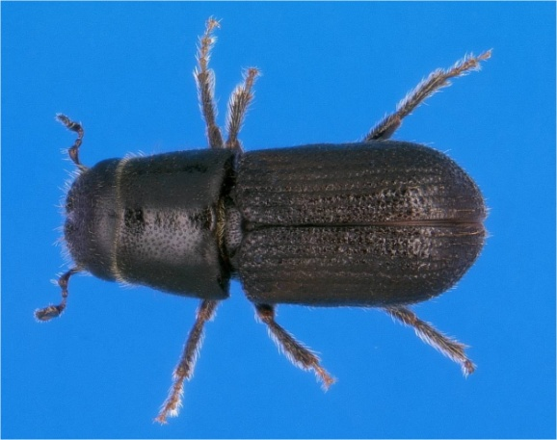
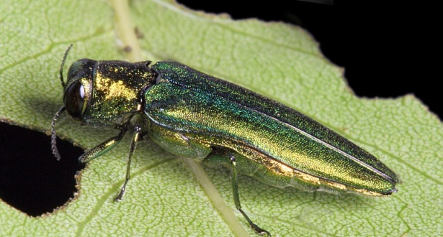
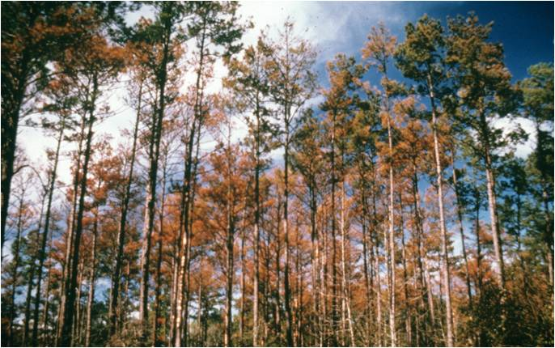
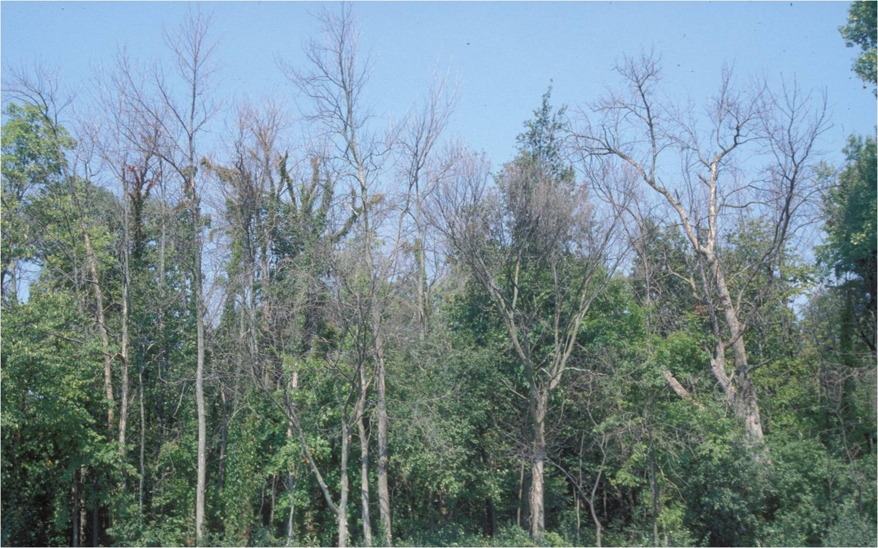
Pest
  Organisms that compete with humans for resources
  Competition includes consuming or damaging food, fiber, other resources that humans value
  Pests can be native, introduced, or invasive
Pine tree damage caused by Southern pine beetle
Ash tree damage caused by Emerald ash borer
Photos: (Left, main) - Ronald F. Billings, Texas Forest Service, www.bugwood.org, #1546017; (Left, inset) - Erich G. Vallery, USDA Forest Service - SRS-4552, www.bugwood.org, #5289035; (Right, main) - Daniel Herms, The Ohio State University, www.bugwood.org, #5171038; (Right, inset) - David Cappaert, Michigan State University, www.bugwood.org, #2106098.
Notes:
One last definition, well with the title of this talk being Pests and pathways. I wanted to go over exactly what I mean. A pest species are organisms that compete with humans for resources we value. For example, pests may consume, or damage food, fiber or other materials intended for human consumption or use. Those giant African land snails eat a tremendous number of different plants and sometimes even stucco and plaster on buildings.
Pests can be native to an area or be invasive/introduce. For example, lets look at 2 different forestry pests. On the left is the southern pine beetle which is a native species that attacks pine trees. Then on the right we have the emerald ash borer is an introduced pest or invasive species that attacks ash trees.

Slide 7
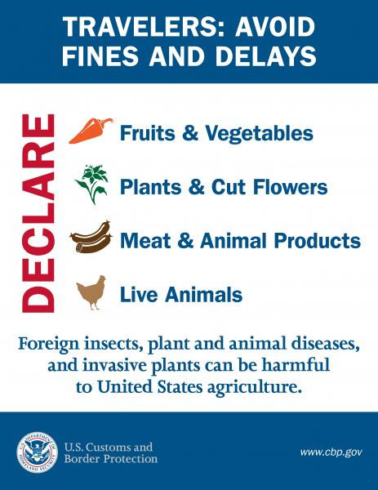
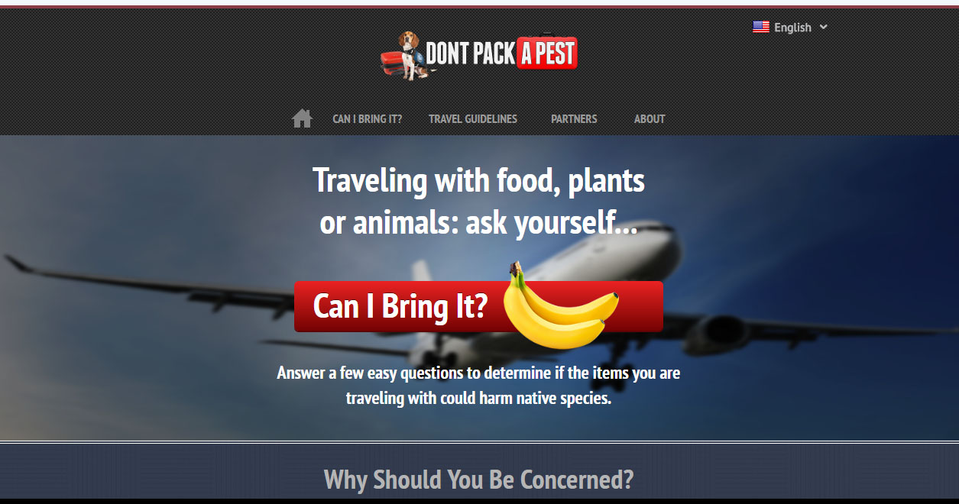
Don’t Pack a Pest!
http://www.dontpackapest.com/

Slide 8

Don’t Pack a Pest!
https://www.youtube.com/watch?v=x0S99cwnDqM

Slide 9
How are new species introduced and why does Florida seem to get so many?
Notes:
Alright so now that we are all on the same page for what native, introduced, invasive, and pest, we can get to the fun part. How are new species introduced? and of course why does Florida seem to get so many?
If you have any ideas for how new species get to Florida and how Florida ends up with so many go ahead and put those in the chat.

Slide 10
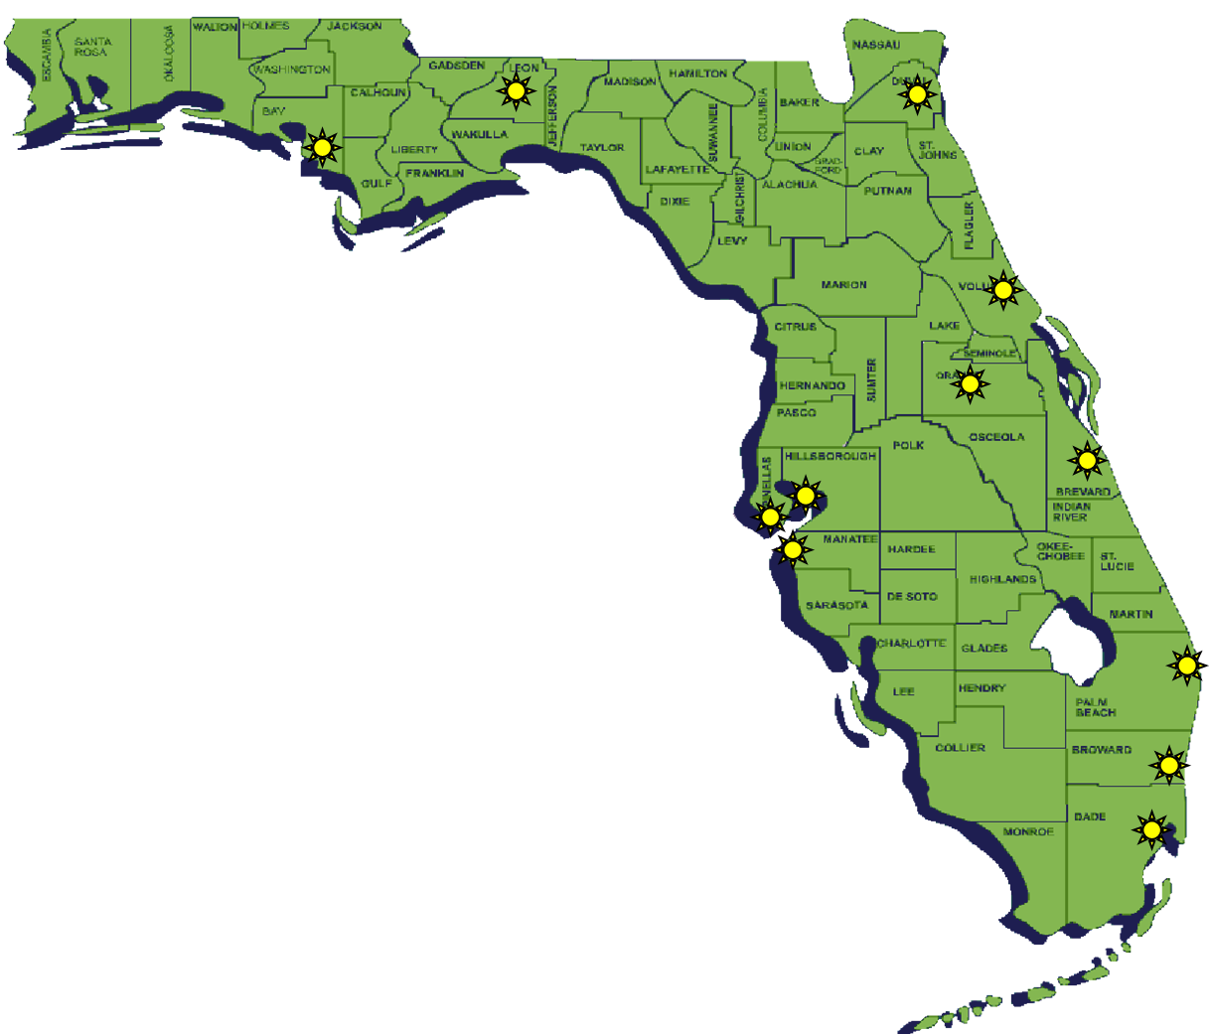

Florida has 12 International Airports
Panama City/Bay County International
Tallahassee International
Jacksonville International
Daytona Beach International
Orlando International
Melbourne International
Palm Beach International
Ft. Lauderdale International
Miami International
Sarasota International
St. Pete/Clearwater International
Tampa International
Map courtesy of: Florida CAPS
Notes:
First let’s talk about how new species actually get to Florida. Well, we said that most of the time new species are hitching a ride people, so how do people get to Florida? Well one way is through air travel. Florida has a lot of airports 12 internationals one total and 3 of them right here in Tampa bay, so that one quarter of the state’s airports.

Slide 11
U.S. Cut Flower Imports
90% of U.S. Cut Flowers via Miami Air Cargo!
Notes:
The airports move a lot of people, but they are also moving goods as well. One of those goods includes flowers. Here we have graph showing where cut flower imports arrive in the US. The overwhelming majority, 90% of the entire country’s cut-flower imports enters through the Miami International Airport. These cut-flower imports are live plant material, on which plant pests can and do hitchhike.

Slide 12
U.S. Cut Flower Imports, Pest Interceptions
51% of Top 10 Pest Interceptions for U.S. Cut Flower Imports, Miami Air Cargo
Notes:
There are around 51% pest intersections in cut-flower imports that arrive through Miami. This means more opportunities for pests to enter and establish in Florida

Slide 13
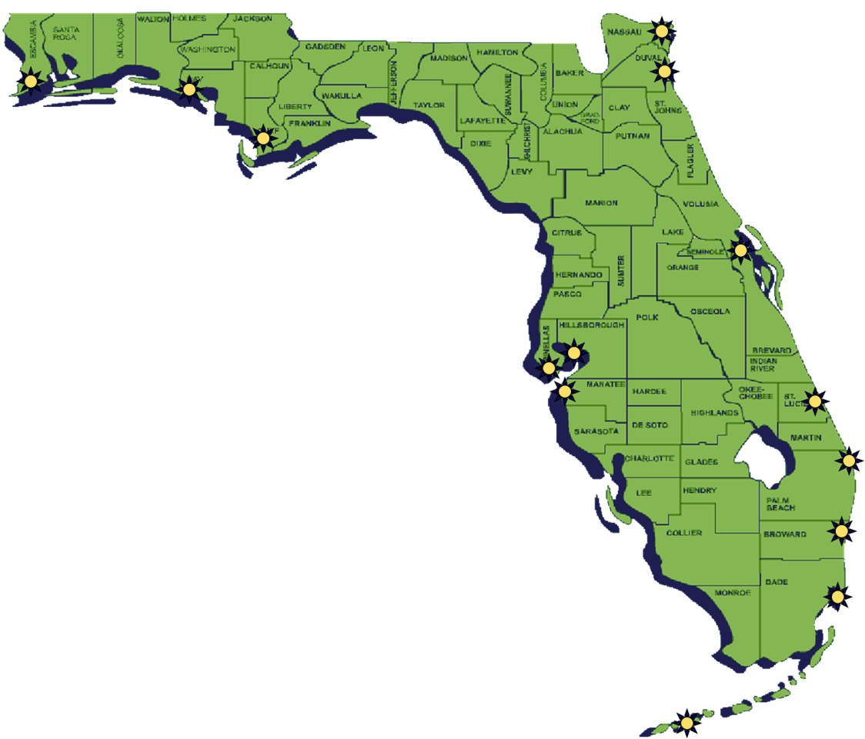
Florida has 14 Deepwater Ports
Port of Pensacola
Port of Panama City
Port of St. Joe
Port of Tampa
Port of St. Petersburg
Port of Manatee
Port of Key West
Port of Miami-Dade
Port of Everglades
Port of Palm Beach
Port of Ft. Pierce
Port Canaveral
Port of Jacksonville
Port Fernandina
Photo: Microsoft Power point clip art, Map courtesy of: Florida CAPS
Notes:
In addition to the 12 airports, Florida also has 14 Deepwater ports that play an important role in international trade. Each one of these is a potential pathway for new and invasive species to arrive in Florida

Slide 14
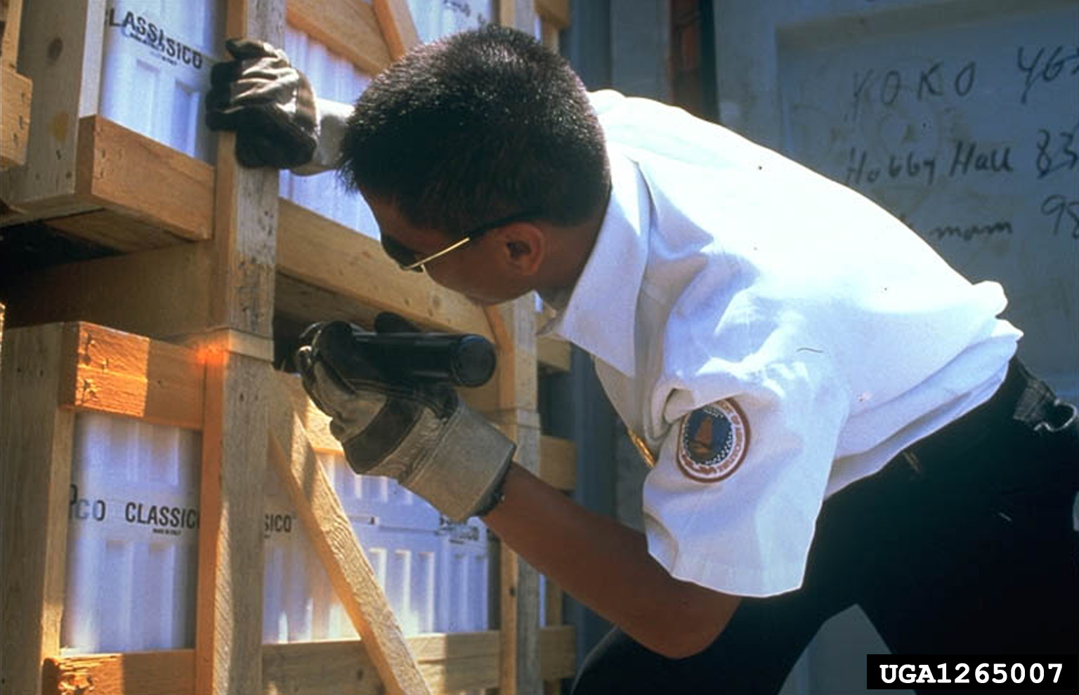
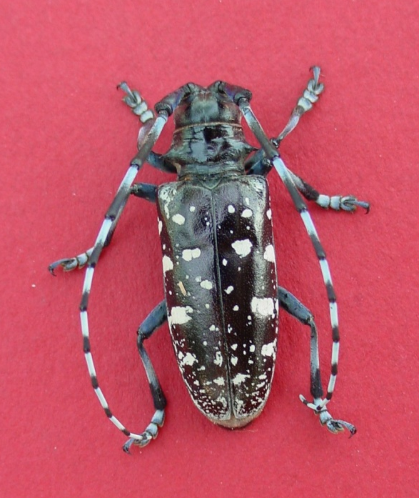
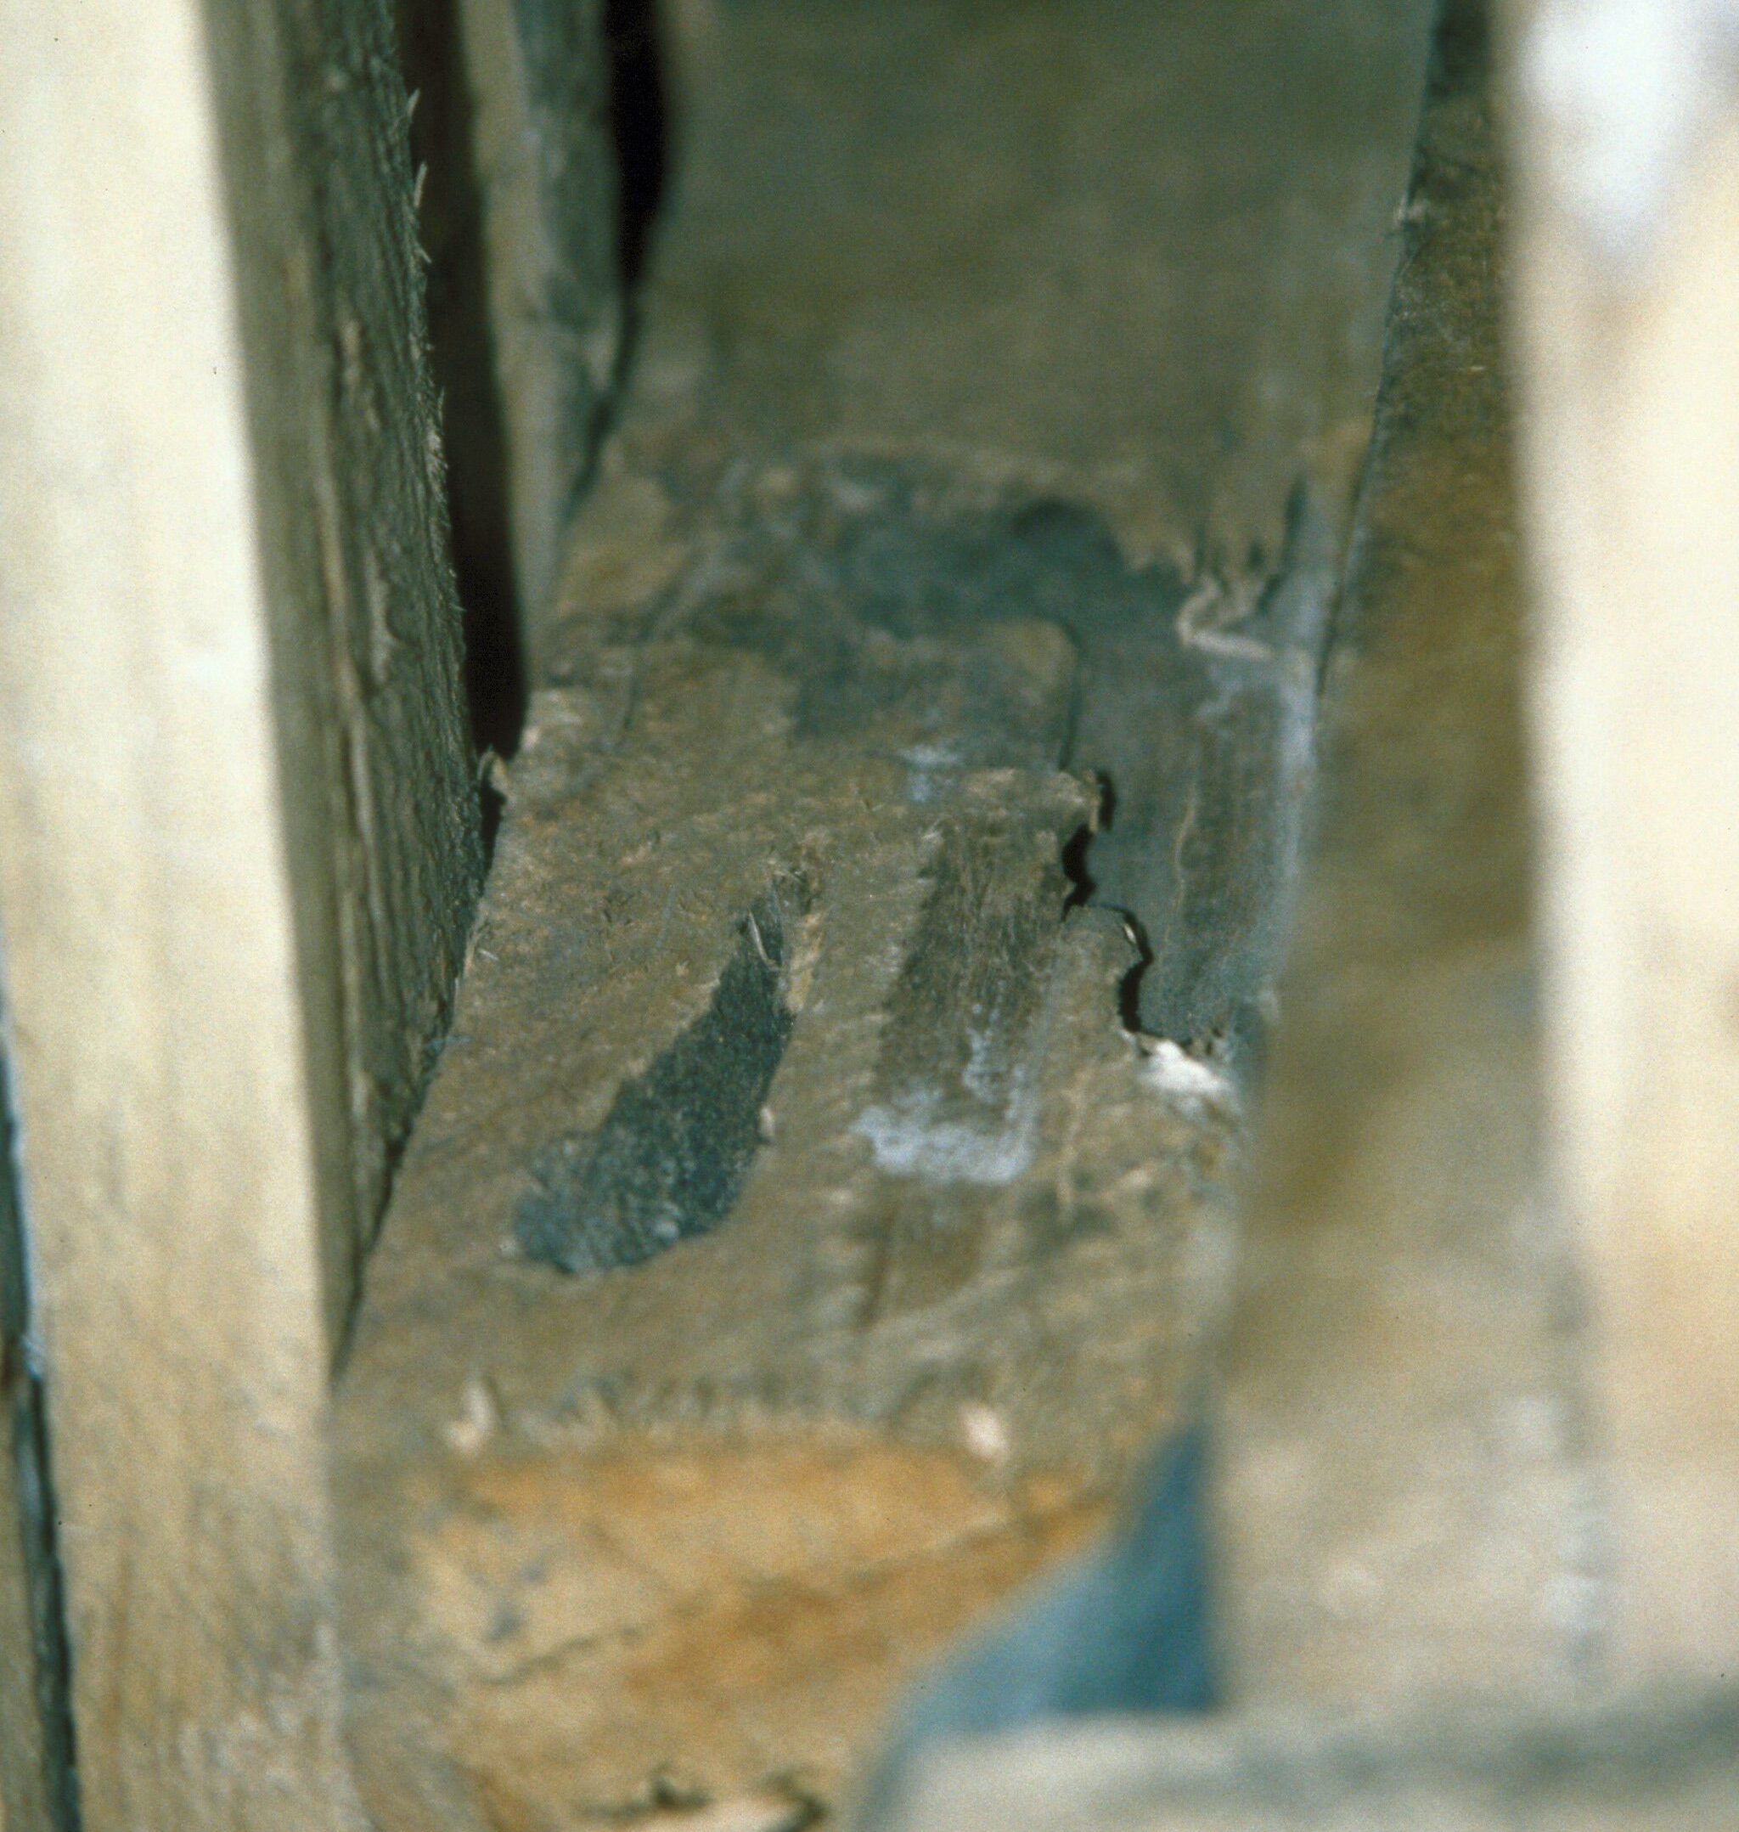
Stowaways in Cargo
Asian longhorned beetle
Pallet damaged by Asian longhorned beetle
Cargo being inspected
(Left to right) - Michael Bohne, Bugwood.org #UGA1262002; USDA-APHIS-PPQ, Bugwood.org #1265007; Larry R. Barber, USDA Forest Service, Bugwood.org #3047036;.
Notes:
One example of how pests can be stowaways on these imports, is the Asian longhorned beetle that is thought to be introduced to the US through infested wood packing and shipping material itself and not actual commodity being important. The photo in the middle shows the pallets being inspected and on the right you can see an example of damage to a wood pallet.

Slide 15
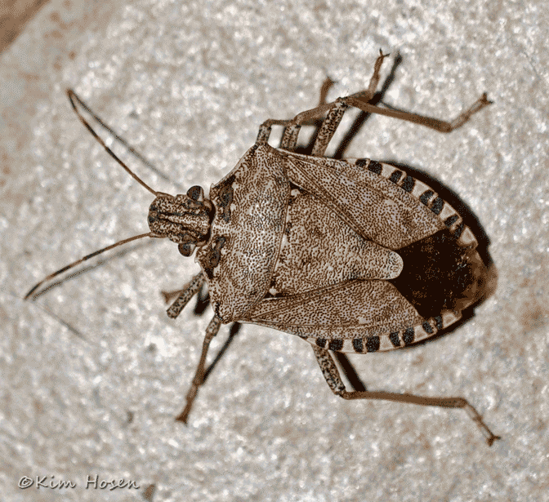
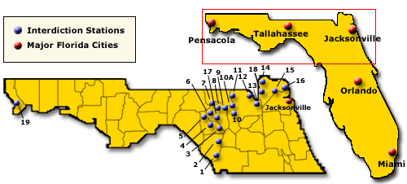
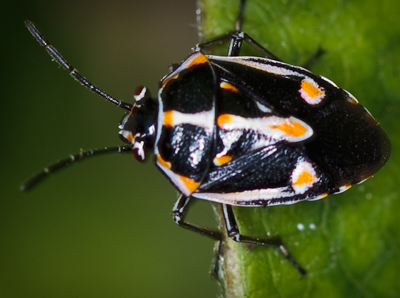
Agricultural Interdiction Stations
Brown Marmorated Stink Bug
Multiple Interceptions
Bagrada Bug
Map courtesy of: Florida CAPS
Notes:
Lastly, invasive pests can also come into Florida through commercial shipments of agricultural, ornamental, or forestry products that originated in a different part of the United States and are brought to Florida on trucks.
The Brown marmorated stink bug and the bagrada bug are 2 pests of concern that could arrive in this fashion. Part of the mission of the Florida Cooperative Agricultural Pest Survey (CAPS) is to inspect agricultural shipments traveling into Florida from other states. Although less than 5% of agricultural shipments can be thoroughly inspected, in 2012, CAPS detected brown marmorated stink bug and bagrada bug (both potentially invasive pest species) three times each at interdiction stations.
The brown marmorated stink bug is also know to sometimes hitch rides in peoples cars that are traveling to the state.

Slide 16
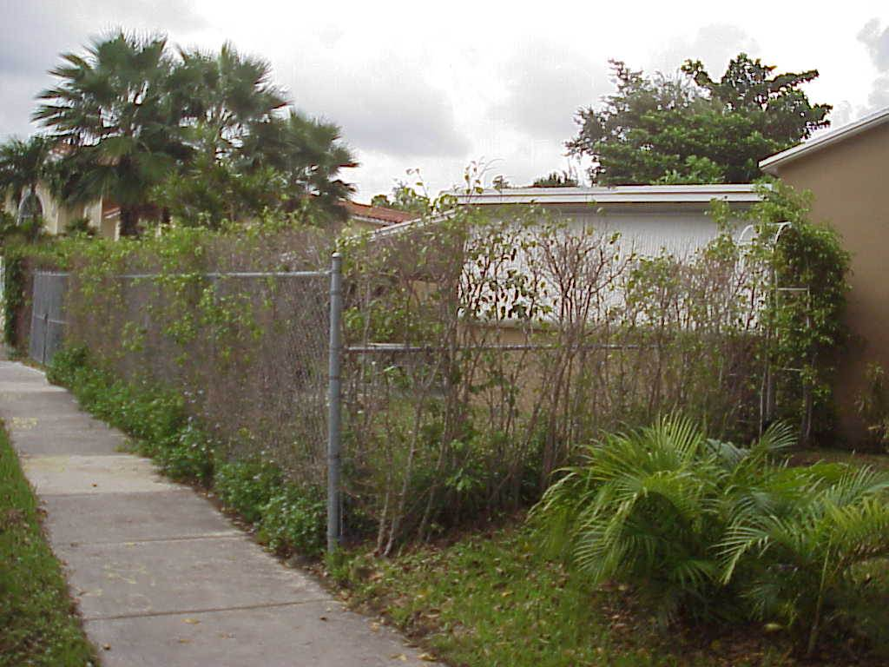
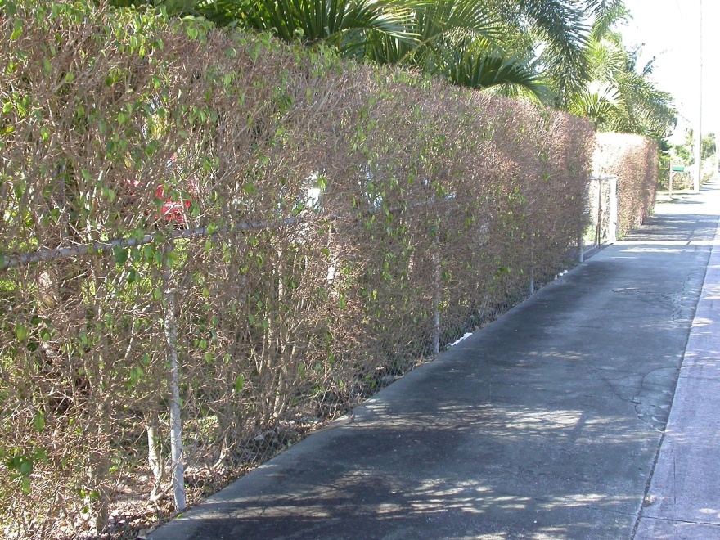
Ficus Whitefly Damage
Photos: A. Hunsberger, UF/IFAS, Miami-Dade County Extension; C. Mannion, UF/IFAS, Tropical REC
Notes:
Initial damage includes yellowing of leaves. Severe infestations cause leaf drop, branch dieback and defoliation of the plant. Repeated re-growth and defoliation may eventually reduce plant health. Ficus whitefly does not excrete large quantities of honeydew, so sooty mold is not a problem.
Information sources:
Evans, G.A. 2008. The Whiteflies (Hemiptera: Aleyrodidae) of the World and Their Host Plants and Natural Enemies. USDA-APHIS.
accessed 2/26/2012 –
http://www.sel.barc.usda.gov:8080/1WF/World-Whitefly-Catalog.pdf
Hodges, G.S. 2007. The Fig Whitefly Singhiella simplex (Singh) (Hemiptera: Aleyrodidae): A New Exotic Whitefly Found on Ficus Species in South Florida. FDACS-DPI Pest Alert.
accessed 2/25/2012-
http://www.freshfromflorida.com/pi/pest-alerts/singhiella-simplex.html
Legaspi, J.C., C. Mannion, D. Amalin, and B.C. Legaspi, Jr. 2011. “Life Table Analysis and Development of Singhiella simplex (Hemiptera: Aleyrodidae) Under Different Constant Temperatures”. Annals of the Entomological Society of America, vol. 104, issue 3, pp. 451-458.
Stocks, I.C., Florida Department of Agriculture and Consumer Services, Division of Plant Industry. Personal Communication. ian.stocks@freshfromflorida.com

Slide 17
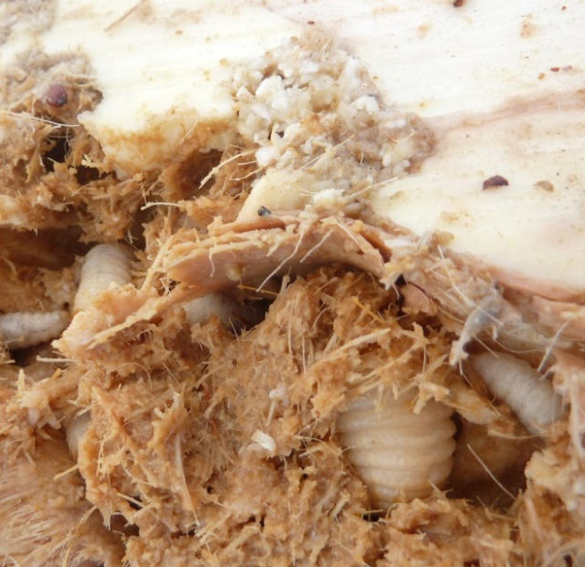
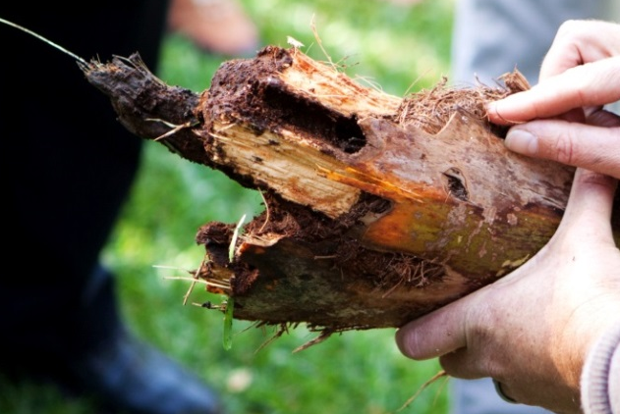
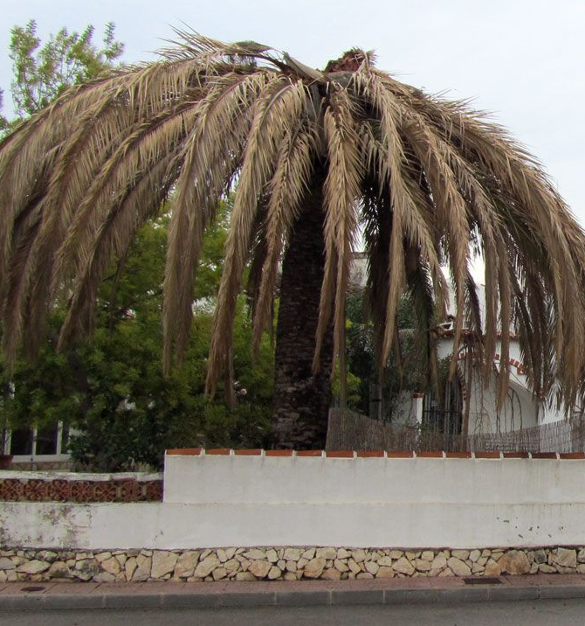
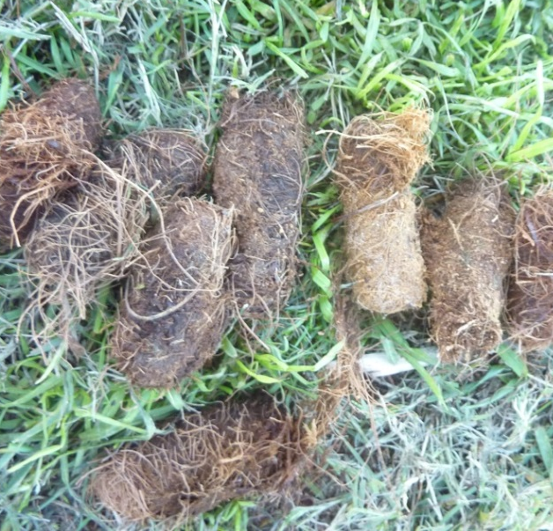
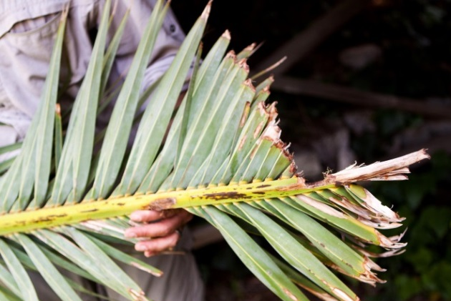
Red Palm Weevil Damage
Photos: (Top left) - Christina Hoddle, University of California - Riverside, Bugwood.org #5432623; (Middle) – Katja Schulz; Others) - Center for Invasive Species Research, University of California, Riverside
Notes:
Since most of the red palm weevil’s life cycle occurs in the palm’s internal tissues, early infestations of red palm weevil are difficult to detect. If it is possible to view the crown of the palm, look for larval mines and frass around the central growing point (apical meristem) or points of injury. The older leaves may also begin to droop.
Later stages of infestation are more noticeable. The newer leaves will not grow as large as older leaves and will start to yellow. The crown of dead or dying trees will become distorted and droop downward. Also, look for empty pupal cases and dead adults at the base of the tree.
Symptoms of red palm weevil:
Presence of tunnels on the base or crown of tree.
“Gnawing" sounds caused by larvae feeding inside.
Frass or plant fluids oozing near external tunnel entrances.
Highly distinctive "fermented" odor.
Empty pupal cases and dead adult in and around heavily infested palms.
Breaking of the trunk, or toppling of the palm crown.
Information sources:
Bertone, C., P. S. Michalak, and A. Roda. 2010. New pest response guidelines: Red palm weevil, Rhychophorus ferrugineus. USDA APHIS.
Accessed 2/9/2014-
http://www.aphis.usda.gov/import_export/plants/manuals/emergency/downloads/nprg-redpalmweevil.pdf
Nisson, N., D. Hodel, and M. S. Hoddle. “Red palm weevil”. Center for Invasive Species Research – University of California, Riverside.
Accessed 2/9/2014-
http://cisr.ucr.edu/red_palm_weevil.html

Slide 18
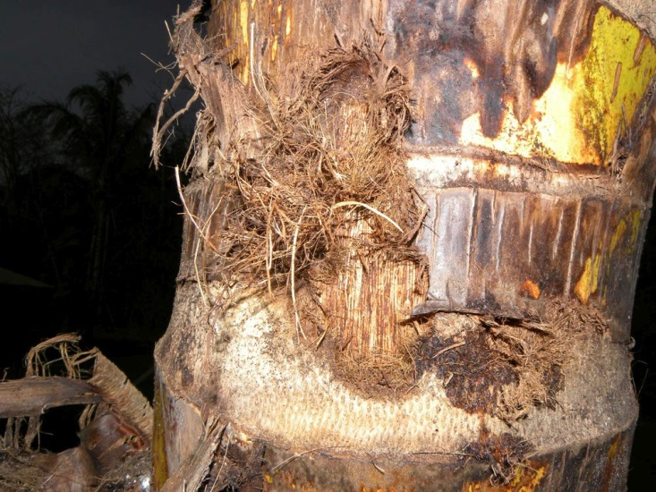
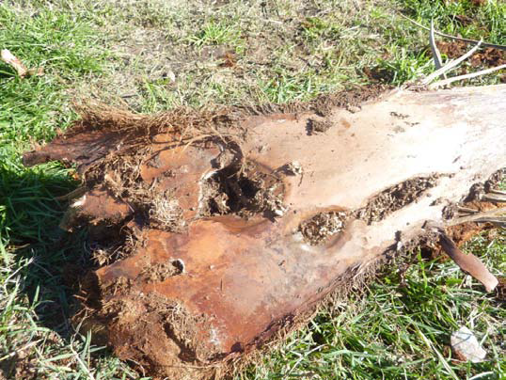
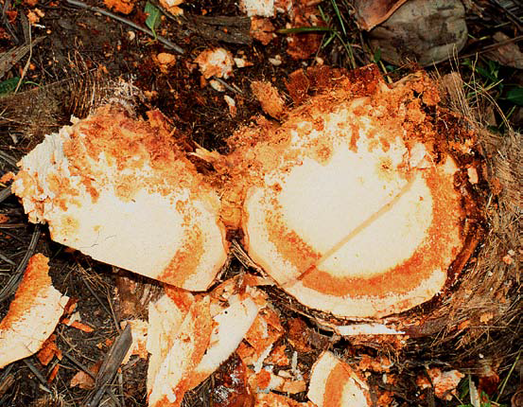
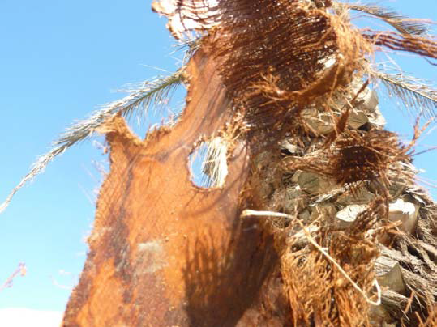
South American Palm Weevil Damage
Palm trunk damaged by R. palmarum in Costa Rica
Palm frond damage caused by larval tunneling of R. palmarum
Red ring disease showing the characteristic “red ring” in a coconut palm
Photos: (Top left) - Reinaldo Aguilar, www.osaresearch.org; (Others) - Center for Invasive Species Research, University of California, Riverside; Pupa - Robin M. Giblin-Davis , University of Florida
Notes:
Symptoms involve progressive yellowing of leaves, necrotic flowers and the death of emerging leaves. Leaves dry out from the crown down, with the apical meristem drooping and eventually dying. Most of the damage is caused by older larval instars which can excavate tunnels up to 40 cm in length and 3 cm wide in 24 to 36 hours. Larval galleries are clearly evident in leaves and stems of heavily infested hosts. The internal tissue of a 3 to 5 year old palm can be completely destroyed by larvae in just 5 to 6 weeks. It has been reported that just 30 larvae are sufficient to kill an adult coconut palm.
Pupae and older instars are often found in the petiole bases of the crown where they are well concealed.
Infested trees emit a characteristic odor which is foul and strong.
Symptoms of the lethal red ring disease of palms may also be evident as Rhynchophorus palmarum vectors the nematode Bursaphelenchus cocophilus which transmits the disease. A characteristic “red ring” is evident when the interior of the tree stem is exposed. Other symptoms vary depending on host species but can include yellowing of older leaves followed by younger leaves, premature nut fall and withering of inflorescences. Trees infected with red ring disease typically die 2 - 4 months after first showing symptoms. Red ring disease causes serious damage to over 17 species of palms, but is especially important to coconut and oil palms in the Neotropics where it is causes up to 10 – 15% of the annual losses of these two species.
Information sources:
EPPO. 2005. Data sheets on quarantine pests: Rhynchophorus palmarum. OEPP/EPPO Bulletin. 35: 468 – 471.
Accessed 2-7-14 –
http://www.eppo.int/QUARANTINE/insects/Rhynchophorus_palmarum/DS_Rhynchophorus_palmarum.pdf
Giblin-Davis, R. M., P. S. Lehman, and R. N. Inserra. Fact sheet: Bursaphelenchus cocophilus, Red Ring Disease of Coconut. Society of Nematologists. A
ccessed 2-7-14 –
http://nematode.unl.edu/pest1.htm

Slide 19
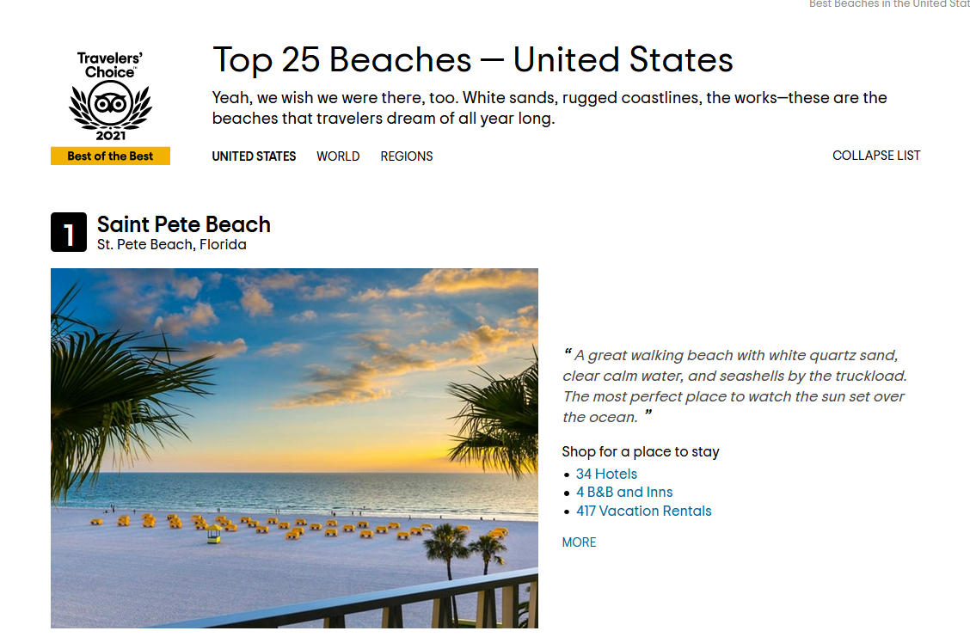
Why is Florida a likely place for invasive species to establish?
Live plant material is imported through airports, deepwater ports, and interstate travel
Florida has a large tourism industry
Florida has prolonged growing seasons and a favorable climate
Photo: https://www.tripadvisor.com/TravelersChoice-Beaches-cTop-g191
Notes:
So now we know how new species arrive, we can get back to why there seems to be so many in Florida. And one of a huge contributing factor is just the shear amount of plant material that passes through the state via airports, seaports and interstate travel.
Another contributing factor is tourism a lot of people want to come visit Florida’s beaches and sunshine. St Pete beach won Trip advisors Travelers’s choice for best beach in the US for 2021. And with people from coming form all over the world to visit that also increase the chance that one of them may accidently pack a pest.
And then just like people when a pest does arrive here, they kind of like and want to stay around. The climate here is suitable for many different types of organisms, especially invasive ones. Our climate allows for an extended growing season. This means that there is a continuous food source for agricultural and horticultural pests. And in addition to that in the southern part of Florida, there is no hard freeze. This means that organisms that would normally die off during a hard freeze don’t get that hard freeze and instead continue to live and prosper.

Slide 20
Thank you!

Slide 21
Lab Team
Authors & Editors
Daniela Perez Lugones, M.S. – Graduate Student, Doctor of Plant Medicine Program, University of Florida
Lindsay Mikell, M.S. – Graduate Student, Doctor of Plant Medicine Program, University of Florida
Lyuyi Chen, M.S. – Graduate Student, Doctor of Plant Medicine Program, University of Florida
Sarah Tafel, B.S. – Graduate Student, Doctor of Plant Medicine Program, University of Florida
Lab Director
Amanda Hodges, Ph.D. - Associate Extension Scientist, Department of Entomology and Nematology, University of Florida

Slide 22
Collaborating Agencies
U.S. Department of Agriculture Animal and Plant Health Inspection Service (USDA-APHIS)
Cooperative Agricultural Pest Survey Program (CAPS)
Florida Department of Agriculture and Consumer Services (FDACS)
National Plant Diagnostic Network (NPDN)
Sentinel Plant Network (SPN)
University of Florida Institute of Food and Agricultural Sciences (UF-IFAS)
Protect U.S.

Slide 23
Educational Disclaimer and Citation
This presentation can be used for educational purposes for NON-PROFIT workshops, trainings, etc.
Citation:
  –University of Florida, Entomology and Nematology Department, Biosecurity Research and Education Lab. October 2023. Collaborative and Enhanced First Detector Training: Pests and Pathways, Day Accessed

Slide 24
Original Author
Jennifer Hamel, Ph.D. - Postdoctoral Associate, Department of Entomology and Nematology, University of Florida

Slide 25
Editors
Sarah Tafel, B.S. – Graduate Student, Doctor of Plant Medicine Program, University of Florida
Lindsay Mikell, M.S. – Graduate Student, Doctor of Plant Medicine Program, University of Florida
Amanda Hodges, Ph.D. - Associate Extension Scientist, Department of Entomology and Nematology, University of Florida
Matthew D. Smith, Ph.D. - Postdoctoral Associate, Department of Entomology and Nematology, University of Florida
Keumchul Shin, M.S. - Graduate student, Doctor of Plant Medicine program, University of Florida

Slide 26
Reviewers
Stephanie Stocks, M.S. - Assistant-In, Extension Scientist, Department of Entomology and Nematology, University of Florida
Amanda Hodges, Ph.D. - Associate Extension Scientist, Department of Entomology and Nematology, University of Florida
Smriti Bhotika, Ph.D. - Postdoctoral Associate, Department of Entomology and Nematology, University of Florida

Slide 27
UPDATE INFORMATION FOR AUTHORS
*Keep slide hidden*
Presentation Topic: Invasive Pests and Pathways
Updated by: Sarah Tafel
Update began (dd/mm/yy): 9/5/2023
Update complete (dd/mm/yy): 9/12/2023
Uploaded to site (dd/mm/yy):

