Slide 1
False Codling Moth Thaumatotibia leucotreta

Slide 2
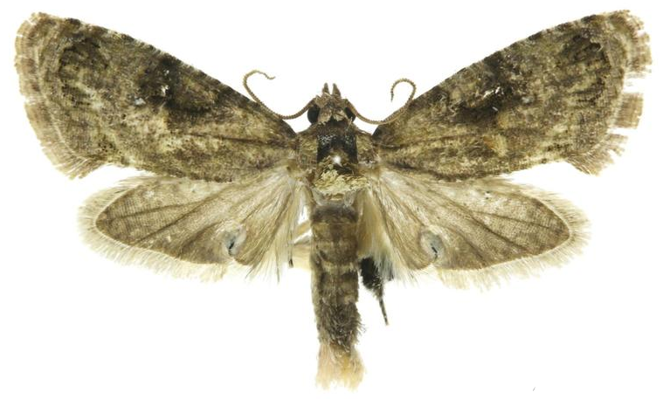
False Codling Moth
Other common names: citrus codling moth, orange codling moth, orange moth, palomilla de la naranja, fausse carpocapse, and teigne de l’oranger
Native to Africa
Economic pest
Not yet in the United States
Image credits: Todd M. Gilligan and Marc E. Epstein, TortAI: Tortricids of Agricultural Importance, USDA APHIS ITP, Bugwood.org
5482546
Notes:
The scientific name of this moth is Thaumatotibia leucotreta, and it is in the family Tortricidae. It has been previously known under the scientific names Cryptophlebia leucotreta (Meyrick), Cryptophlebia roerigii (Zacher), Olethreutes leucotreta (Meyrick), and Thaumatotibia roerigii (Zacher). The preferred common name is false codling moth, but it is also known as citrus codling moth, orange codling moth, orange moth, palomilla de la naranja, fausse carpocapse, and teigne de l’oranger (2). False codling moth has a wide range of hosts, and is a pest of economic importance in its native habitat of Africa (4 and 10). It is frequently intercepted in both cargo and passenger luggage. This is a major concern, since it could easily become established in the United States (10).

Slide 3
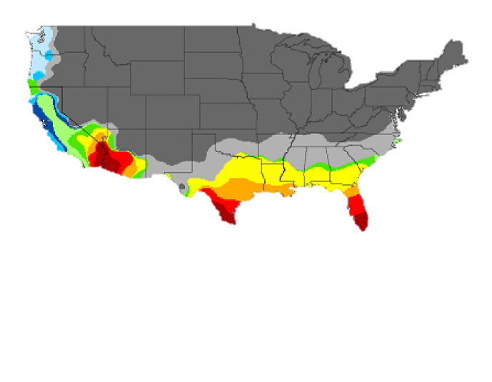
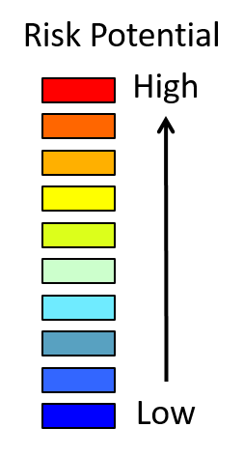
Potential Distribution in the U.S.
Risk Map
Thaumatotibia leucotreta, False Codling Moth
A singe male moth was found in Ventura, CA
Often intercepted at quarantine
Image credits: Map-USDA Pest Response Guidelines
Notes:
On July 30, 2008, the USDA identified a single male false codling moth in Ventura County, California (10). This was the first domestic detection of this moth. Extensive trapping in the region uncovered no other specimens (8). The moth is often intercepted at entry stations such as ship ports. Nonetheless, has not established in the U.S. as of September 2016(4).
Based on geographic regions where false codling moth is currently established, it is believed the moth could successfully establish in USDA climatic zones 7b though 10a (10).

Slide 4
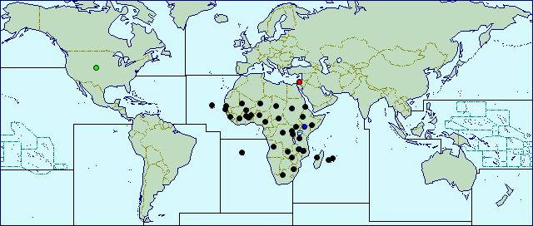
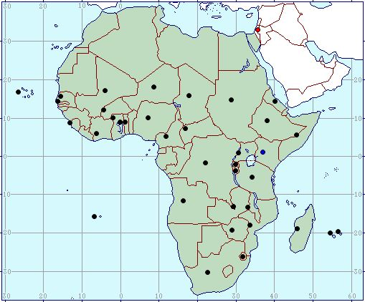
Global Distribution of the False Codling Moth
Global distribution
Distribution in Africa
Image credits: http://www.cabi.org/isc/datasheet/6904
Notes:
False codling moth is thought to originate in the Ethiopian region of Africa. It is widely distributed throughout the continent in many countries and regions including: Angola, Benin, Burkina Faso, Burundi, Cameroon, Cape Verde, Central African Republic, Chad, Côte d’Ivoire, Democratic Republic of the Congo, Eritrea, Ethiopia, Gambia, Ghana, Kenya, Madagascar, Malawi, Mali, Mauritius, Mozambique, Niger, Nigeria, Reunion, Rwanda, Saint Helena, Senegal, Sierra Leone, Somalia, South Africa, Sudan, Swaziland, Tanzania, Togo, Uganda, Zambia, and Zimbabwe (4). The moth is not considered to be established outside of Africa. It is however commonly intercepted during quarantine inspections in Europe. In the United States, detection of a single larva in a fruit will result in a rejection of an entire shipment (2).

Slide 5
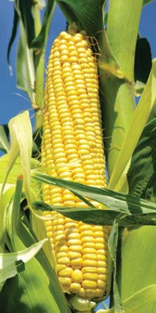
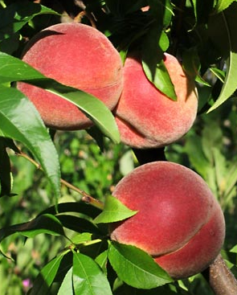
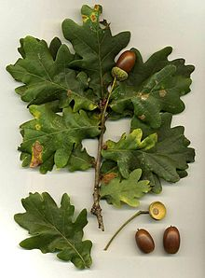
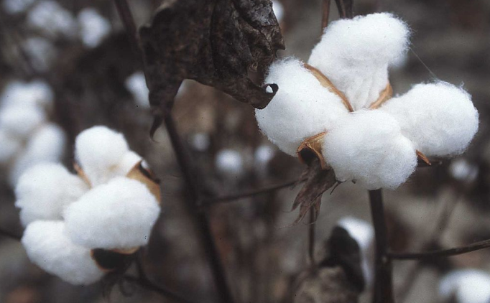
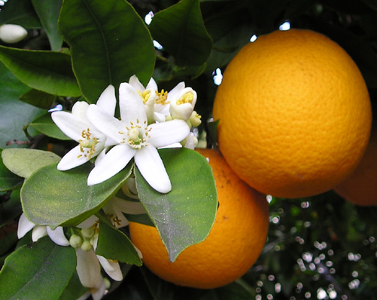
Pest of Fruits and Seeds
Very broad host range
Some primary hosts include: corn, orange, peach, oak, and cotton
Peach
Corn
Oak
Cotton
Orange
Image credits: Oak - Wikipedia https://en.wikipedia.org/wiki/Oak Peach - https://www.britannica.com/plant/peach Orange – By Ellen Levy Finch (Elf) - Own work, CC BY-SA 3.0, https://commons.wikimedia.org/w/index.php?curid=39146 Corn – https://www.britannica.com/plant/corn-plant Cotton - Public Domain, https://commons.wikimedia.org/w/index.php?curid=689304
Notes:
False codling moth has a very wide host range, and is a significant crop pest. Oak, Quercus spp., is a preferred host.
Preferred hosts:
Corn (Zea mays), Cotton (Gossypium spp.), Guava (Sodium guajava), Macadamia (Macadamia spp.), Mandarin orange (Citrus reticulata), Oak (Quercus spp.), Okra (Abelmoschus esculentus), Oranges (Citrus spp.), Orange-Temple (Citrus reticulata x Citrus sinensis), Peach (Prunus persica), Pepper (Capsicum spp.), Sorghum (Sorghum vulgare), Tangelo (Citrus paradisi x Citrus reticulata)
Secondary hosts:
Apricot (Prunus armeniaca), Avacado (Persea americana), Banana (Musa paradisiaca var. sapientum), Butterseed (Musa paradisiaca var. sapientum), Castor bean (Ricinus communis), Cherimoya (Annona cherimola), Cherries-All (Prunus spp.), Chrysophyllum magalis-montanum, Coffee (Coffea spp.), Cowpea (Vigna unguiculata), Custard apple (Annona reticulata), Eggplant (Solanum melongena), Elephant grass (Pennisetum purpureum), Flowering Maple (Abutilon spp.), Grape (Vitis vinifera), Grapefruit (Citrus paradisi), Ground Cherry (Physalis spp.), Hibiscus (Hibiscus spp.), Hottentot kafir bean tree (Schotia speciosa), Husk tomato (Physalis ixocarpa), Jute (Sida spp.), Kafir marvolanut (Sclerocarya caffra), Kafir plum (Harpephyllym cattrum), Large fruited bushwillow (Combretum zeyheri), Kapok ceiba (Ceiba pentandra), Lemon (Citrus limon), Lima bean (Phaseolus lunatus), Lime (Citrus aurantiifolia), Litchi/Litchee (Litchi chinensis), Loquat (Eriobotrya japonica), Mallow (Abutilon spp.), Mango (Mangifera indica), Miraculous berry (Synsepalum dulciticum), Oak (Quercus spp.), Olives (Olea europaea), Outeniqua yellowwood (Podocarpus falcata), Persimmon (Diospyros spp.), Plum (Prunus spp.), Pomegranate (Punica granatum), Pond Apple (Annona glabra), Prune (Prunus domestica), Pseudolachnostylis maprounaefolia, Red bushwillow (Combretum apiculatum), Rose apple (Syzygium jambos), Royena pallens, Sidas (Sida spp.), Soursop (Annona muricata), Spanish bayonet (Yucca alofolia), Spanish dagger (Yucca gloriosa), Star apple (Chrysophyllum cainito), Sugar apple (Annona squamosa), Sweetsop (Annona spp.), Tomato (Lyvopersicon esculentum), Tree tomato (Cyphomandra betacea), Triumfetta/Burrbark (Triumfetta spp.), Vanguria (Vangueria infausta), Walnut (Juglans spp.), Ximenia (Ximenia caffra), Yucca (Yucca spp.), Zizyphus (Zizyphus mucronata) (10).

Slide 6
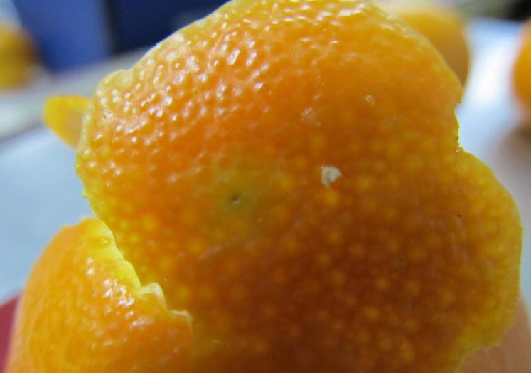
Damage
Varies depending on host
Hidden inside fruit
Little or no external signs
Can cause premature fruit drop
Can cause secondary infections
Image credits: Kenneth R. Law, USDA APHIS PPQ, Bugwood.org 5471810
Notes:
Damage symptoms will vary depending on the host. Often damage will not be visible, since larvae feed inside of the seed and there is little, if any, external signs (2 and 9). Larval feeding can cause premature fruit ripening and fruit drop (7). Feeding by larva can cause secondary infections by fungi and bacteria (10).

Slide 7
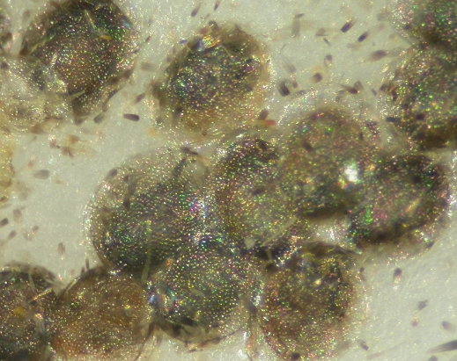
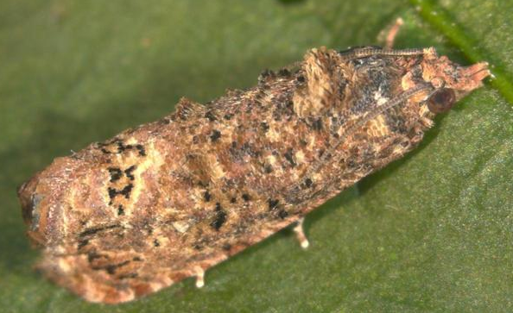
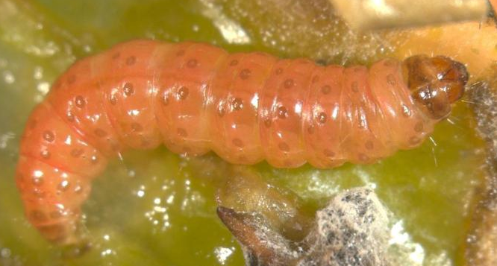
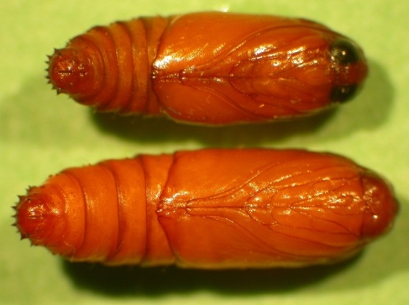
Life cycle
Eggs
Adult
Larvae
Pupae
Image credit: Eggs – J.H. Hofmeyr, Citrus Research International, Bugwood.org UGA5137015 Larvae – Marja van der Straten, NVWA Plant Protection Service, Bugwood.org 5471822 Pupae – J.H. Hofmeyr, Citrus Research International, Bugwood.org UGA5137010 Adult -Marja van der Straten, NVWA Plant Protection Service, Bugwood.org 5471821
Notes:
A complete life cycle may take 30 to 174 days depending on conditions (10). False codling moth does not enter diapauses, or a quiescent period, and is present year round with overlapping generations (4). Moths are multivoltine, or have multiple generations a year (5). The ratio of males to females is 1:2. Males live 14 to 57 days and females live 16 to 70 days. Females attract males through pheromones. Mated females will fly at night and lay eggs on hosts between 5:00 and 11:00 p.m. Eggs are laid singly or in groups at random on depressions on fruit rinds, smooth surfaces, fallen fruit, or foliage. Females will lay between 3 to 8 eggs depending on temperature. Each female may lay up to 800 eggs over her lifespan. Larval period lasts 12 to 67 days depending on conditions. Mature larva will exit the fruit and, if the fruit has not dropped, will drop to the ground on silk threads (10). Larva use soil particles and silk to form a prepupa at the soil surface. If the prepupa becomes covered by sand, prepupa will leave the cocoon to form a new one. This stage lasts 2 to 27 days. Prepupa then molt into a pupa (5). Males take 13 to 60 days to pupate while females take 11 to 39 days (10).

Slide 8
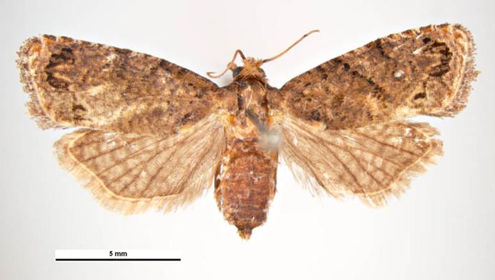
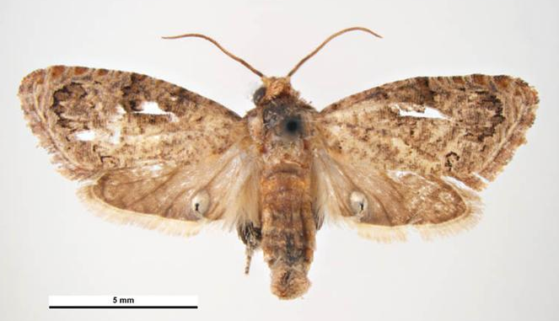
Identification
Adults
6-9mm long, 2.5mm wide
Female: 19-20mm wingspan Male: 15-16mm wingspan
Color grayish brown to dark brown or black
Distinctive black triangular marking beneath crescent shaped mark on wing edge
Female:
Male:
Image credits: Female - By Simon Hinkley & Ken Walker, Museum Victoria https://commons.wikimedia.org/w/index.php?curid=15562337 Male - By Simon Hinkley & Ken Walker, Museum Victoria https://commons.wikimedia.org/w/index.php?curid=15562343
Notes:
Moths are 6 to 9mm in length and about 2.5mm in width (10). Male wingspan is 15 to 16mm and female wingspan is 19 to 20mm (2). Color can vary from grayish brown to dark brown or black (10). Forewings are broad and elongate with a distinctive black triangular marking beneath a crescent shaped marking near the outer part of the wing (2). Forewing edges are fringed with hairs. Hindwings are a grayish brown that darken toward the margins (10). Males can be identified from other species by the specialized hindwing which has a circular pocket of fine hair-like black scales with slightly shinning whitish scales over the top (2). Dissection is needed to identify the female compared to other moths in the same family (6).

Slide 9
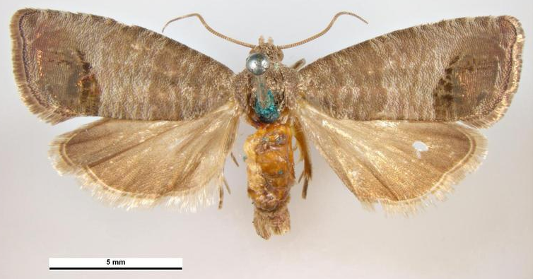
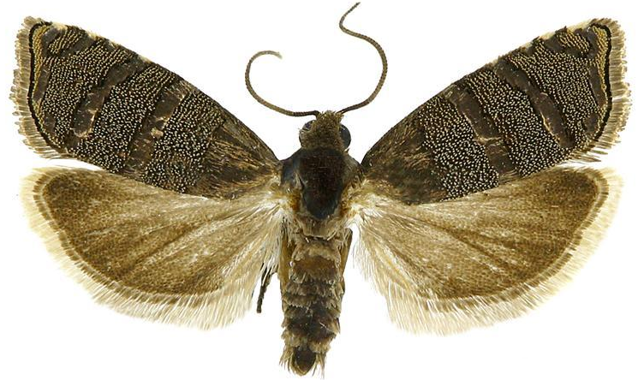
Lookalikes - Adults
Codling moth: Cydia pomonella
Eastern pine seedworm: Cydia toreuta
Image credits: Codling moth- Pest and Diseases Image Library, Bugwood.org 5488473 Eastern pine seedworm- Todd M. Gilligan and Marc E. Epstein, TortAI: Tortricids of Agricultural Importance, USDA APHIS ITP, Bugwood.org 5482438
Notes:
False codling moth is easily confused with the codling moth, Cydia pomonella , Eastern pine seedworm, Cydia toreuta, and dotted Ecdytolopha moth, Ecdytolopha punctidiscana in the United States (10).

Slide 10
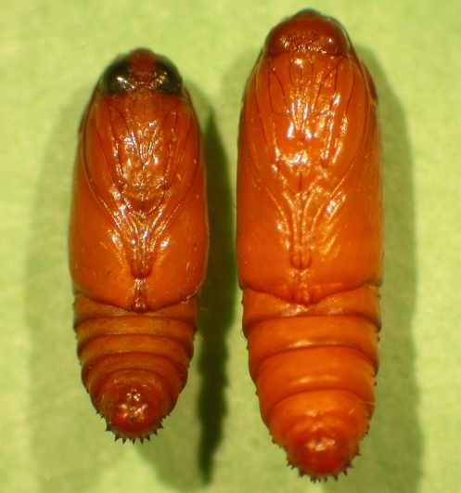
Identification
Pupae
7mm long
Males smaller than females
Begin soft and cream colored
Mature to hardened yellow to dark brown
Sensitive to low temperatures, humidity, and frequent irrigation
Image credit: J.H. Hofmeyr, Citrus Research International, Bugwood.org UGA5137009
Notes:
False codling moth has both a pupal and prepupal stage. Larva use soil particles and silk to form a prepupa at the soil surface. If the prepupa becomes covered by sand, prepupa will leave the cocoon to form a new one. This stage lasts 2 to 27 days. Prepupa then molt into a pupa. Pupation can occur in the soil, soil surface, on fallen fruit, or in debris (5). Pupa begin cream colored and soft then mature into a hardened yellow to dark brown. Both pupa are about 7mm long, but males are smaller than females. Pupa emerge slightly from the cocoon before full adult emergence. An empty pupal skin usually stays attached to the cocoon (10). Adult emergence is less when temperatures are low, soil is frequently irrigated, or humidity is low (5).

Slide 11
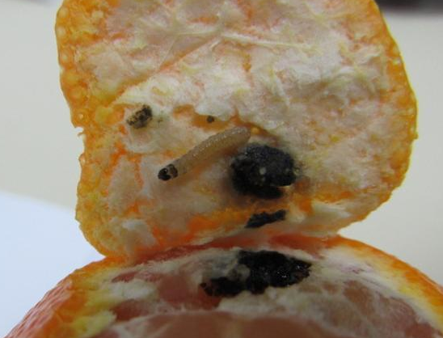
Identification
Larvae
Larva change as they age
Start 1-1.3mm long, end 15 to 20mm
Creamy, yellow white bodies that later become pink or red with yellow-orange sides
Head begins brownish black then turns light maroon
Image credits: Kenneth R. Law, USDA APHIS PPQ, Bugwood.org 5471816
Notes:
Larvae hatch and wander the outside of the fruit or acorn, then burrow inside. On acorns, larvae will burrow in at the base or at attachment to the cup (10). Caterpillars begin 1 to 1.3mm long with creamy yellow white bodies with tiny black spots that have short hairs. The head is brownish black. More mature larva are 12 to 20mm long and have a pink or reddish bodies with an orange to yellow color on the sides and legs. Head is light maroon (2 and 10).

Slide 12
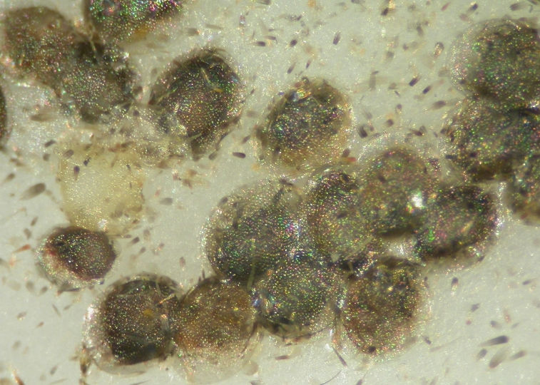
Identification
Eggs
Translucent white
Flattened
Oval
0.9-1mm diameter
Hatch in 2-22 days
Sensitive to cold and low humidity
Image credits: J.H. Hofmeyr, Citrus Research International, Bugwood.org UGA5137015
Notes:
Eggs are a translucent white, flattened and oval, with a diameter of 0.9 to 1mm (2 and 10). Development takes 2 to 22 days depending on the temperature. The eggs are very sensitive to cold temperatures and periods of low humidity (5).

Slide 13
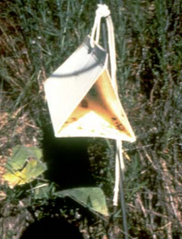
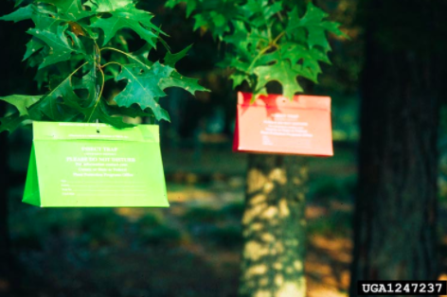
Monitoring
Use yellow delta traps
50:50 false codling moth pheromone
Stake into ground
Hang in trees
Image credits: stake d delta trap- http://www.invasive.org/weeds/knapweedbook.pdf two delta traps - William A. Carothers, USDA Forest Service - Bugwood.org, #1515074
Notes:
The recommended monitoring trap for false codling moth is a yellow delta trap baited with pheromone. The pheromone is a 50:50 ratio or (Z)-8-Dodecen-ol acetate and (E)-8-Dodecen-ol acetate. Traps should be placed in a standard grid array. With tree crops, place traps 1.5m (4 1/2ft) from ground in tree limbs. With row crops, place traps on stakes that are the same height as the crop. Wild hosts should follow the same trap placement guidelines (10).

Slide 14
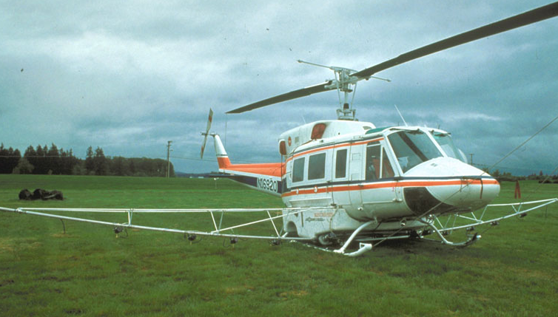
Chemical Control
Larvae protected inside of fruit
Pheromone mating disruption
Pyrethroids and chitin inhibitors
Image credits: Helecopter- USDA APHIS PPQ , USDA APHIS PPQ, Bugwood.org UGA2651006
Notes:
Chemical control is often difficult, since false codling moth has multiple and overlapping generations. Larvae live inside of fruits and hosts which protects them from chemicals (4). Pheromones can also be used for mating disruption (2). Pyrethroids have been found to decrease false codling moth populations. Chitin inhibitors are effective when targeting eggs (5).

Slide 15
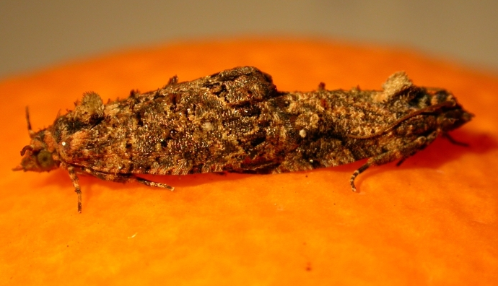
Biological Control
No native parasitoids
Granulosis virus
Baculovirus
Sterile insect release
Image credits: J.H. Hofmeyr, Citrus Research International, Bugwood.org UGA5137008
Notes:
There are several parasitoids of false codling moth; however, they are not present in North America. The use of viruses may be an effective biological control method. Both a granulosis virus and a baculovirus have been used in Africa (2). Baculovirus is available as a bioinsecticide called Cryptex (Andermatt). The use of sterile insects might also be used as control, and is currently used in South Africa (3).

Slide 16
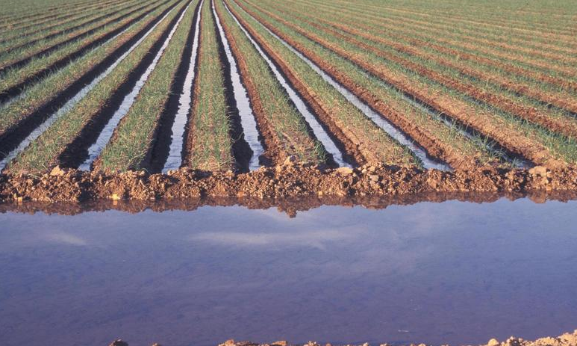
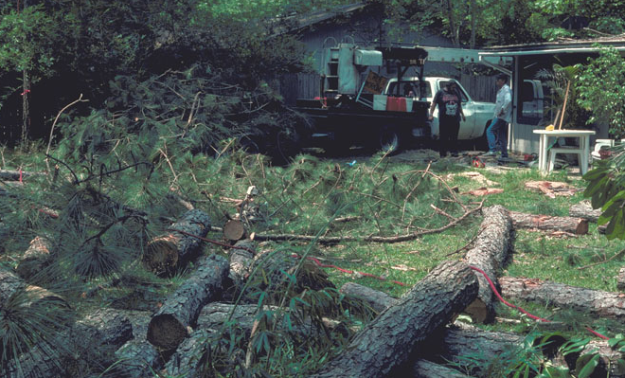
Cultural Control
Sanitize site
Remove infected materials
Heavy irrigation can kill pupae
Cold treatments (-0.5°C)
Image credits: Flood irrigation - Gerald Holmes, California Polytechnic State University at San Luis Obispo, Bugwood.org 1572692 Log removal - Robert L. Anderson, USDA Forest Service, Bugwood.org UGA0590094
Notes:
Sanitation and removal and destruction of infected hosts is used to control false codling moth (10). Dropped fruit and infected fruit should be removed and destroyed. Native host species should also be removed from the surrounding areas. Heavy irrigation can be used to kill pupae in the soil (5). Cold treatments of -0.5°C or below for 22 days are effective in removing false codling moth on citrus fruit (4).

Slide 17
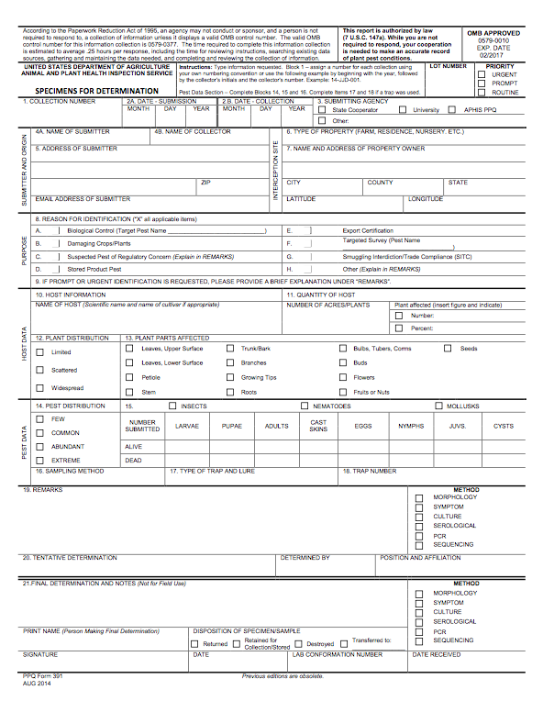
Suspect Sample Submissions
Contact your State Department of Agriculture or University Cooperative Extension laboratory
http://www.npdn.org/home
PPQ form 391, Specimens for Determination
https://www.aphis.usda.gov/library/forms/pdf/PPQ_Form_391.pdf
An example of a PPQ form for sample submissions
Image credits: https://www.aphis.usda.gov/library/forms/pdf/PPQ_Form_391.pdf
Notes:
If a suspect pest has been located in the United States, a sample should be submitted for proper identification. Contact your local diagnostic lab to ship in a sample for identification. Information regarding your local diagnostic lab is available at National Plant Diagnostic Network (NPDN) website. The diagnostic lab information and available contacts are divided by state.
http://www.npdn.org/home
The sample specimen should be submitted along with accompanying documentation using the PPQ form 391.
https://www.aphis.usda.gov/library/forms/pdf/PPQ_Form_391.pdf
Your local diagnostic lab is part of your local cooperative extension service or your state department of agriculture. Your local lab will also have a specific form. All local labs may not be a member of NPDN. However, all labs should report new pest and pathogen detections to local regulatory officials.

Slide 18
Communications
Contact your State Plant Health Director
https://www.aphis.usda.gov/aphis/ourfocus/planthealth/ppq-program-overview/ct_sphd
Contact your State Plant Regulatory Official
http://nationalplantboard.org/membership/
Image credits: http://www.usda.gov/wps/portal/usda/usdahome; http://nationalplantboard.org/
Notes:
Remember that new pest and pathogen records must be reported to your State Plant Health Director (SPHD) and your State Plant Regulatory Official (SPRO). The SPRO is a State Department of Agriculture Employee and the SPHD is a USDA-APHIS-PPQ employee.
The link to your SPRO is on the National Plant Board (NPB) website. It has an interactive map and when you click on your state it will take you to another page with contact information. The NPB is a cooperative organization that includes membership from all State Departments of Agriculture.

Slide 19
Author and Publication Dates
Brianna Whitman, B.S.
Laboratory Technician, Department of Entomology and Nematology, University of Florida
Amanda Hodges, Ph.D.
Associate Extension Scientist, Department of Entomology and Nematology, University of Florida
Publication date: October 2016

Slide 20
Reviewers
Catherine A. Marzolf
Assistant State Plant Health Director, USDA APHIS PPQ

Slide 21
Educational Disclaimer and Citation
This presentation can be used for educational purposes for NON-PROFIT workshops, trainings, etc.
Citation: Whitman, Brianna and Amanda Hodges. 2016. False codling moth – Thaumatotibia leucotreta.
Accessed (add the date) –
www.protectingusnow.org

Slide 22
Our Partners
United States Department of Agriculture, National Institute of Food and Agriculture (USDA NIFA)
United States Department of Agriculture, Animal and Plant Health Inspection Service, Plant Protection and Quarantine (USDA APHIS PPQ)
Cooperative Agriculture Pest Survey (CAPS) Program
National Plant Board (NPB)
States Department of Agriculture
Extension Disaster Education Network (EDEN)
Center for Invasive Species and Ecosystem Health (Bugwood)
National Plant Diagnostic Network (NPDN)
U.S. Department of Homeland Security (DHS)
U.S. Forest Service (USFS)

Slide 23
References
1. Andermatt Biocontrol. 2016. Cryptex. Andermat Biocontrol AG. Accessed 6/29/16.
http://www.export.biocontrol.ch/sites/products/bio-insecticides/baculovirus/cryptex.html
2. Anonymous. 2015. Thaumetotibia leucotreta (false codling moth). Invasive Species Compendium. Accessed 6/29/16.
http://www.cabi.org/isc/datasheet/6904
3. Carpenter, J., S. Bloem, and H. Hofmeyr. 2007. Area-wide Control Tactics for the False Codling Moth Thaumatotibia leucortreta in South Africa: a Potential Invasive Species. Area-wide Control of Insect Pests: 351-359. U.S. Government.
4. EPPO. 2016. European and Mediterranean Plant Protection Organization: Thaumatotibia leucotreta (Lepidoptera: Tortricidae). OEPP. EPPO. Accessed 6/29/16.
https://www.eppo.int/QUARANTINE/Alert_List/insects/thaumatotibia_leucotreta.htm
5. Gendall, Kierryn Leigh. 2007. Agathis bishop (Nixon) (Hymenoptera: Braconidae): its biology and usefulness as a biological control agent for false codling moth (FCM), Thaumatotibia leucotreta (Meyrick) (Lepidoptera: Tortricidae), on citrus. Rhodes University.
6. Gillian, Todd M. and Marc E. Epstein. 2014. TortAI: Tortricids of Agricultural Importance. Colorado State University. Accessed 6/29/16.
http://idtools.org/id/leps/tortai/Thaumatotibia_leucotreta.htm

Slide 24
References
7. North American Moth Photographers Group. 2016. Mississippi State University, Mississippi Entomological Museum. Accessed 6/29/16.
http://mothphotographersgroup.msstate.edu/species.php?hodges=19685
8. Plantwise Technical Factsheet: false codling moth (Thaumatotibia leucotreta). 2016. Plantwise Knowledge Bank. Accessed 6/29/16.
http://www.plantwise.org/KnowledgeBank/Datasheet.aspx?dsid=6904
9. U.S. Department Of Agriculture, Animal Plant Health Inspection Service, Plant Protection and Quarantine, Emergency and Domestic Programs. 2010. New Pest Response Guidelines: False Codling Moth Thaumatotibia leucotreta. Riverdale, Maryland
http://www.aphis.usda.gov/import_export/plants/manuals/online_manuals.shtml

