Slide 1
Irrigation 101 for Small Farms
Bob Hochmuth
Multi County Extension Agent
UF/IFAS North Florida Research and Education Center – Suwannee Valley
Notes:
Basic irrigation principles for small areas.

Slide 2
Irrigation Systems
Water is Critical
Small Acreage
  Sprinklers
  Drip
    Irrigate larger areas
    Reduces disease
    Aids in fertilizer application
    Can use many small pumps and wells
Notes:
Drip can have several advantages over sprinklers.

Slide 3
Frost Protection
If you need sprinkler irrigation for frost protection:
  Design is critical
  Large pumping demand for constant water supply
  Need 0.25 inches per hour
  One acre – inch of water = 27,154 gallons
  Equals 113 gallons per minute for one acre
Notes:
If sprinklers are to be used for frost protection, realize high pumping requirements needed.

Slide 4
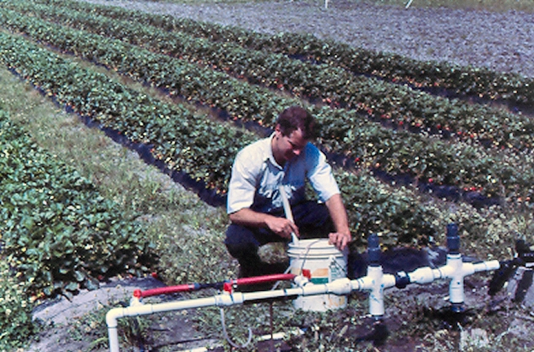
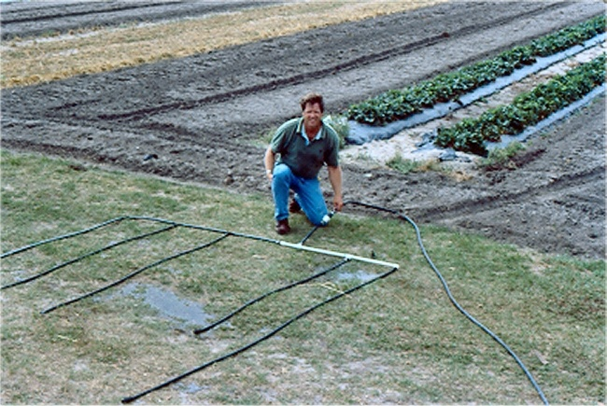
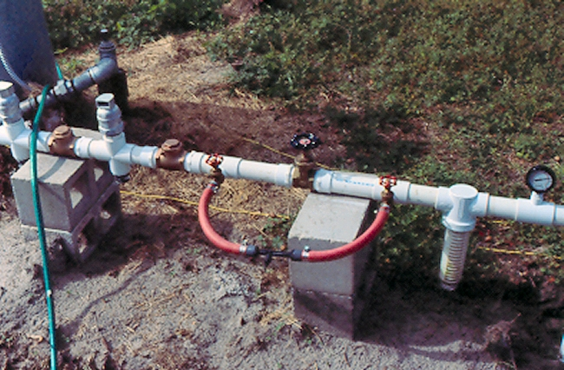
Simple Irrigation Systems
1 acre drip zone = 40 gallons per minute
If 4 zones per acre = 10 gallons per minute
Notes:
Drip systems can use black poly tubing or PVC to build the system.

Slide 5
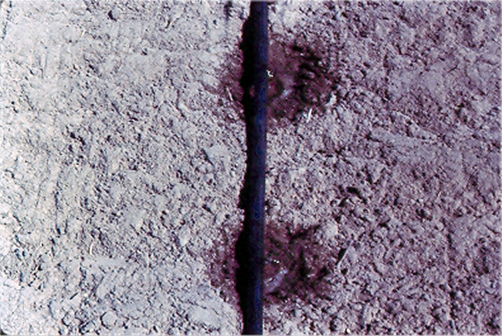
Notes:
Drip tape emits water out of hole every 12” usually.
Spacing can be closer, but not further in sandy soils.

Slide 6
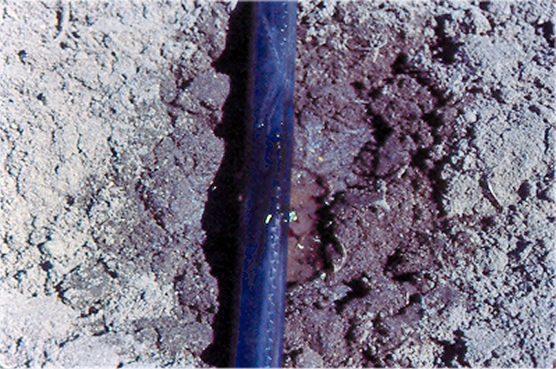
Notes:
Place drip tape with hole “up” to minimize clogging of holes with particles that can settle into the emitters if holes are placed down.

Slide 7
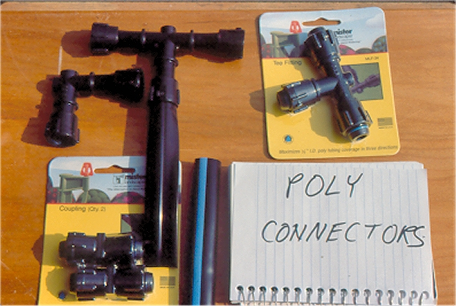
Notes:
Connectors make hook-up easy.

Slide 8
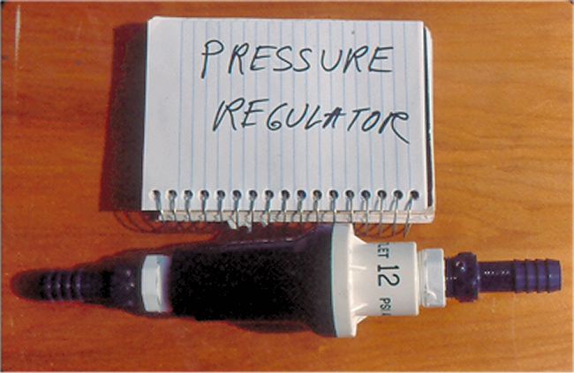
Notes:
Drip tape is used at pressures of 8-12 psi. Regular well pressure may operate up to 40 psi or more.
High pressures burst the tape so use a regulator.

Slide 9
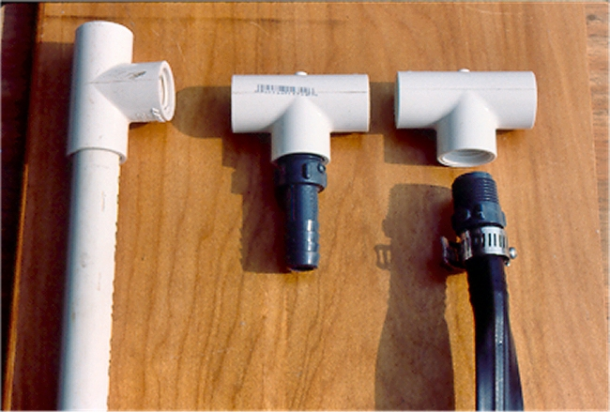
Notes:
Easy hook up to PVC pipe.

Slide 10
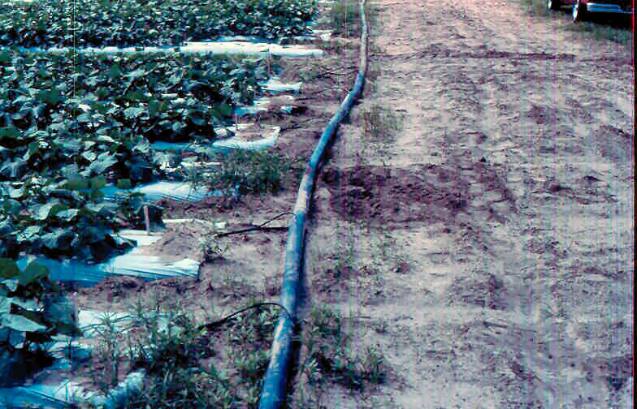
Notes:
Can also use a “lay flat” hose as the water carrying main line or manifold.

Slide 11
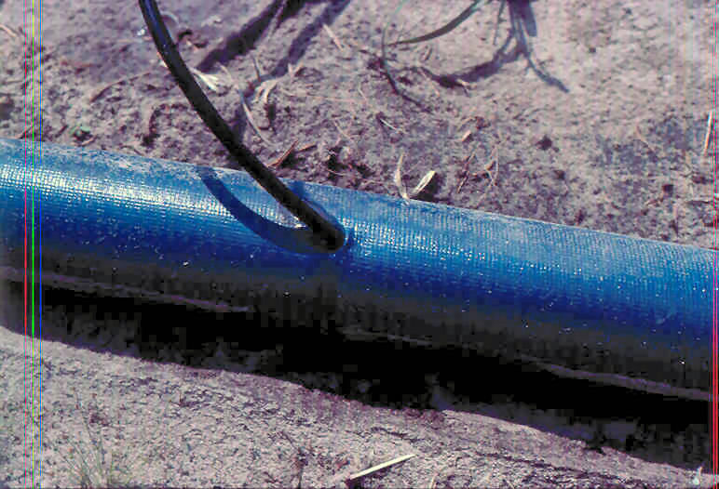
Notes:
Some systems insert feed line into tube.
Does not leak because low operating pressure.

Slide 12
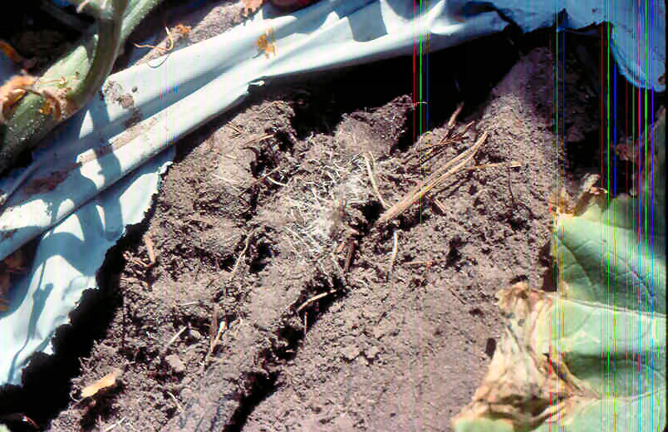
Notes:
Roots growing abundantly around drip emitter sign of not enough watering being done, soil too dry.

Slide 13
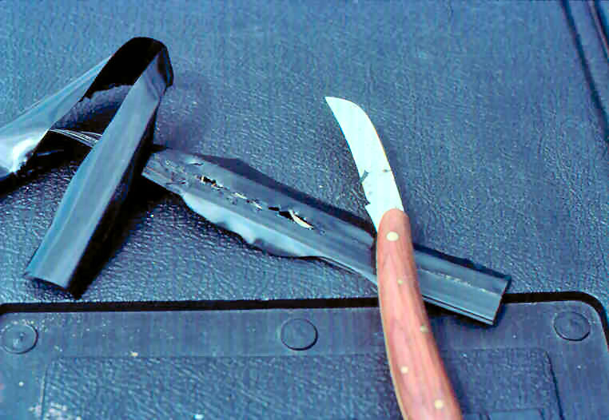
Notes:
Cut into drip tape here to show roots have grown into the emitters.

Slide 14
Notes:
Can inject fertilizer into system.
Venturi type system here.
Requires backflow prevention.

Slide 15
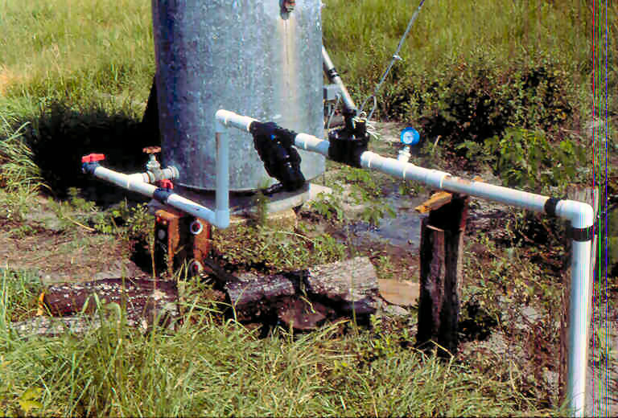
Notes:
Standard adaption to a small well.
Can be automated with solenoid valve.
Also notice black filter, important also in drip systems.

Slide 16
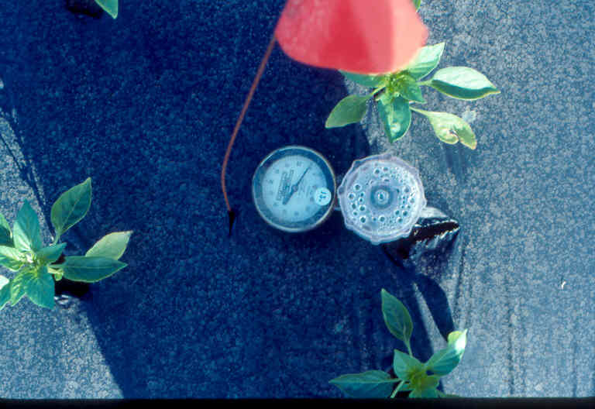
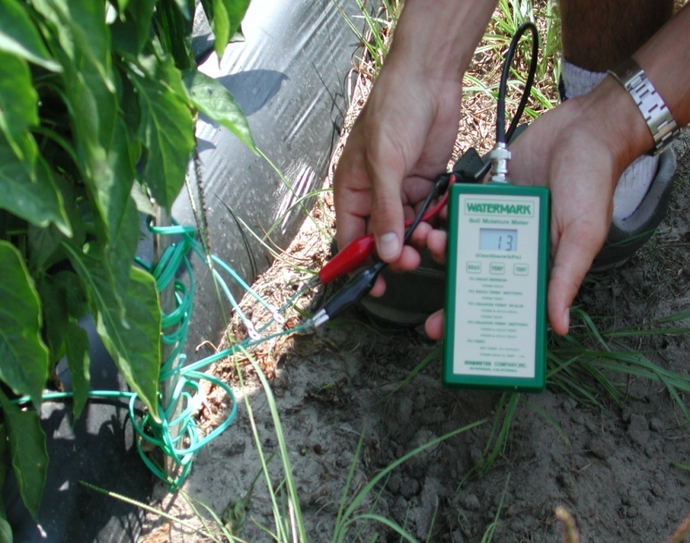
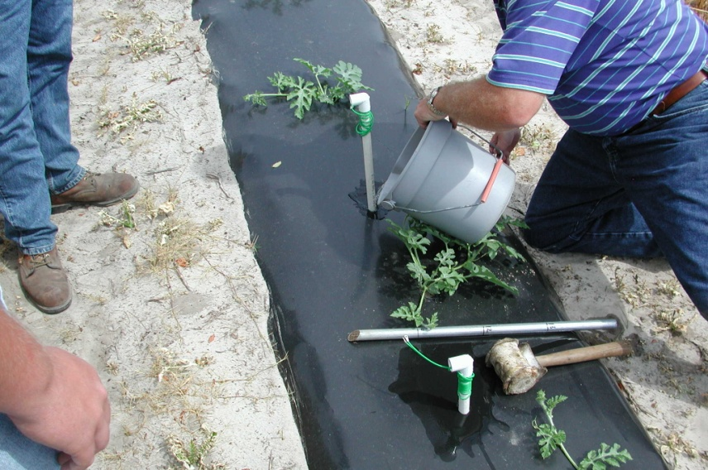
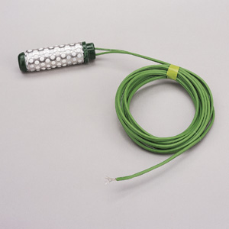
Irrigation Management
Notes:
Tools are available to help growers determine soil moisture levels.
Left – tensiometer
Right – watermark

Slide 17
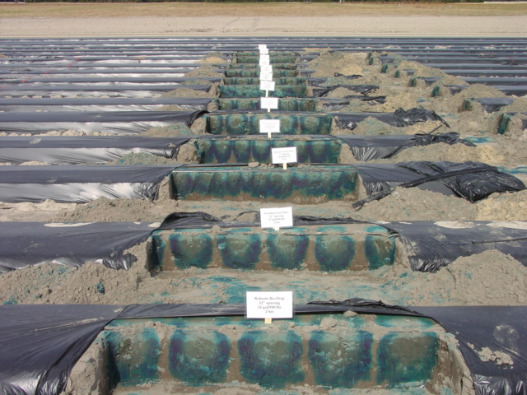
Drip Irrigation Schools
Notes:
Blue dye is being used to help growers learn BMPs
See Virtual Field Day website (http://vfd.ifas.ufl.edu) for excellent videos on this.

Slide 18
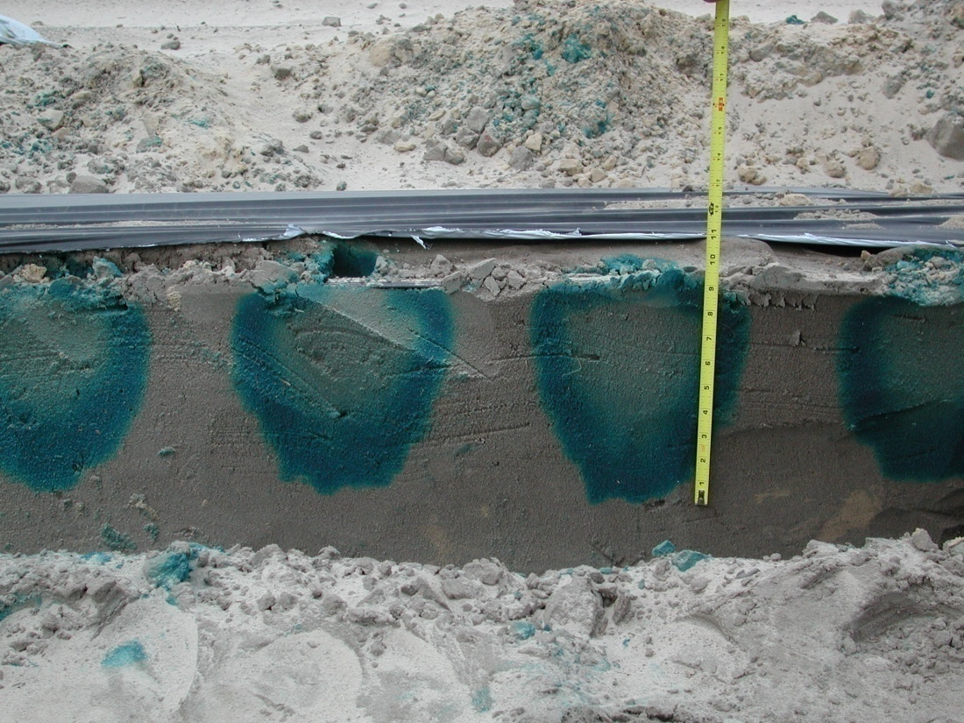
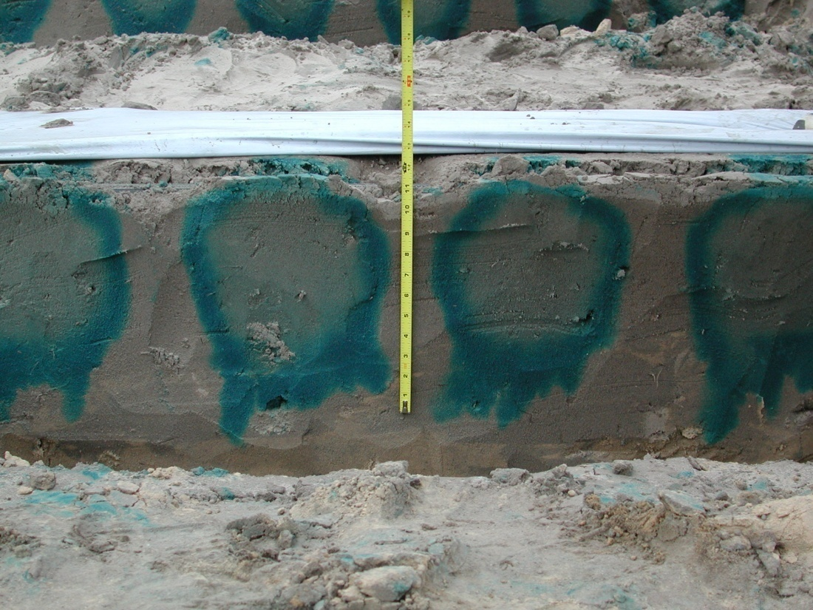
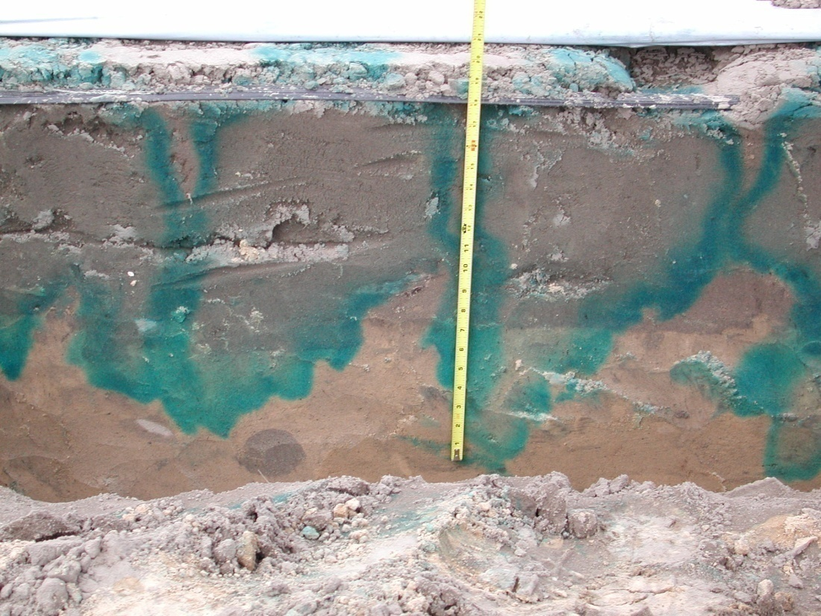
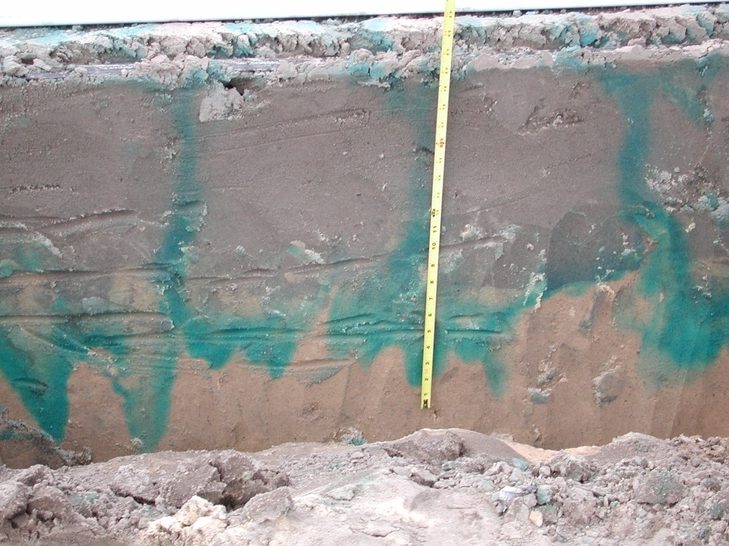
T0-1h
T0-2h
Ro-Drip
T0-4h
T0-8h
Notes:
Irrigation events that are too long leach fertilizer below the root zone.

Slide 19
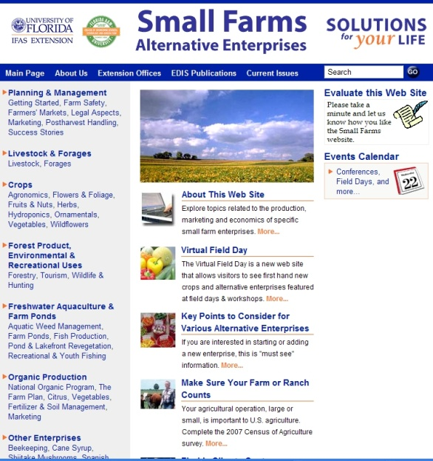
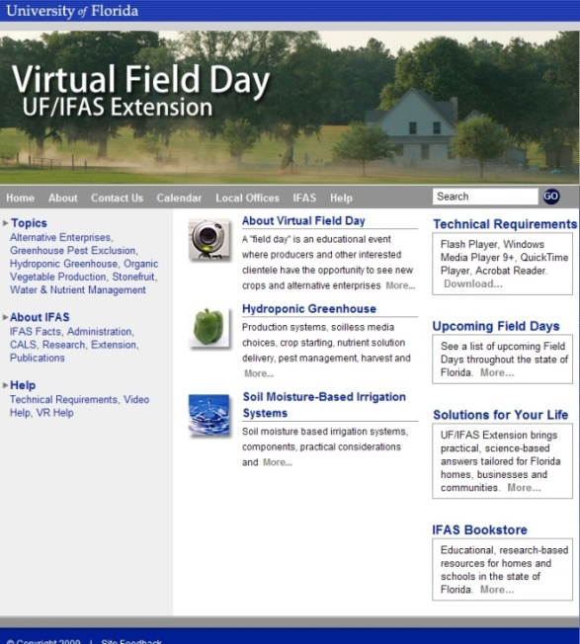
Thank You
For more information visit
the Small Farms web at http://smallfarms.ifas.ufl.edu
Take a virtual field day tour by visiting the Virtual Field Day web at http://vfd.ifas.ufl.edu
This presentation brought to you by the
Small Farms/Alternative Enterprises Focus Team.

