Slide 1
Living Well with Diabetes

Slide 2
Overview
Diabetes 101 – the basics
Emotional reactions vary
Building your health care team
Diabetes self management
Helpful resources

Slide 3

Diabetes 101
What is diabetes mellitus?
How early was it described and by whom?
Two breakthroughs:
  Islets of Langerhans discovered in 1860.
  Insulin first used in 1921.
Over 25 million Americans have diabetes.
About 90% have type 2 diabetes.

Slide 4
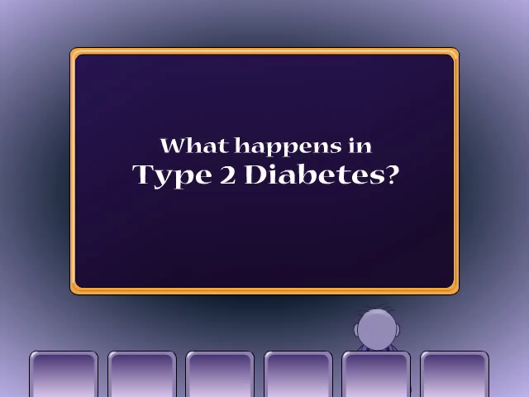
Insulin Resistance and
Defective Insulin Secretion
Source: http://professional.diabetes.org/ResourcesForProfessionals.aspx?cid=60378&typ=17

Slide 5
So what happens when a person is diagnosed with diabetes?

Slide 6



Emotional Reactions Vary
Denial
Fear
Anger
Guilt
Sadness
Frustration
Relief
Hope
Adaptation

Slide 7

Emotional Reactions
Denial
Feelings suppressed
Protection from overwhelming feelings
Can be paralyzing
Danger of health complications
Must overcome denial to “live well” with diabetes

Slide 8

Emotional Reactions
Fear
Real concerns about diabetes
May already have symptoms of health complications
Sense of loss of control is frightening
If overwhelming, seek help
Can be motivating in small doses

Slide 9

Emotional Reactions
Anger
Why me? It’s not fair!
Can be normal part of dealing with a serious situation
Seek help if anger:
  is overwhelming
  lasts too long
  causes abuse of self or others

Slide 10

Emotional Reactions
Guilt
Feeling that you have done something wrong
Can lead to feelings of failure
May neglect your health
Can be reminder to live well NOW
Can motivate positive change

Slide 11

Emotional Reactions
Sadness
Realize diabetes is here to stay
Alter self-image to include diabetes
Can motivate positive behavior changes
May develop into depression
  Lack of energy
  Change in appetite
  Sleep problems
  Sense of hopelessness
  Thoughts of suicide

Slide 12

Emotional Reactions
Frustration
Steep learning curve in diabetes care
Many aspects of care to implement
Outcomes not always what we expect
Focus on what IS working
Avoid backsliding to anger or other negative emotion

Slide 13

Emotional Reactions
Relief
May have expected something worse
Diabetes can be managed
Don’t get too relaxed though
Knowledge, motivation and perseverance necessary for good control

Slide 14

Emotional Reactions
Hope
Helpful when things get rough
Sources of hope vary among people
  Family and friends
  Support groups
  Personal knowledge
  Community and spiritual life
Share with others!

Slide 15

Emotional Reactions
Adaptation
Managing your diabetes
Feeling better physically
Sense of balance in life
Emotional well-being often tied to feeling better physically

Slide 16

Building Your Health Care Team
The primary care team:
YOU
Physician (preferably an endocrinologist)
Certified Diabetes Educator (CDE)
Registered Nurse (RN)
Registered Dietitian (RD)

Slide 17

Building Your Health Care Team
Other potential team members:
Exercise Specialist (ES)
Podiatrist
Ophthalmologist
Psychologist or psychiatrist
If needed:
  Nephrologist
  Cardiologist

Slide 18
Diabetes Self-Management
Meal planning
Physical activity
Diabetes medications
Blood glucose monitoring
All four work together to meet treatment goals.

Slide 19
Meal Planning
Goals
Achieve blood glucose goals.
Achieve optimal blood lipid and blood pressure levels.
Provide appropriate calories for a healthy weight
Improve overall health through optimal nutrition.

Slide 20
Nutrient Recommendations
Calories:
  Adequate to achieve healthy body weight
Fat:
  Saturated fat: less than 7% of calories
  Trans fat: minimize intake
Protein and carbohydrate:
  Individual recommendation based on eating habits and blood glucose/blood lipid/blood pressure goals.

Slide 21

Meal Planning Strategies
Improve food choices.
Consume moderate amount of calories.
Evenly distribute carbohydrates.
Follow the Idaho Plate Method.

Slide 22


Evenly Distribute Carbohydrate
Carbohydrate converted 100% to glucose
Main effect on blood glucose
Count carbohydrates
  Food labels
  Exchange Lists*
  Basic Carbohydrate Counting (ADA)
  Consult an RD
*Free exchange lists from the federal government: http://www.nhlbi.nih.gov/health/public/heart/obesity/lose_wt/fd_exch.htm

Slide 23
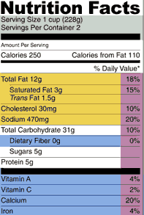
Carbohydrate Recommendations
Space carbohydrates throughout the day.
Limit concentrated sugars, like sucrose (table sugar) and honey.
Eat carbohydrates mostly in the form of starch and fiber.

Slide 24

Dietary Fiber
Reduces blood cholesterol.
Helps maintain healthy gut.
Fiber recommendations - Men
  19-50 years old: 38 grams per day
  > 50 years old: 30 grams per day
Fiber recommendations - Women
  19-50 years old: 25 grams per day
  > 50 years old: 21 grams per day

Slide 25
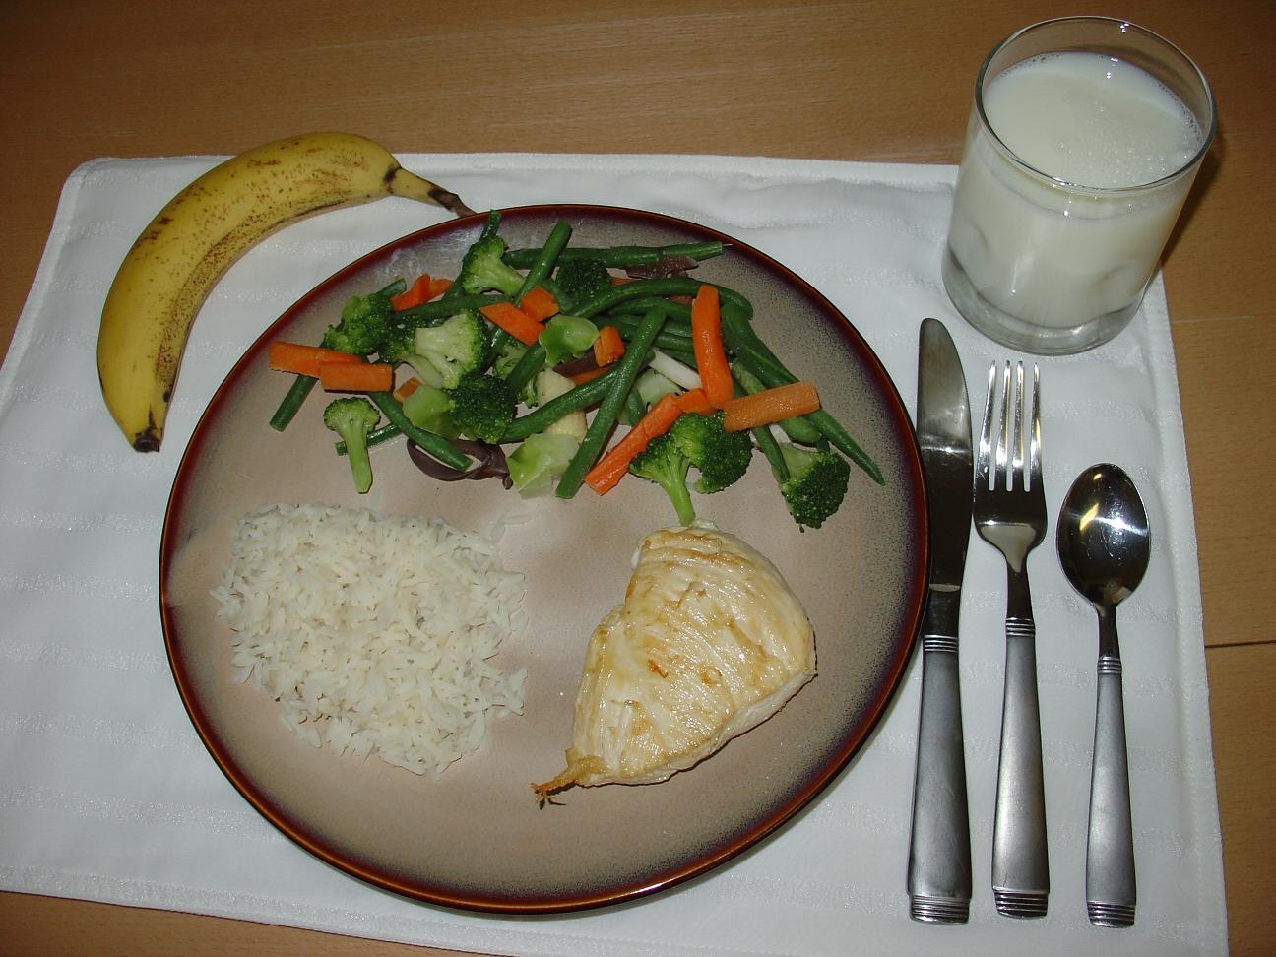
Idaho Plate Method

Slide 26

Physical Activity
Balance calories for weight management
Cardiovascular health
Improve glycemic control
Improve insulin sensitivity
Reduce stress

Slide 27

Physical Activity
Reduce Health Complications
Reduces major risk factors for heart disease and stroke:
  Obesity
  Abnormal blood lipids
  Hypertension

Slide 28
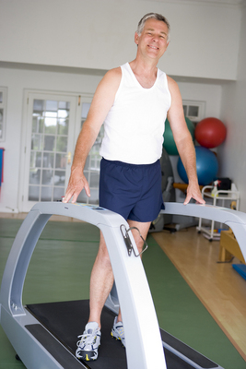


Physical Activity
Types of Physical Activity
Aerobic
Strength training
Flexibility

Slide 29

Physical Activity
How Much Physical Activity?
At least 150 min/week of moderate-intensity aerobic physical activity
No more than two consecutive days without physical activity.
Resistance training three times a week (unless contraindicated).

Slide 30

Physical Activity
Before Beginning to Exercise
Visit doctor for a check-up:
  Screen for health complications.
  Discuss exercise plan.
  Adjust medication if necessary.
  Identify any special precautions.
Discuss eating plan with dietitian.
Possibly see exercise specialist for fitness test.

Slide 31
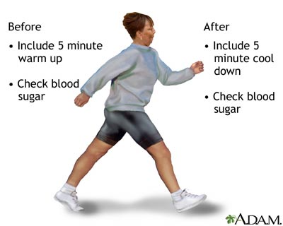
Physical Activity
Staying Safe
A person with type 2 diabetes can use exercise to help control their blood sugar levels and provide energy their muscles need to function throughout the day. By maintaining a healthy diet and sufficient exercise, a person with type 2 diabetes may be able to keep their blood sugar in the normal non-diabetic range without medication.
Used with permission. Visit: shands.org/health

Slide 32
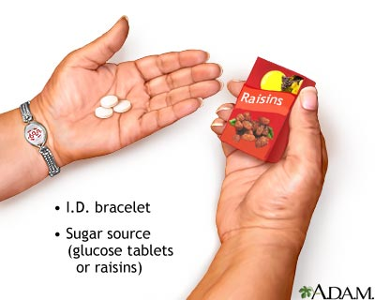
Physical Activity
Special Concerns
Maintain glycemic control:
  Select appropriate exercise.
  Adjust diet and medications as needed.
  Monitor blood glucose.
  Carry glucose tablets or gel.
Stay well hydrated.
Wear a diabetes identification bracelet.
Used with permission. Visit: shands.org/health

Slide 33
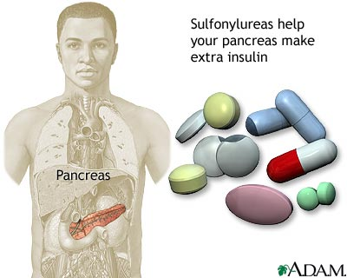
Diabetes Medications
Oral agents
  Single
  Combination
Insulin
  Injectable
Adjunct therapies (injectable)
Used with permission. Visit: shands.org/health

Slide 34

Diabetes Medications
Treatment Protocol
Common practice is to try oral medications before insulin.
However, insulin may be part of the initial treatment depending on:
- length of time since diagnosis
- blood glucose levels
- other medications taken
- general health status
Discuss with your doctor!

Slide 35

Diabetes Medications
Take Home Messages
Many medications available.
New medications continue to be developed.
Individual responses vary.
Your treatment options will likely change over time.
Work with your health care team to find the right treatment for YOU.

Slide 36
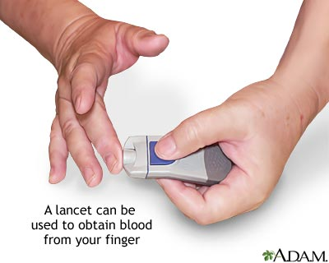
Blood Glucose Monitoring
Cornerstone of diabetes management.
Used to assess effectiveness of therapy.
Guides adjustments in nutrition, exercise, and medicine to achieve optimal control.
Self-monitoring of blood glucose (SMBG)
Hemoglobin A1C
Used with permission. Visit: shands.org/health

Slide 37
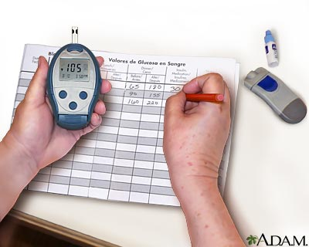
SMBG Recommendations
Aim for blood glucose levels as close to normal as is safely possible.
Schedule determined by needs and goals of the individual.
General guide:
  Type 1: 3 or more times daily
  Type 2: adequate to meet glucose goals
Used with permission. Visit: shands.org/health

Slide 38

SMBG
When to Check?
Early a.m. or before breakfast
2 hours after meals
At bedtime
3 a.m.
When experiencing signs and symptoms of hypoglycemia or hyperglycemia

Slide 39

SMBG
Check More Often If . . . .
Medication changed
Unusual stress
Illness
Change in activity level
Change in eating pattern

Slide 40

Hemoglobin A1C (A1C)
Measured in a lab or using home kit.
Reflects blood glucose over 2 to 3 months.
Should be tested at least two times per year for patients meeting treatment goals.
More frequently when:
  assessing glycemic control OR
  not meeting glycemic goals OR
  therapy has changed

Slide 41
A1C and Estimated Average Glucose (eAG)
A1C (%)
6
7
8
9
10
11
12
eAG (mg/dl)
126
154
183
212
240
269
298

Slide 42

Helpful Resources
American Diabetes Association http://www.diabetes.org
National Diabetes Education Program http://ndep.nih.gov
National Heart, Lung and Blood Institute http://www.nhlbi.nih.gov/health/public/heart/index.htm
USDA Food Guidance System http://ChooseMyPlate.gov
University of Florida IFAS Extension publications http://solutionsforyourlife.ufl.edu

Slide 43

Summary
Diabetes is a serious disease that can be managed.
Many emotions are possible with diagnosis and even years after.
Multidisciplinary health care team is critical for good care.
Self management can improve glycemic control and lower risk of health complications.

Slide 44
Living Well with Diabetes
Prepared by:
Linda B. Bobroff, Ph.D., RD, LD/N
Department of Family, Youth and Community Sciences
University of Florida
Gainesville Florida
August 2006
Updated February 2010/July 2011

