Slide 1
2011 - Vegetable and Small Fruit Nutrition Management Workshop Cucurbit fertilization
Lincoln Zotarelli
Horticultural Sciences Department
University of Florida
Gulf Coast REC, October 6, 2011

Slide 2
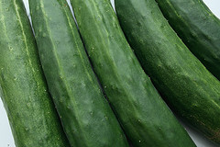
Production Facts – U.S. vs FL
 | Cucumbers |  | Squash |  | Watermelon
 | U.S. | FL | U.S. | FL | U.S. | FL
Planted area (ac) | 49,735 | 12,825 (26%) | 44,875 | 8,800 (20%) | 138,350 | 25,900 (19%)
Production (1,000 cwt) | 8,939 | 3,085 (35%) | 6,679 | 988 (15%) | 39,657 | 7,938 (20%)
(%) FL / U.S.*100 - NASS/USDA (2011)

Slide 3
Production Facts – U.S. vs FL
 | Cucumbers |  | Squash |  | Watermelon
 | U.S. | FL | U.S. | FL | U.S. | FL
Planted area (ac) | 49,735 | 12,825 (26%) | 44,875 | 8,800 (20%) | 138,350 | 25,900 (19%)
Production (1,000 cwt) | 8,939 | 3,085 (35%) | 6,679 | 988 (15%) | 39,657 | 7,938 (20%)
Yield (cwt/ac) | 190 | 246 (130%) | 156 | 116 (74%) | 309 | 320 (103%)
(%) FL / U.S.*100 - NASS/USDA (2011)

Slide 4
Production Facts – U.S. vs FL
 | Cucumbers |  | Squash |  | Watermelon
 | U.S. | FL | U.S. | FL | U.S. | FL
Planted area (ac) | 49,735 | 12,825 (26%) | 44,875 | 8,800 (20%) | 138,350 | 25,900 (19%)
Production (1,000 cwt) | 8,939 | 3,085 (35%) | 6,679 | 988 (15%) | 39,657 | 7,938 (20%)
Yield (cwt/ac) | 190 | 246 (130%) | 156 | 116 (74%) | 309 | 320 (103%)
Value ($/cwt) | 24 | 25 | 29 | 51 | 12 | 17
Total value ($1,000) | 218,101 | 76,882 (35%) | 196,314 | 49,741 (25%) | 468,748 | 132,220 (28%)
(%) FL / U.S.*100 - NASS/USDA (2011)

Slide 5
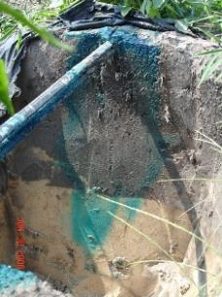
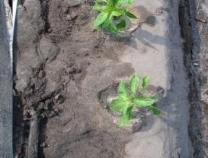
Production challenges in Florida
Reduced lateral soil water distribution and low soil organic matter content
High susceptibility to NO₃-N leaching
Predominant vertical water movement
Higher requirement
of fertilizer
effect on
production costs &
vegetable yield
soil moisture distribution after 1h irrigation
Irrigation water percolation

Slide 6
Cucurbit characteristics
As a group, cucurbits can develop a good root system in the top 12”
Taproot going deeper (2-3 ft)
Cucurbits are sensitive to wet soil conditions
prevent prolonged saturation of the root zone – condition that favors development of root rot pathogens
Light-textured soils are most suitable
Very sandy soils have limited water holding capacity
more frequent irrigation required

Slide 7
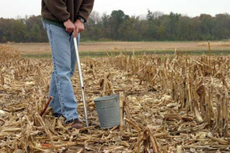
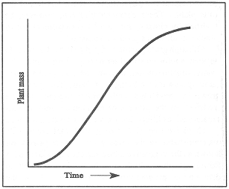
Fertilization strategies for cucurbits
It’s critical to understand:
1) nutrient status in the soil
2) nutrient requirement of the crop
A soil probe is used to sample fields for SCN. (Tom Schultz)

Slide 8
1) Nutrient status in the soil how much can soil offer?
Fact: soil must have good fertility status to produce good yields and quality.
Step 1) Soil sampling – soil fertility test
composite sample from representative areas
sampling areas delineated by soil types, topography, cropping history, etc.
Great tool available: USDA – Web Soil Survey

Slide 9
USDA – WEB SOIL SURVEY - Main page http://websoilsurvey.nrcs.usda.gov/app/HomePage.htm

Slide 10
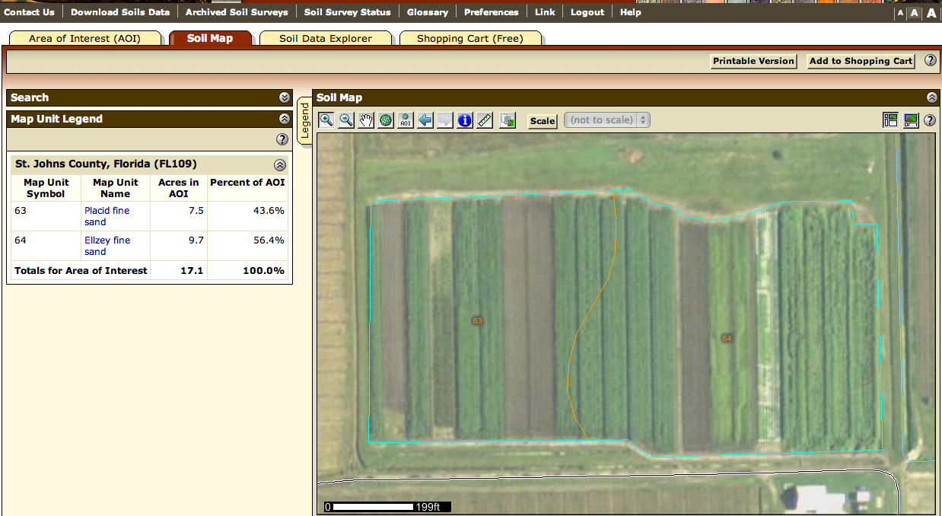
Identify and view soil map units of a production area

Slide 11
Identify and view soil map units of a production area
Web Soil Survey provides:
Soil map of a area of interest
understanding the soil properties and limitation
2. Acreage and linear measurement to be used for:
A. More precise fertilizer calculation rate
B. chemical calculation rate
C. required info for fumigation documentation e.g. exact location of the area (coordinates)
3. Better yield estimation

Slide 12
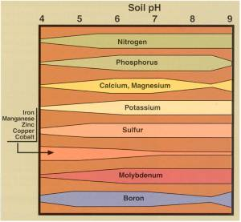
Fertilization strategies for cucurbits
Excellent indicator of soil chemical status
Adjustment of soil pH if necessary
For cucurbits maintaining soil pH between 6.0 and 6.5
Nutrient most affected by pH are P and Mn
P most available (pH 6.0-6.5)
Mn low availability above pH 6.5
Mn toxicity below near pH 5.0

Slide 13
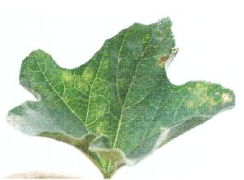
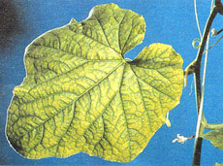
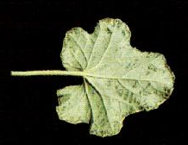
Fertilization strategies for cucurbits
Mn toxicity below or near pH 5.0
Mn deficiency
pH above 6.5
The Mn toxicity symptoms develop as pale green or yellow spotting on the upperside of older leaves, with water-soaked rings around necrotic spots on the underside. The necrotic spots expand rapidly and coalesce into dead tissue areas; the result is complete death of older leaves in a week's time. Muskmelon leave.
The veins of middle to upper leaves remain green while the rest of the leaf of this manganese deficient plant becomes a uniform pale green to yellow.
Source: Nutrient disorders of greenhouse Lebanese cucumbers (Agfact H8.3.3)
If pH higher than 6.5 – foliar application of Mn may be consider (visit with your local Extension Service for specific rates and time of application)
http://www.extension.purdue.edu/extmedia/HO/HO-191.html

Slide 14
Fertilization strategies for cucurbits
Mg may become limiting in acid conditions especially in sandy soils
pH between 6.0-6.8 – higher Mg and Ca availability
Adequate soil moisture helps in minimizing blossom-end-rot associated with inadequate Ca getting into the blossom end of young developing fruit
In season correction – foliar application of Ca and/or Mg
Long term correction – soil application of dolomitic limestone (best option)

Slide 15
2) Nutrient requirement of the crop:
General guidelines:
For muskmelon, watermelon, pumpkin and squash
For cucumbers – about half of the above values
Again, this is general guidelines for the amount supplement to apply
the requirement may vary according to variety, management practices and growing conditions
 | N (lb/ac) | P₂O₅ (lb/ac) | K₂O (lb/ac)
Nutrient accumulated plant + fruit | 145-160 | 30-45 | 160-180
Source: Warncke (2007) – MSU

Slide 16
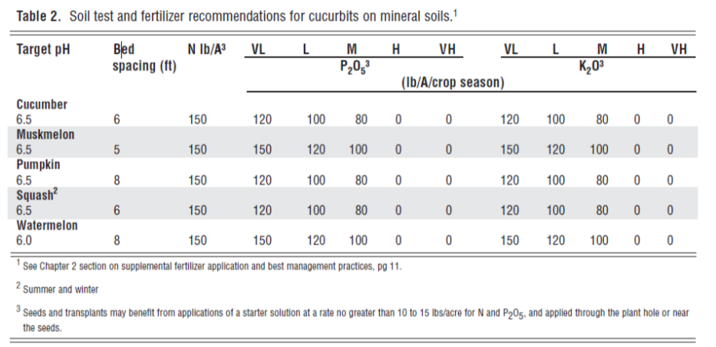
Application of fertilizer according to soil testing for cucurbits:
Source: Florida Vegetable Handbook

Slide 17
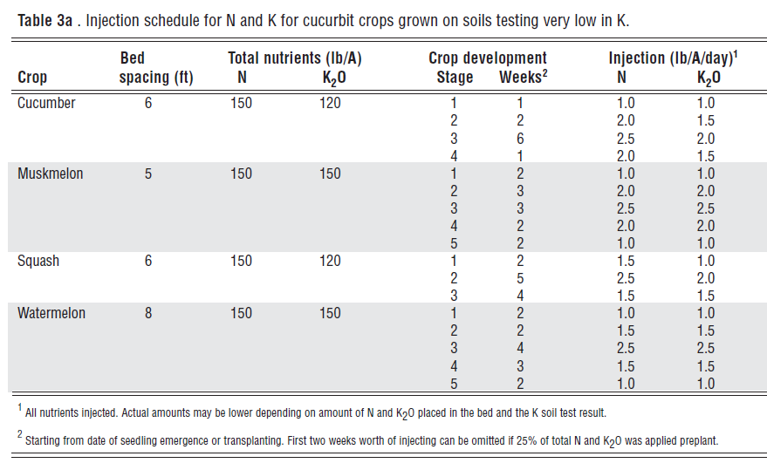
2) Nutrient requirement of the crop: fertigation of N and K
Source: Florida Vegetable Handbook

Slide 18
Water management and zucchini production
Two irrigation strategies
Fixed irrigation – 2 hours continuously
Equivalent to 79.6 gal/100ft/day
At the end of the season applied 16.2 in or 5,970 gal/100ft
Controlled irrigation – TARGET WAS TO WET THE TOP 12-16” OF SOIL
5 possible irrigation windows controlled
by soil moisture sensors set at soil field capacity
Equivalent to 33.2 gal/100ft/day
At the end of the season applied 6.7in or 2,492 gal/100ft
N-rates of 75, 150 and 225 lb/ac
weekly fertigation with calcium nitrate
Source: Zotarelli et al 2008. Scientia Horticulturae

Slide 19
225 lbN/ac
150 lbN/ac
75 lbN/ac
Controlled irrigation
Controlled irrigation
2h fixed irrigation

Slide 20
75 lbN/ac
225 lbN/ac
Controlled irrigation
75 lbN/ac
Controlled irrigation
2h fixed irrigation

Slide 21
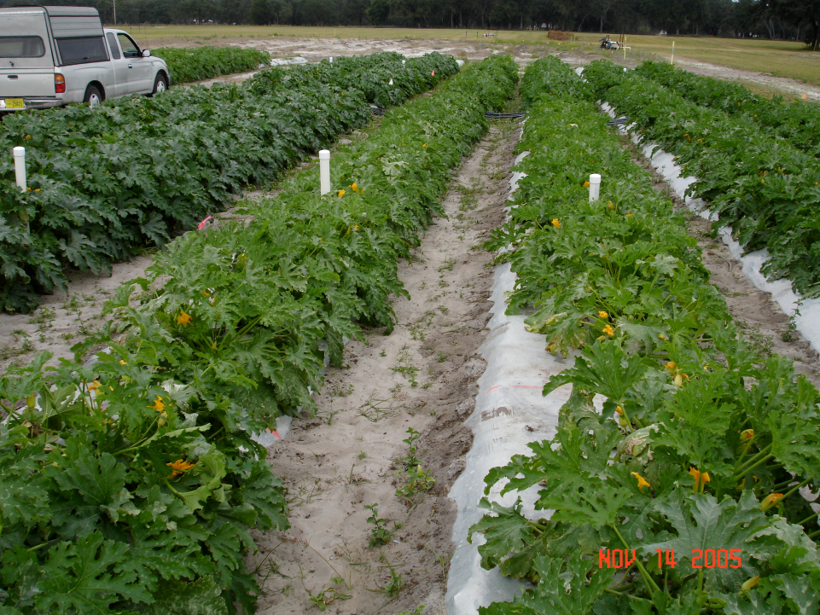
150 lbN/ac
Controlled irrigation
75 lbN/ac
2h fixed irrigation
150 lbN/ac
2h fixed irrigation
75 lbN/ac
Controlled irrigation

Slide 22
Zucchini plant N accumulation

Slide 23
Zucchini daily N uptake

Slide 24
Irrigation vs. N-fertilization on zucchini
 | 75 lbN/ac | 150 lbN/ac | 225 lbN/ac | Average
 | Zucchini marketable yield (lb/ac)
Controlled irrigation – up to 5 irrig. windows/day | 22,389 | 25,422 | 26,135 | 24,649 A
Fixed irrigation of 2h/day | 15,525 | 19,535 | 19,891 | 18,316 B
Average | 19,955 B | 22,478 A | 23,013 A
† Means within columns/lines followed by the same lowercase letters are not significantly different (P ≤ 0.05) according to Duncan’s multiple range test.

Slide 25
Irrigation vs. N-fertilization on zucchini
 | 75 lbN/ac | 150 lbN/ac | 225 lbN/ac | Average
 | Zucchini marketable yield (lb/ac)
Controlled irrigation – up to 5 irrig. windows/day | 22,389 | 25,422 | 26,135 | 24,649 A
Fixed irrigation of 2h/day | 15,525 | 19,535 | 19,891 | 18,316 B
Average | 19,955 B | 22,478 A | 23,013 A
100%
74%
84%
100%
102%

Slide 26
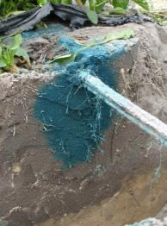
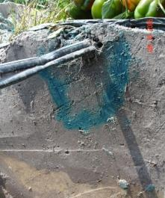
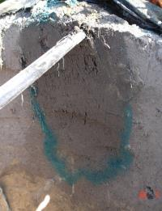
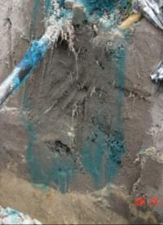
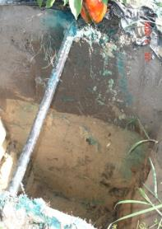
Effect of irrigation on solute displacement
(injecting dye in fertigation lines)
24 hrs
3 days
7 days
soil sensor based
irrigation
16in
fixed time irrigation schedule
+38 in

Slide 27
Final consideration:
Establishment of integrated fertilizer and irrigation program
Remember: Low water and nutrient retention of Florida soils
Soil pH
Combination of fertilizer rate / placement and timing are key for success

