Slide 1
City Longhorned Beetle Aeolesthes sarta

Slide 2
City Longhorned Beetle
Other common names: Uzbek longhorn beetle, sart longhorn beetle, town longhorn beetle
Thought to originate in Pakistan and Western India
Often found invading plants within cities in Western Europe and Asia
Notes:
The city longhorned beetle (Aeolesthes sarta) is also known as the Uzbek longhorn beetle, sart longhorn beetle, town longhorn beetle or other names in local languages. This pest of trees, including oaks, is thought to have originated in Pakistan and Western India. Presently, the species only invades cities in Western Europe and Asia but threatens to spread to other parts of the globe.
Information sources: 3

Slide 3
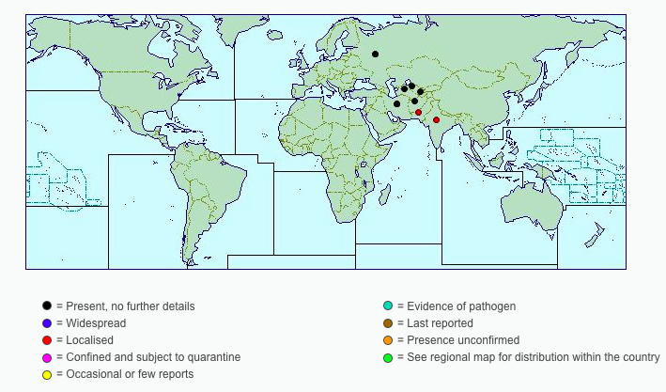
Global Distribution
Image credits: Distribution Map - http://www.cabi.org/isc/datasheet/3430
Notes:
The city longhorned beetle is distributed throughout certain regions of Western Europe and Asia. It is currently present in India, Pakistan, Afghanistan, Iran, Turkmenistan, Uzbekistan, Tajikistan, Kyrgyzstan and the former Soviet Union. Mediterranean countries at risk for this pest due to the dry and hot climates. Aeolesthes sarta has not yet established in the Western hemisphere, but many of these countries including the United States are at risk of pest invasion due to climate and vegetation.
Information sources: 1, 4, 5

Slide 4
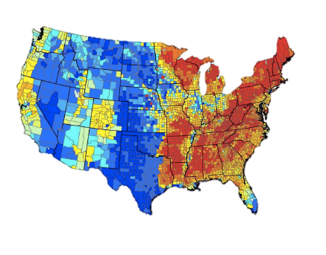
Potential Distribution in the United States
Risk Potential
High
Low
Image credits: Distribution Map - USDA-APHIS-PPQ-CPHST
Notes:
Based on host availability in the United States, the city longhorned beetle is most likely to establish in the eastern United States. According to the map above, the western coast and some midwestern states are also at a medium level of risk for invasion.
Information sources: 2

Slide 5
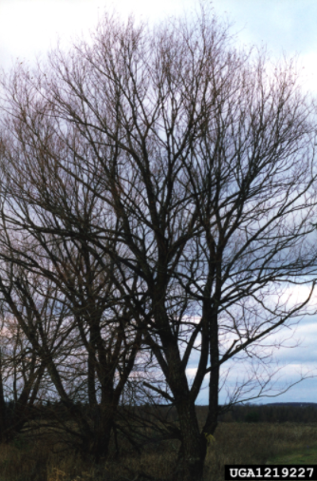
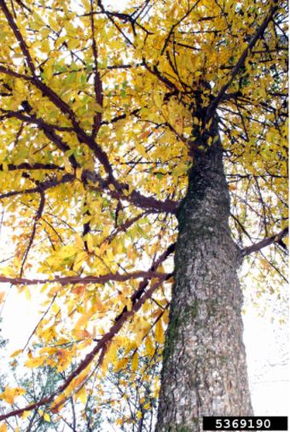
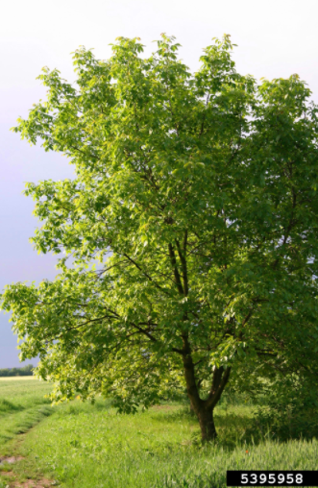
Pest of forest, fruit and ornamental trees
Image credits: English walnut (Juglans regia) L. - Robert Vidéki, Doronicum Kft. - Bugwood.org, #5395958; winged elm (Ulmus alata) Michx.- Joe Nicholson -Bugwood.org, #5369190; black willow (Salix nigra) Marsh. - Bill Cook, Michigan State University - Bugwood.org, #1219227
Notes:
The city longhorned beetle is a pest of many different deciduous trees including oaks. They cause damage to forest, fruit and ornamental trees each year in Western Europe and Asia.
The main hosts include:
Ulmus minor,
Ulmus pumila,
Populus alba,
Populus diversifolia,
Populus euphratica,
Populus talassica,
Populus x canadensis,
Salix acmophylla,
Salix songarica,
Salix turanica,
Platanus orientalis,
Platanus x hispanica,
Malus domestica
Juglans regia
Other hosts:
Acer (maples)
Alnus subcordata
Betula (birches)
Elaeagnus
Fraxinus (ashes)
Gleditsia
Juglans regia (walnut)
Malus domestica (apple)
Morus (mulberrytree)
Morus alba (mora)
Platanus acerifolia (London planetree)
Platanus orientalis (plane)
Populus (poplars)
Populus alba (silver-leaf poplar)
Populus alba var. pyramidalis (Boll's poplar)
Populus euphratica (Euphrates poplar)
Populus talassica
Populus x euramericana
Prunus (stone fruit)
Prunus (stone fruit)
Prunus armeniaca (apricot)
Pyrus (pears)
Quercus (oaks)
Robinia pseudoacacia (black locust)
Salix (willows)
Salix acmophylla
Ulmus densa
Ulmus minor (European field elm)
Ulmus pumila (dwarf elm)
Ulmus pumila var. arborea
Information sources: 1, 3

Slide 6
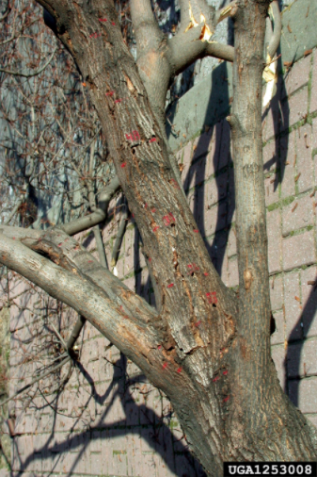
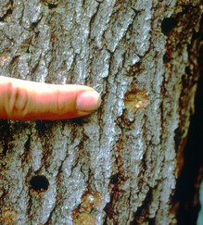
Damage
Emergence holes
Larval galleries in bark
Wilted or dry leaves
Tree dieback
Image credits: Asian longhorned beetle (Anoplophora glabripennis) (Motschulsky, 1853) - Thomas B. Denholm, New Jersey Department of Agriculture - Bugwood.org, #1253008; Oviposition niche - http://www.na.fs.fed.us/fhp/alb/slides_images/slides/ovi.htm;
Notes:
The city longhorned beetle causes a large amount of damage to forest trees every year in Western Europe and Asia. Several generations can infect a host before it eventually dies. The main damage is the destruction of the trunks and branches of a healthy tree by larvae. Larval galleries can be seen in the bark created by the feeding insects. Emergence holes are also visible from where adults exit the tree. Some of the visible consequences of city longhorned beetle infection is wilted or dry leaves and tree dieback. Once the host dies, it is no longer a food source for the pest as it can only feed on the living tissues.
Information Sources: 4

Slide 7
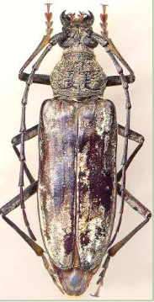
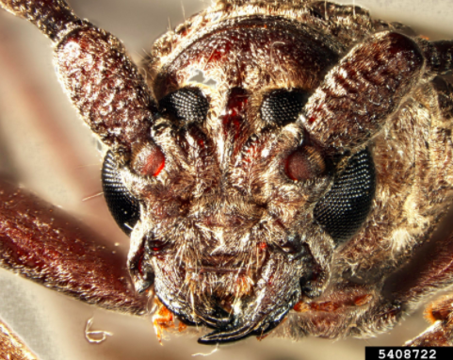
Identification
Adults
Dark grey-brown bodies
Fine silvery pubescence
28-47mm in length
Long antennae
Image credits: CITY LONGHORNED BEETLE - http://www.maine.gov/dacf/php/documents/Nursery-Pest_handout_2015.pdf; city longhorn beetle (Aeolesthes sarta) (Solsky, 1871) - Kira Zhaurova, USDA APHIS PPQ- Bugwood.org, #5408722
Notes:
Adult city longhorned beetles are dark gray to brown bodied. The pest have a fine silver pubescence with two irregular bands on the elytra. Overall, the city longhorned beetles are usually around 28-47mm in length. Typically, males have antennae that are 2.5 times the length of the body while females have antennae that are shorter than the body. Adults are usually most active at night and during the day they will hide in the larval chambers in the bark. Although they have wings, they fly very little and do not feed as adults.
Information sources: 6, 7

Slide 8
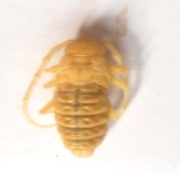
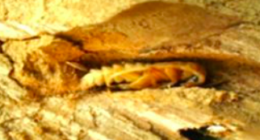
Identification
Pupae
Creamy yellow
30-40mm in length
11-15mm in width
Long antennae
Image credits: Khan, S.A., S. Bhatia, and N. Tripathi. - http://jairjp.com/NOVEMBER%202013/03%20SAJAD.pdf
Notes:
Aeolethes sarta pupae are creamy yellow with long antennae. They are about 30-40mm in length and 11-15mm in width. They hide in crevices and will overwinter in the cavities in the wood created by larvae.
Information sources: 7

Slide 9
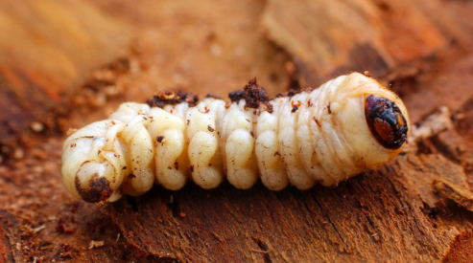
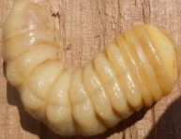
Identification
Larvae
White-yellow
60-70mm long
Black mandibles
Pale yellow hairs
Image credits: Aeolesthes (Aeolesthes) sarta (Solsky, 1871) -Lech Karpinski - http://cerambycidae.org/taxa/sarta-(Solsky-1871); Khan, S.A., S. Bhatia, and N. Tripathi. - http://jairjp.com/NOVEMBER%202013/03%20SAJAD.pdf
Notes:
The larvae of the city longhorned beetle are a pale yellow color and are about 60-70mm in length by their last instar. They are covered in pale yellow or golden hairs and have black mandibles. The larvae are typically found in the bark of trees where they will construct tunnels where they complete 3 instars. They will produce a reddish to yellowish brown frass which can be found on the host. As a whole, the larvae are similar in appearance to many related beetles and are not the best life stage to use for identification.
Information sources: 6, 7

Slide 10
Identification
Eggs
White
3-4mm long
Slit-like cluster of 4-13 eggs
Found in crevices of host
Image credits: Khan, S.A., S. Bhatia, and N. Tripathi. - http://jairjp.com/NOVEMBER%202013/03%20SAJAD.pdf
Notes:
Eggs are white and about 3-4mm long. They are laid in slit-like clusters of 4-13 eggs in the crevices of host bark. While on average the slits are in smaller clusters a total of 240-270 can still be laid by adult Aeolesthes sarta.
Information sources: 6, 7

Slide 11
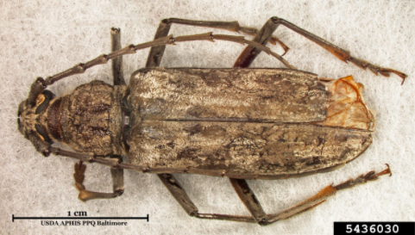
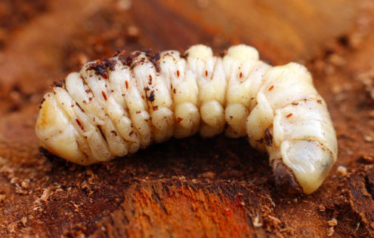
Life cycle
Eggs
10-15 days
Adult
Larvae
Pupae
10-20 days
Image credits: long-horned beetle (Aeolesthes spp.) Gahan 1890 - James D. Young, USDA APHIS PPQ - Bugwood.org, #5436030; Aeolesthes (Aeolesthes) sarta (Solsky, 1871) -Lech Karpinski - http://cerambycidae.org/taxa/sarta-(Solsky-1871); Khan, S.A., S. Bhatia, and N. Tripathi. - http://jairjp.com/NOVEMBER%202013/03%20SAJAD.pdf;
Notes:
Adults will lay eggs in late April where they will hatch 10-15 days later. Once hatched, the larvae will begin making their own tunnel in the host tissues. They will eat and then overwinter in their tunnel until the following spring. Then, the larvae continue to eat. The larvae will pupate around August, become adults in 10-20 days, and remain in the a pupal chamber for 7-8 months overwintering where they emerge in late April. The total cycle takes two years to complete. Often, several generations will invade the host before the tree eventually dies.
Information sources: 1, 7

Slide 12
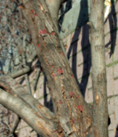
Monitoring
Look for:
Emergence holes
Boring debris
Wilted or dry leaves
Tree dieback
Larval galleries
Reddish yellow frass
Image credits: Asian longhorned beetle (Anoplophora glabripennis) (Motschulsky, 1853) - Thomas B. Denholm, New Jersey Department of Agriculture - Bugwood.org, #1253008, ; Oviposition niche - http://www.na.fs.fed.us/fhp/alb/slides_images/slides/ovi.htm;
Notes:
Monitoring occurs primarily through visual inspection of hosts. One of the common signs is emergence holes in the bark from adult beetles. It is also common to see boring debris at the base of the tree along with reddish-yellow frass on the host. Furthermore, there is larval galleries in the wood that may not be visible until damage is very extensive. Common symptoms of an infected host is wilted or dry leaves and tree dieback. Currently, there is no literature regarding the use of pheromone baited traps to monitor for the city longhorned beetle.
Information Sources: 5

Slide 13
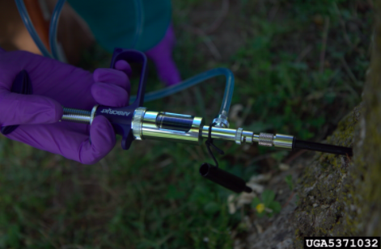
Chemical Control
Imidacloprid, chlorpyrifos, cyfluthrin and bifenthrin
Image credits: tree injections - David Cappaert, Michigan State University - Bugwood.org, #5371032
Notes:
Overall, there is variable success with chemical control of the city longhorned beetle. Some scientific studies suggest that imidacloprid injections into either the soil or the tree trunk can control the population of larvae in a host. The larvae will feed on plant tissues that contain the chemical and as a result die. Also, chlorpyrifos have shown moderate success in the targeting eggs and young larvae. Spraying the bark with cyfluthrin or bifenthrin seemed to have some success in killing the pest. The labels on all chemical treatments should be read and followed to ensure proper use and effective treatment. All in all, chemical controls exist but it is predicted that other controls like phytosanitary measures are more effective for a wider variety of hosts.
Information sources: 8

Slide 14
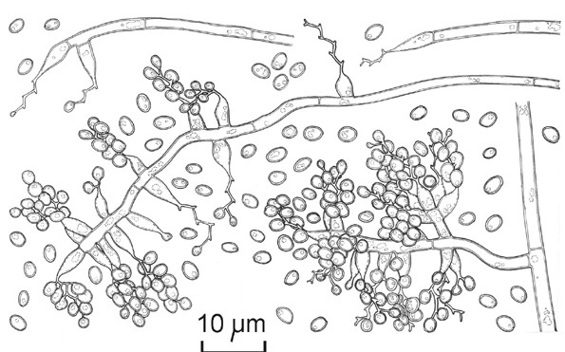
Biological Control
White muscardine fungus (Beauveria bassiana)
Bethylidae wasp (Sclerodermus turkmenicus)
White muscardine fungus
Image credits: line drawing - Dave Minter/CABI BioScience - http://www.cabi.org/isc/datasheet/8785
Notes:
White muscardine fungus (Beauveria bassiana) will attack the adult city longhorned beetles.
Schlerodermus turkmenicus is a parasitic wasp in the family Bethylidae that will target the larvae of Aeolesthes sarta. It is a type of hymenoptera common in areas where the long horned beetle are prevalent.
Information Sources: 4

Slide 15
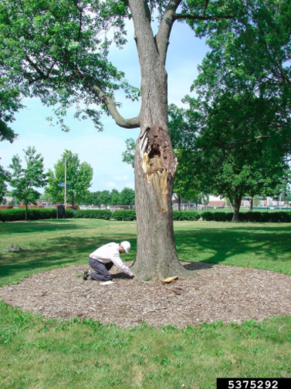
Cultural Control
Phytosanitary measures
Monitoring nurseries
Cutting and burning infested trees
Debarking wood before movement
Planting more resistant tree species
Image credits: visual tree inspection - Andrew Koeser, International Society of Arboriculture, - Bugwood.org, #5375292
Notes:
Most cultural controls involve phytosanitary measures. This includes monitoring nurseries and trees frequently and cutting and burning extremely infected trees. Any wood from an infected host should be burned. If wood is to be moved, it should be inspected by debarking ahead of time. International movement of untreated wood could lead to he spread of the pest to more areas of the world. Furthermore, cities with city longhorned beetle problems have begun planting species of trees that are resistant to the pest.
Information Sources: 3, 4

Slide 16
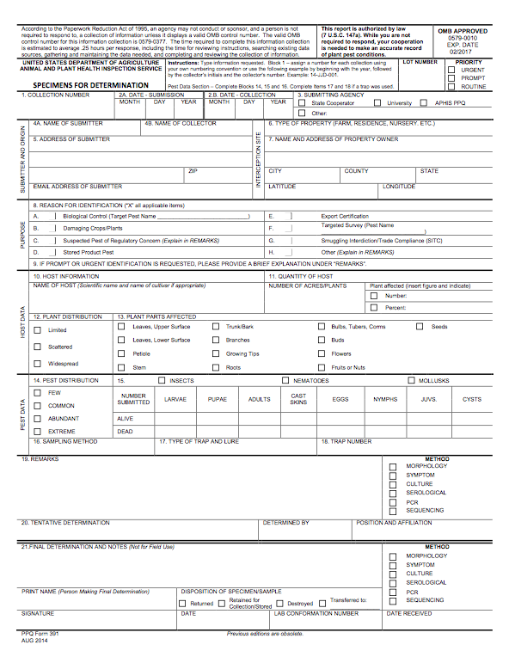
Suspect Sample Submissions
Contact your State Department of Agriculture or University Cooperative Extension laboratory
http://www.npdn.org/home
PPQ form 391, Specimens for Determination
https://www.aphis.usda.gov/library/forms/pdf/PPQ_Form_391.pdf
An example of a PPQ form for sample submissions
Image credits: https://www.aphis.usda.gov/library/forms/pdf/PPQ_Form_391.pdf
Notes:
If a suspect pest has been located in the United States, a sample should be submitted for proper identification. Contact your local diagnostic lab to ship in a sample for identification. Information regarding your local diagnostic lab is available at National Plant Diagnostic Network (NPDN) website. The diagnostic lab information and available contacts are divided by state.
http://www.npdn.org/home
The sample specimen should be submitted along with accompanying documentation using the PPQ form 391.
https://www.aphis.usda.gov/library/forms/pdf/PPQ_Form_391.pdf
Your local diagnostic lab is part of your local cooperative extension service or your state department of agriculture. Your local lab will also have a specific form. All local labs may not be a member of NPDN. However, all labs should report new pest and pathogen detections to local regulatory officials.

Slide 17
Communications
Contact your State Plant Health Director
https://www.aphis.usda.gov/aphis/ourfocus/planthealth/ppq-program-overview/ct_sphd
Contact your State Plant Regulatory Official
http://nationalplantboard.org/membership/
Image credits: http://www.usda.gov/wps/portal/usda/usdahome; http://nationalplantboard.org/
Notes:
Remember that new pest and pathogen records must be reported to your State Plant Health Director (SPHD) and your State Plant Regulatory Official (SPRO). The SPRO is a State Department of Agriculture Employee and the SPHD is a USDA-APHIS-PPQ employee.
The link to your SPRO is on the National Plant Board (NPB) website. It has an interactive map and when you click on your state it will take you to another page with contact information. The NPB is a cooperative organization that includes membership from all State Departments of Agriculture.

Slide 18
Author and Publication Dates
Morgan Pinkerton
Lab Technician, Department of Entomology and Nematology, University of Florida
Amanda Hodges, Ph.D.
Associate Extension Scientist, Department of Entomology and Nematology, University of Florida
Publication date: October 2016

Slide 19
Reviewers
Catherine A. Marzolf
Assistant State Plant Health Director, USDA APHIS PPQ

Slide 20
Educational Disclaimer and Citation
This presentation can be used for educational purposes for NON-PROFIT workshops, trainings, etc.
Citation: Pinkerton, Morgan and Amanda Hodges. 2016. City Longhorned Beetle – Aeolesthes sarta.
Accessed (add the date) –
www.protectingusnow.org

Slide 21
Our Partners
United States Department of Agriculture, National Institute of Food and Agriculture (USDA NIFA)
United States Department of Agriculture, Animal and Plant Health Inspection Service, Plant Protection and Quarantine (USDA APHIS PPQ)
Cooperative Agriculture Pest Survey (CAPS) Program
National Plant Board (NPB)
States Department of Agriculture
Extension Disaster Education Network (EDEN)
Center for Invasive Species and Ecosystem Health (Bugwood)
National Plant Diagnostic Network (NPDN)
U.S. Department of Homeland Security (DHS)
U.S. Forest Service (USFS)

Slide 22
References
Anonymous. City Longhorned Beetle. Ohio Department of Agriculture. Accessed 3/4/2016.
http://www.agri.ohio.gov/divs/plant/caps/docs/clb.pdf
Anonymous. Aeolesthes sarta, Beetles: Arthropod Pests. Center for Plant Health Science and Technology (CPHST). Accessed 6/10/2016.
http://pest.ceris.purdue.edu/redirect.php?i=15721&u=http://download.ceris.purdue.edu/file/2960
Anonymous. 2006. Data sheets on quarantine pests: Aeolesthes sarta. European and Mediterranean Plant Protection Organization. Accessed 3/4/2016.
http://afghanag.ucdavis.edu/a_horticulture/fruits-trees/apples/pest-management-ipm/Beetle_Aeolesthes_sarta.pdf
Anonymous. 2015. Aeolesthes sarta (city longhorn beetle). Invasive Species Compendium. Accessed 2/29/2016.
http://www.cabi.org/isc/datasheet/3430

Slide 23
References
Coluzzi, K. 2015. 2015 Cooperative Agricultural Pest Survey (CAPS) Program. Maine Department of Agriculture, Conservation and Forestry.
http://www.maine.gov/dacf/php/documents/Nursery-Pest_handout_2015.pdf
Holland, J.D., et al. 2013. Americas Least Wanted Wood Borers. Purdue Extensions. Accessed 3/3/2016.
https://extension.entm.purdue.edu/publications/WB-3.pdf
Khan, S.A., S. Bhatia and N. Tripathi. 2013. Entomological Investigation on Aeolesthes sarta (Solsky), A Major Pest on Walnut trees (Juglans Regia L.) in Kashmir Valley. Journal of Academia and Industrial Research (JAIR) 2(6): 325-330. Accessed 3/7/2016.
http://jairjp.com/NOVEMBER%202013/03%20SAJAD.pdf
Mazaheri, A., et al. 2015. Laboratory and field evaluation of insecticides for the control of Aeolesthes sarta Solsky (Col.: Cerambycidae). J. Crop Prot. 2015, 4(2): 257‐266. Accessed 3/10/2016.
http://jcp.modares.ac.ir/pdf_12581_49529e9fc0a3ae2f68657414cdc75f37.html

Slide 24
References
Zhaurova, K. 2009. Aeolesthes sarta Cerambycidae: City longhorned beetle. Purdue. Accessed 3/4/2016.
download.ceris.purdue.edu/file/90

