Slide 1
Tremex woodwasp
Tremex fuscicornis

Slide 2
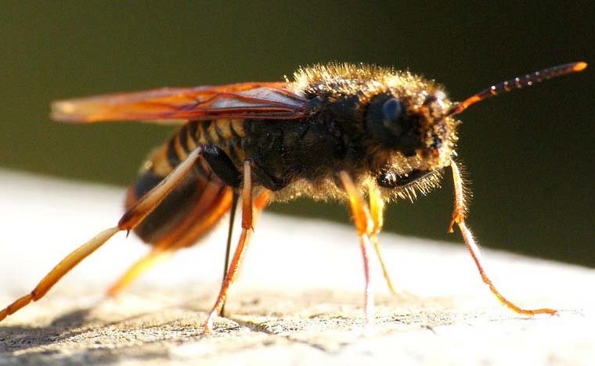
Tremex woodwasp
Native of Europe and Asia where it feeds only on dead or diseased trees.
Found in Chile in 2000.
Attacks healthy trees.
Agricultural loss of lumber and windbreaks.
Wasps infect trees with phytotoxic fungus (Cerrena unicolor)
Image credits: T. fuscicornis -United States Department of Agriculture- http://www.aphis.usda.gov/import_export/plants/manuals/online_manuals.shtml
Notes:
The scientific name of this insect is Tremex fuscicornis (Fabricius). It has previously been known under the names Sirex camelogigas Christ, Sirex fuscicornis F., Sirex struthiocamelus Villers, Tremex juxicernis Walker, Tremex simulacrum Takeuchi, Urocerus fuscicornis Latreille, Xyloecematium fuscicornis Heyden, Xyloterus fuscicornis Boie. The wasp’s common name is Tremex woodwasp, but is also known as Tremex wasp and avispa taladradora de la madera. It is of the family Siricidae (4).
Tremex woodwasp is a native of Europe and Asia (4). It is not a pest there, because the wasp only infests dead or sick trees and is generally only seen in small numbers. In its native range, the wasp has never been known to attack healthy trees. Little is known about the species, as it was not considered significant until it was discovered in Chile in 2000 (3). In Chile, it was found to be feeding on healthy poplar trees. There has been no documentation on other trees in Chile, since the loss of poplar was an agricultural loss from the killing of windbreak trees. All attacked trees have been killed. One tree is capable of harboring 2000 adult wasps (5). Female wasps inoculate trees with a fungus. The fungus, Cerrena unicolor, is pytotoxic (8). The fungus breaks down cellulose in the tree and accelerates the tree’s decay. High presence of larva and adult wasps, along with the fungus, makes the trees useless for lumber or wood products (5). Tremex woodwasp could become a significant pest of forests.

Slide 3
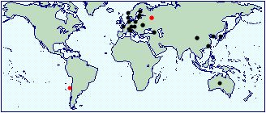
Global Distribution of the Tremex woodwasp
Widely distributed in Europe and Asia.
Introduced to Australia (1996) and Chile (2000)
Introduced to Chile in 2000
Caused agricultural damage from windbreak and lumber loss.
Image credits: Distribution map - http://www.cabi.org/isc/datasheet/54516
Notes:
Countries where Tremex woodwasp is established: Armenia, Austria, Bulgaria, Croatia, Czech Republic
Danish mainland, Denmark, Estoria, Finland, France, Germany, Hungry, Italy, Latvia, Norway, Poland, Romania, Russia, Slovokia, Sweden,Switzerland, The Netherlands, Ukriane, China, Japan, Korea, Taiwan, Australia, Iran, and Chile (4).
T. fuscicornis was introduced to Australia and found in 1996. It was also found to be introduced to Chile in 2000 (3).

Slide 4
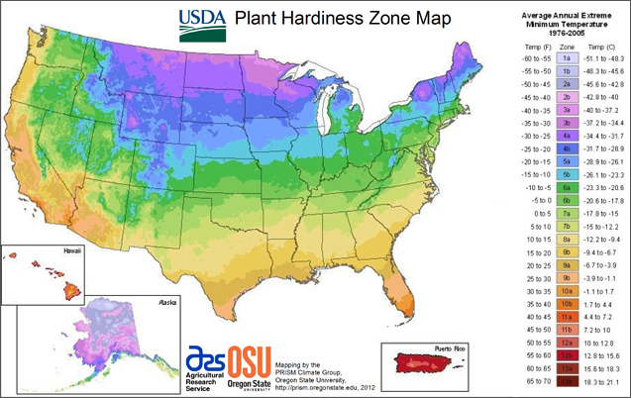
Distribution of the Tremex woodwasp in the U.S.
Could be introduced/not currently present.
Estimated survival in Plant Hardiness Zones 3 to 11
Most of the U.S. within this range
Image credits: Zone map – U.S. Department of Agriculture http://planthardiness.ars.usda.gov/PHZMWeb/
Notes:
From the 2011 USDA-APHIS-PPQ New Pest Response guidelines, it is estimated that Tremex woodwasp can survive in USDA Plant Hardiness Zones 3 to 11, based on distribution in Eurasia (4).
In 2012, Tremex woodwasp was found during a warehouse trapping in Elberton, Georgia. Early detection traps were placed in the area. There were no specimens collected in 2013 or 2014, so it does not appear to have established in the area yet (2).

Slide 5
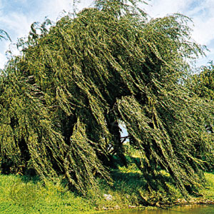
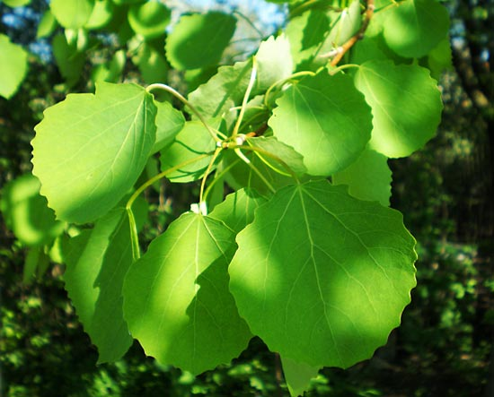
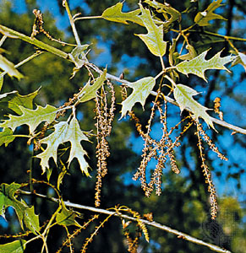
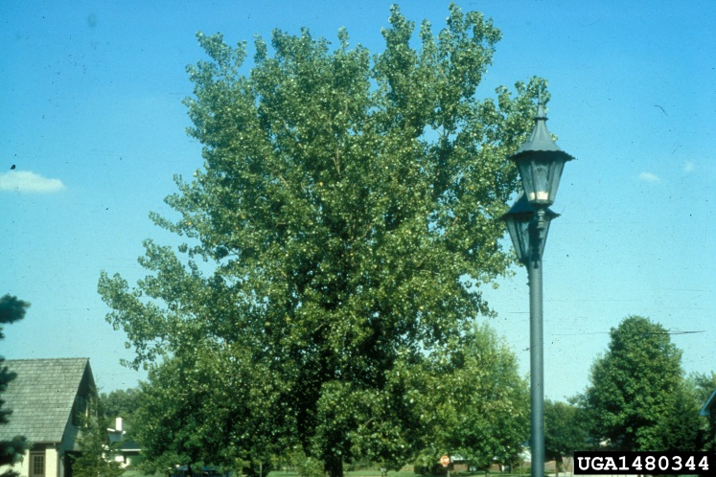
Pest of Broadleaf Trees
A very wide range of trees are hosts, including:
oak
poplar
Eastern cottonwood
apple
pear
maple
willow
Poplar
Willow
Oak
Eastern cottonwood
Image credits: Oak-Encyclopaedia Britannica-http://www.britannica.com/plant/oak Poplar-Encyclopaedia Britannica-http://www.britannica.com/plant/poplar Eastern cottonwood-Richard Webb-http://www.forestryimages.org/browse/detail.cfm?imgnum=1480344 Weeping willow-Encyclopaedia Britannica-http://www.britannica.com/plant/willow
Notes:
There is a very broad range of host plants identified that are present in North America (4).
Asteraceae
Boxelder (Acer negundo L.)
Norway maple (Acer platanoides L.)
Maple (Acer spp.)
Sugar maple (Acer saccharum Marsh.)
Betulaceae
Alder (Alnus spp.)
Japanese alder (Alnus japonica)
Birch (Betula spp.)
Downy birch (Betula pubescens)
European hornbeam (Carpinus betulus L.)
Fabaceae
Black locust (Robinia pseudoacacia L.)
Fagaceae
Beech (Fagus spp.)
European beech (Fagus sylvatica L.)
American beech (Fagus grandifolia Ehrh.)
Oak (Quercus spp.)
Juglandaceae
English walnut (Juglans regia L.)
Chinese walnut (Pterocarya stenoptera C.)
Hickory (Carya spp.)
Plantanaceae
American sycamore (Palatanus occidentalis L.)
Rosaceae
Apple (Malus spp.)
Pear (Pyrus spp.)
Prunus × yedoensis Matsum.
Salicaceae
Poplar (Populus spp.)
White poplar (Populus alba L.)
Eastern cottonwood (Populus deltoides Bartram ex Marsh.)
Lombardy poplar (Populus nigra L.)
European aspen (Populus tremula L.)
Willow (Salix spp.)
Weeping willow/Babylon willow (Salix babylonica L.)
Humboldt’s willow (Salix humboldtiana Willd.)
Ulmaceae
Japanese/Chinese hackberry (Celtis sinensis Pers.)
Elm (Ulmus spp.)
Japanese elm (Ulmus davidiana Planch. var. japonica)
Zelkova spp.
Japanese zelkova (Zelkova serrata Makino)
Sugerberry (Celtis laevigata Willd.)

Slide 6
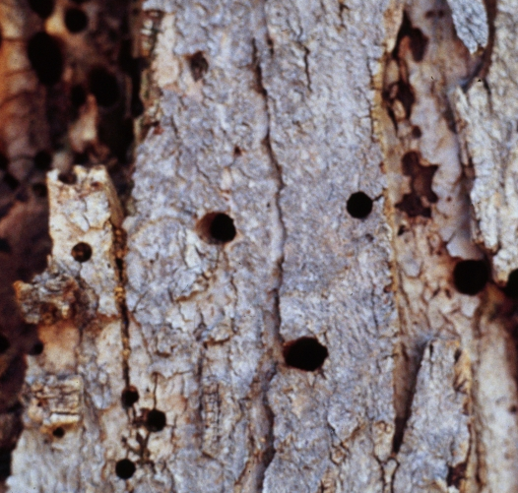
Damage
Look for:
Holes 5-6mm
Die back
Yellow, wilted, or dying leaves
Tree death
Image credits: Whitney Cranshaw, Colorado State University, Bugwood.org
Notes:
Adult wasp emergence from trees causes holes about 5 to 6mm in diameter (3). Boring larva damage the wood from feeding. The fungal symbiont of Tremex woodwasp causes wood decay. Trees may have dark patches on the bark from sap production caused by larval feeding. (7). Infected trees exhibit many symptoms such as reduced growth, yellowing leaves, wilting leaves, branch and crown dieback, loose bark, sapwood discoloration, leaf and trunk necroses, structural weakening, and tree death (1 and 4).

Slide 7
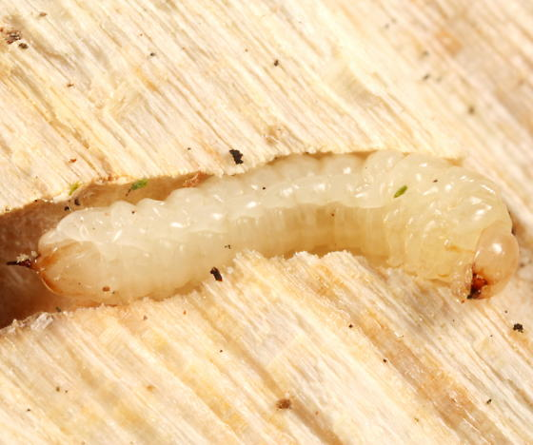
Identification
Larvae
Inside of tree in galleries
Cream colored
3-4cm long
Spine at the end of abdomen
Image credits: Charley Eiseman -T. columba larva - http://bugguide.net/node/view/36832/bgimage?from=24
Notes:
Larvae are cylindrical and cream colored. They have a semi-spherical head with mandibles, one-segmented antennae, and three pairs of prothoracic legs (7). They can be 3 to 4cm in length (3). The larva also have a distinctive spine at the end of the abdomen (1). Once hatched, the larva will burrow into the tree, creating galleries and feeding on the fungus Cerrena unicolor (8).

Slide 8
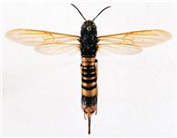
Identification
Adults
Males:
Females:
11-29mm long
Solid black
Metallic sheen
Brown wings
Thorn-like tergite
14-40mm long
Dark head and thorax
Orange-yellow abdomen with black banding
Light brown wings
Stout ovipositor
Image credits: http://www.cabi.org/isc/datasheet/54516
Notes:
Adults emerge from trees by chewing though the bark, creating circular exit holes (4). The males are completely black with dark brown wings (1). Their bodies have a metallic sheen and range from 11 to 29mm long. The end of the abdomen has a short, thorn-like tergite. Female wasps are larger than the males. They range from 14 to 40mm long (7). They have dark heads and thoraxes and light brown wings. The abdomen is an orange-yellow color with black banding (4). Females also have a long ovipositor at the end of the abdomen (1).

Slide 9
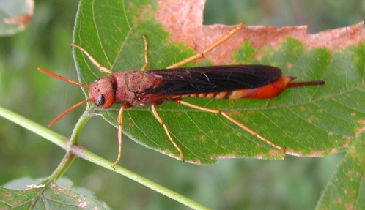
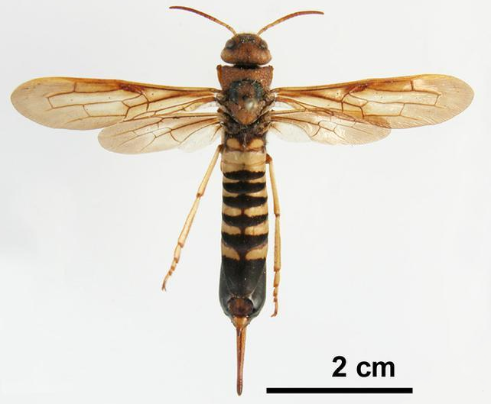
Lookalikes - Adults
Tremex columba –
Pidgon Tremex
Image credits: Pest and Diseases Image Library, Bugwood.org Image 2: Pennsylvania Department of Conservation and Natural Resources - Forestry , Bugwood.org
Notes:
The wasp Tremex fuscicornis is most similar in appearance to Tremex columba. T. columba, or Pidgon Tremex, is a common wood wasp that is native to North America. As both wasps are in the same genus, they can be difficult to tell apart. The key identifier to the species level is the distance ratio between posterior ocelli. Since this is difficult to determine, positive identification to species should be left to experts (4).

Slide 10
Life cycle
Eggs
Adult
Larvae
Pupae
Image credit: Larvae-Isenbrands www.poplar.ca/upload/documents/isebrands-richardson.pdf Adult female- Isenbrands www.poplar.ca/upload/documents/isebrands-richardson.pdf
Notes:
Not much is known about the Tremex woodwasp because most of the life cycle occurs within the trunk of a tree. In its native habitat, wasps select weakened or dying trees to oviposit. In Chile it was found to be capable of attacking healthy trees (4). Once females select a tree, they oviposit in the cambium layer. This also inoculates the tree with a phytotoxin and a white rot fungus, Cerrena unicolor. The females will lay between 300 to 400 eggs and will usually die in oviposition (7). The eggs are off-white and cylindrical (1). They are 1 to 1.2mm long and 0.2 to 0.25mm wide. Eggs are placed perpendicularly and at an oblique angle, so that they are separate in the wood, but grouped together. The larvae will hatch in 3 to 4 weeks and will feed on the hyphae of C. unicolor. Later, they will tunnel into the tree toward the xylem, creating galleries. When the larvae reaches the final instar, they will tunnel to the edge of the tree to pupate (7). They usually pupate about 4cm from the bark surface. The pupae are about 3cm long (1). They begin cream colored, but darken as they mature. Eventually they take on adult colorations (7). Wasps are univoltine, have a single generation a year, but may complete their life cycle in 5 months under optimal environmental conditions. The sex ratio is usually 1:1 (7). Adult wasps often mate in the upper branches of trees (4). Based on other wasps in the same family, adults do not feed, and live only long enough to mate and lay eggs (1).
Larvae will pupate inside the tree within the galleries (4). The pupae are about 3 cm long (1). They begin cream colored, but darken as they mature. Eventually they take on adult colorations (7).

Slide 11
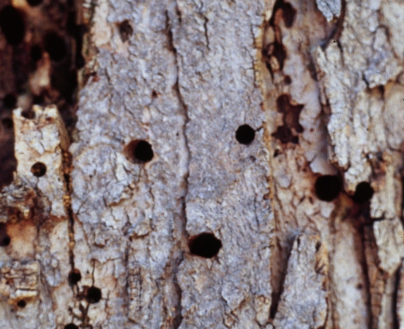
Monitoring
Watch out: 5-6mm holes
Watch out: Tree yellowing and death
Watch out: Larvae galleries and exit holes
Image credits: Whitney Cranshaw, Colorado State University, Bugwood.org Poplar tree windrow damage-P. Parra www.poplar.ca/upload/documents/isebrands-richardson.pdf Larvae galleries - Isenbrands www.poplar.ca/upload/documents/isebrands-richardson.pdf
Notes:
Adults are strong fliers, though not much is known on the exact distance they can travel. Most likely, introduction will occur by contaminated wood products. Larvae and pupae can be unintentionally transported by wood products. Things such as wood pallets or firewood should be monitored for insects and signs such as holes and larval galleries. Bait trees or trap trees can be used to monitor for adults. These trees are injected with herbicides or are girdled to stress the tree and attract the wasp. Trap trees should be placed in areas that are at a high risk for infestation, as trap trees are labor intensive. Recently dead or dying trees should be inspected for insects. At risk trees, or trees that are close to shipping and trade ports, should be monitored for signs of infestation. Signs to look for include: yellowing of leaves near the crown, presence of wasps near the crown, detached ovipositors on the bark, 5 to 6 mm exit holes in the bark, and poor or stunted tree growth. Suspect insects should be submitted for identification (4).

Slide 12
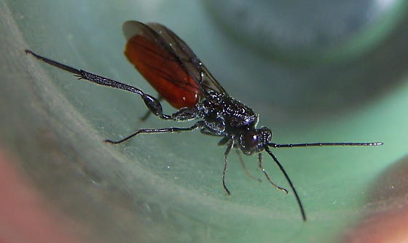
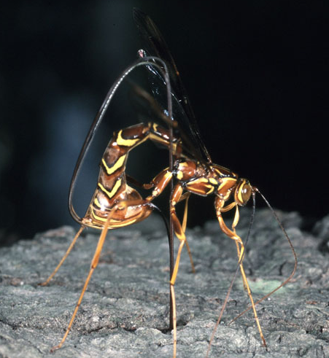
Biological Control
Nematodes
Neotylenchidae
Deladenus proximus
Deladenus siricidicola
Hymenoptera
Ibalia leucospoides
Ibaliidae
Ibalia drewseni
Ibalia leucospoides
Ibalia jakowlewi
Ichneumonidae
Megarhyssa spp.
Megarhyssa macrurus
Image credits: I. leucospoides wasp –Brandon Woo http://bugguide.net/node/view/567306 Megarhyssa - Jim Occi, BugPics, Bugwood.org
Notes:
As there are no known chemical controls for Tremex fuscicornis, biological controls are more effective. One method is the use of nematodes (4). For example, Deladenus proximus is a nematode native to the United States that controls the Eastern wood wasp Sirex nigricornis. This wood wasp is a relative of Tremex, so similar controls may be effective (9). Ongoing research is assessing nematode efficancy against T. fuscicornis. Other controls for Tremex are Ibalidae Ibalia drewseni, Ibalidae Ibalia leucospoides, Ibalidae Ibalia jakowlewi, Ichneumonidae Megarhyssa spp., and Neotylenchidae Deladenus siricidicola (4).

Slide 13
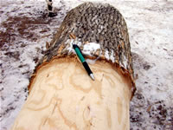
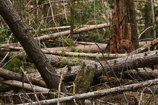
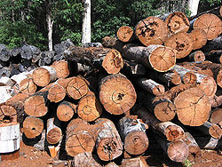
Cultural Control
Keep trees healthy
Destroy infected plants and materials
Treat infected wood
Prevent wood from becoming infected
Debark trees to prevent insect infestation
Remove dead trees to prevent infestation
Prevent infestation by rapid processing and water sprays
Remove and destroy infected trees.
Image credits: Debarked tree - USDA http://www.nrs.fs.fed.us/disturbance/invasive_species/eab/control_management/debarking/ Fallen trees – Wikipedia https://en.wikipedia.org/wiki/Large_woody_debris Logs for processing – Wikipedia https://en.wikipedia.org/wiki/Lumber
Notes:
There are multiple cultural controls for Tremex wood wasp. Preventative measures include keeping trees and plants healthy by watering and thinning. Infected plants should be destroyed. Infected lumber materials should be treated or removed and destroyed. Treatments of wood products include fumigation or exposure to high temperatures to kill eggs, larvae, and pupae. Preventative practices such as debarking, rapid processing, and storage under water sprays should be used to prevent wasp attacks in saw mills (1).

Slide 14
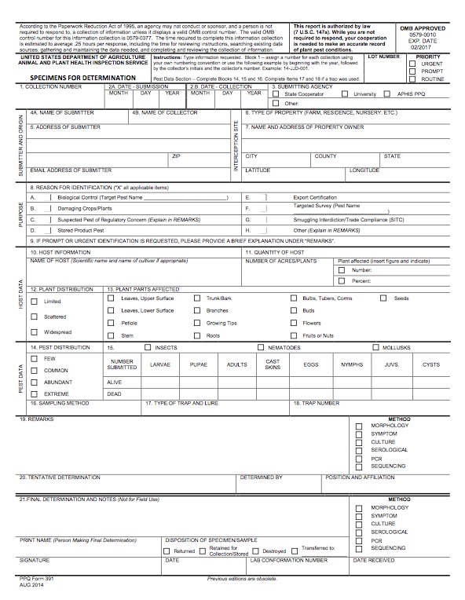
Suspect Sample Submissions
Contact your State Department of Agriculture or University Cooperative Extension laboratory
  http://www.npdn.org/home
PPQ form 391, Specimens for Determination
  https://www.aphis.usda.gov/library/forms/pdf/PPQ_Form_391.pdf
An example of a PPQ form for sample submissions
  Image credits: https://www.aphis.usda.gov/library/forms/pdf/PPQ_Form_391.pdf
Notes:
If a suspect pest has been located in the United States, a sample should be submitted for proper identification. Contact your local diagnostic lab to ship in a sample for identification. Information regarding your local diagnostic lab is available at National Plant Diagnostic Network (NPDN) website. The diagnostic lab information and available contacts are divided by state.
http://www.npdn.org/home
The sample specimen should be submitted along with accompanying documentation using the PPQ form 391.
https://www.aphis.usda.gov/library/forms/pdf/PPQ_Form_391.pdf
Your local diagnostic lab is part of your local cooperative extension service or your state department of agriculture. Your local lab will also have a specific form. All local labs may not be a member of NPDN. However, all labs should report new pest and pathogen detections to local regulatory officials.

Slide 15


Communications
Contact your State Plant Health Director
  https://www.aphis.usda.gov/aphis/ourfocus/planthealth/ppq-program-overview/ct_sphd
Contact your State Plant Regulatory Official
  http://nationalplantboard.org/membership/
  Image credits: http://www.usda.gov/wps/portal/usda/usdahome; http://nationalplantboard.org/
Notes:
Remember that new pest and pathogen records must be reported to your State Plant Health Director (SPHD) and your State Plant Regulatory Official (SPRO). The SPRO is a State Department of Agriculture Employee and the SPHD is a USDA-APHIS-PPQ employee.
The link to your SPRO is on the National Plant Board (NPB) website. It has an interactive map and when you click on your state it will take you to another page with contact information. The NPB is a cooperative organization that includes membership from all State Departments of Agriculture.

Slide 16
Author and Publication Dates
Brianna Whitman, B.S.
  Laboratory Technician, Department of Entomology and Nematology, University of Florida
Amanda Hodges, Ph.D.
  Associate Extension Scientist, Department of Entomology and Nematology, University of Florida
  Publication date: October 2016

Slide 17
Reviewers
Catherine A. Marzolf
  Assistant State Plant Health Director, USDA APHIS PPQ

Slide 18
Educational Disclaimer and Citation
This presentation can be used for educational purposes for NON-PROFIT workshops, trainings, etc.
Citation: Whitman, Brianna and Amanda Hodges. 2016. Tremex woodwasp – Tremex fuscicornis.
Accessed (add the date)
www.protectingusnow.org

Slide 19

Our Partners
United States Department of Agriculture, National Institute of Food and Agriculture (USDA NIFA)
United States Department of Agriculture, Animal and Plant Health Inspection Service, Plant Protection and Quarantine (USDA APHIS PPQ)
Cooperative Agriculture Pest Survey (CAPS) Program
National Plant Board (NPB)
States Department of Agriculture
Extension Disaster Education Network (EDEN)
Center for Invasive Species and Ecosystem Health (Bugwood)
National Plant Diagnostic Network (NPDN)
U.S. Department of Homeland Security (DHS)
U.S. Forest Service (USFS)

Slide 20
References
1. Anonymous. 2015. Tremex fuscicornis (Tremes wasp). Invasive Species Compendium. Accessed 5/3/16.
  http://www.cabi.org/isc/datasheet/54516
2. Bates, Chip, Mark McClure, Lynne Womack, and Chris Barnes. 2014. Georgia’s Forest Health Highlights Report. Forest Health Program, Geogia Forestry Commission. Accessed 5/3/16.
  http://www.fs.fed.us/foresthealth/fhm/fhh/fhh_14/GA_FHH_2014.pdf
3. Ciesla, William M.. 2003. Tremex fuscicornis. Pest Reports-EXFOR Database-Purdue University. Accessed 5/3/16. download.ceris.purdue.edu/file/316.
4. Department of Agriculture, Animal Plant Health Inspection Service, Plant Protection and Quarantine. 2011. New Pest Response Guidelines: Tremex Wood Wasp (Tremex fuscicornis(F.)).Washington, D.C.: Government Printing Office. Accessed 5/2/16.
  http://www.aphis.usda.gov/import_export/plants/manuals/online_manuals.shtml
5. FAO. 2008. Forest Health & Biosecurity Working Papers, Overview of Forest Pests, Chile. FAO, Rome. Accessed 5/3/16.
  http://www.fao.org/docrep/012/ak830e/ak830e00.pdf

Slide 21
References
6. Hardin, Jesse A.. 2013. Tremex fuscicornis (Fabricius) New Pest Response Guidelines. NCSU Center for Integrated Pest Management. Accessed 5/3/16.
  https://www.apsnet.org/meetings/topicalmeetings/NPDRS/Documents/2013/J.%20Hardin.pdf
7. Isebrands, J.G., and J. Richardson. 2014. Poplars and Willows Trees for Society and the Environment. The Food and Agriculture Organization of the United Nations and CABI. Acessed 5/3/16.
  www.poplar.ca/upload/documents/isebrands-richardson.pdf
8. Pazoutova, Sylvie, and Peter Srutka. 2007. Symbiotic relationship between Cerrena unicolor and the horntail Tremex fuscicornis recorded in the Czech Republic. Czech Mycol. 59(1): 83-90.
  http://www.czechmycology.org/_cm/CM59107F.pdf
9. Zieman, Elliot A.. 2011. Distribution and Genetic Structure of Deladenus proximus, a Nematode Parasite of the Woodwasp Sirex nigricornis in the Eastern United States. Southern Illinois University Carbondale.

