Slide 1
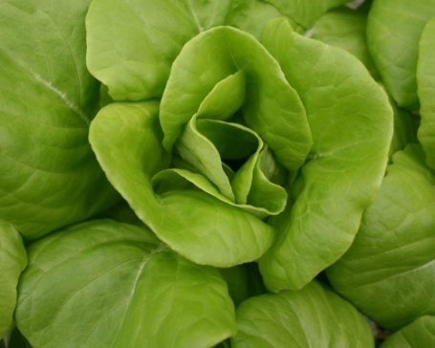
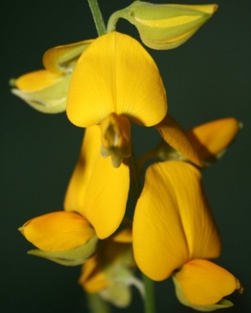
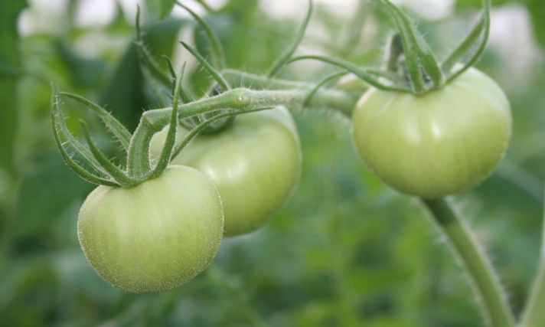

Integrating Cover Crops in Florida Vegetable Production Systems
Danielle Treadwell, Asst. Prof
Horticultural Sciences Dept
ddtreadw@ufl.edu

Slide 2
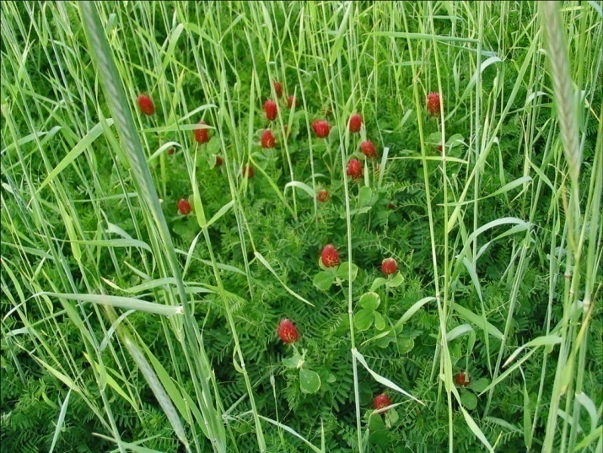
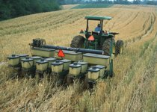
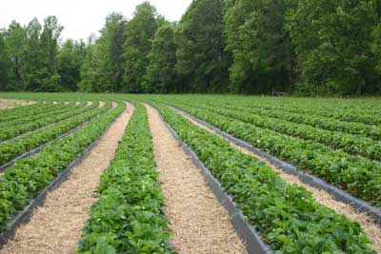
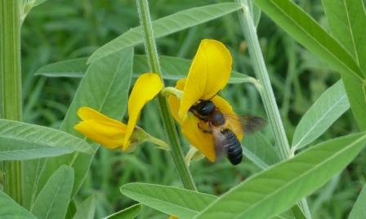
Cover Crops on the Farm
Notes:
Cover crops bring costs and benefits, internal and external, short term and long term to the farm.

Slide 3
Cover Crop Overview
A cover crop should:
  satisfy the producer's main objective
  be easy to establish with minimal to no inputs
  be managed with equipment and labor resources at hand
  not compete with the vegetable crop
  perform well in adverse conditions
Enache and Illnicki, 1990. Weed Technology

Slide 4
Integrating Covers on Your Farm
Identify your objective
Identify the best place and time
Verify the equipment, labor, and environmental conditions will support a cover crop
Select the best species
Settle for the best available species
Build a rotation around cover crops

Slide 5
Identify your objective

Slide 6
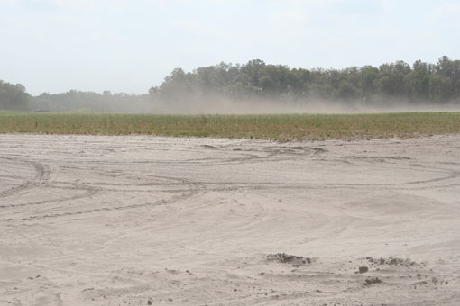
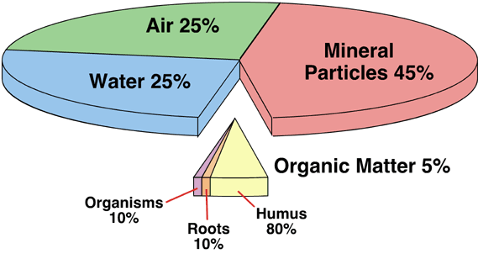
Objective: Soil and Water Quality
Protect soil from water and wind erosion
(Van Doren et al., 1984)
Add organic matter
to soil
(Wander et al., 1994; Doran et al., 1998)
Improve soil structure and water infiltration
(Blevins et al., 1971)
Notes:
Cover crops can fulfill many different objectives.
The photo shows a bare fallow field (behind the field planted) exposed to late summer winds in Citra, FL

Slide 7
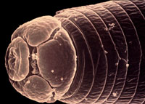
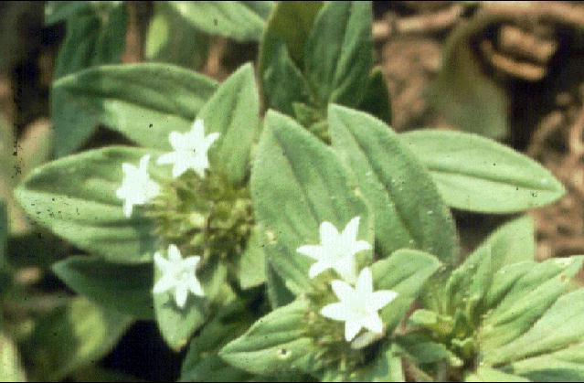
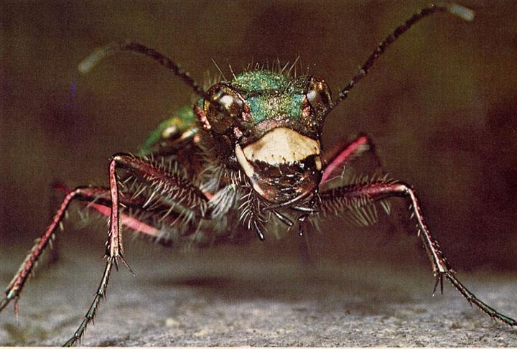
Objective: Pest Suppression
Suppress nematodes
(Gallaher and McSorley, 1993)
Suppress weeds
(Liebman and Dyck, 1993; Cardina et al., 2002)
Attract beneficial organisms
(Landis et al., 2000; Jacometti et al., 2007)
Root-knot nematode
FL Pusley
Tiger beetle (Cicindelidae) (McEuwan)
Notes:
Additional objectives

Slide 8
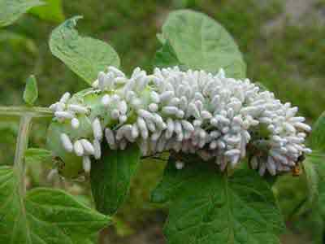
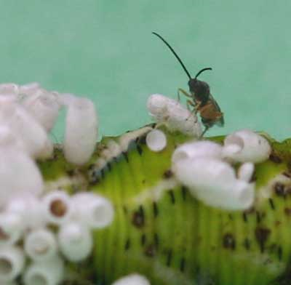
Mechanisms of Pest Suppression
  Attraction of beneficial predators and parasites
  Preemptive use of resources
    Sunlight
    Nutrients
    Water
  Allelopathy (plant toxins)
    Terpenoids
    Phenols
    Alkaloids
Photos by Debbie Roos,
Chatham County Extension, NC
Notes:
Warning – stands that are slow to establish provide opportunity for weeds – prepare a contingency plan if your seed does not establish.
Cover crops can withstand cultivation if needed.
Weed suppression is density dependant. You should aim for 2-5 tons of biomass per acre dry weight for best weed suppression.
Photo shows a parasitic wasp on a hornworm.

Slide 9
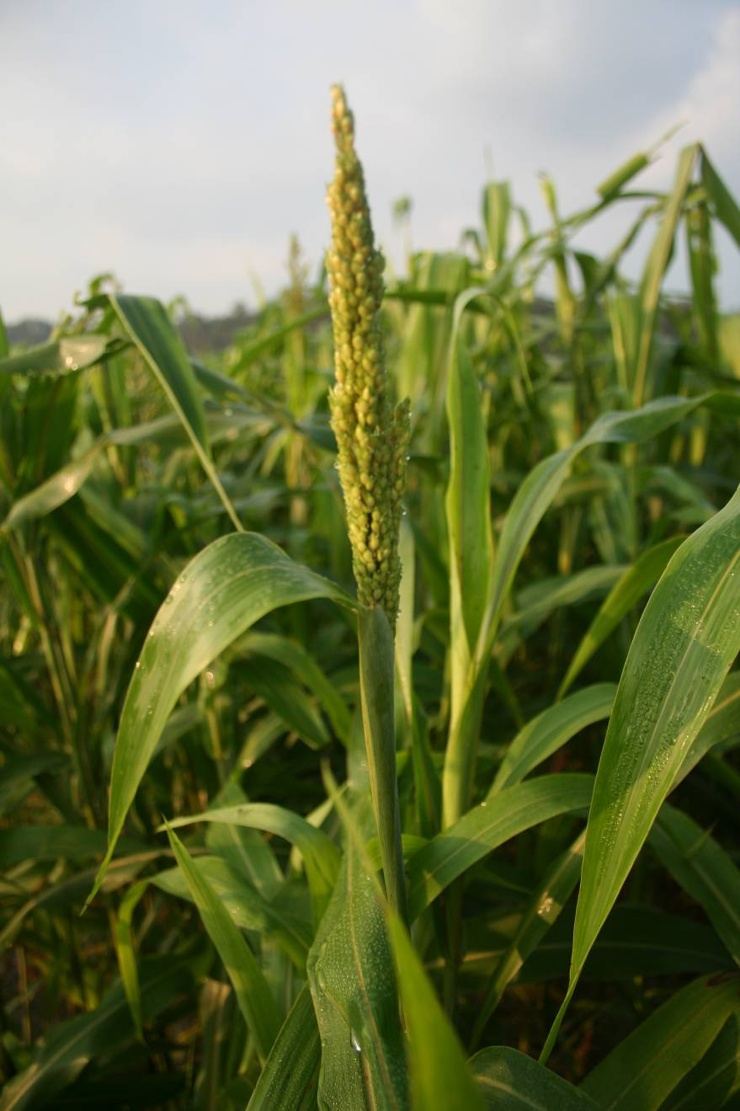
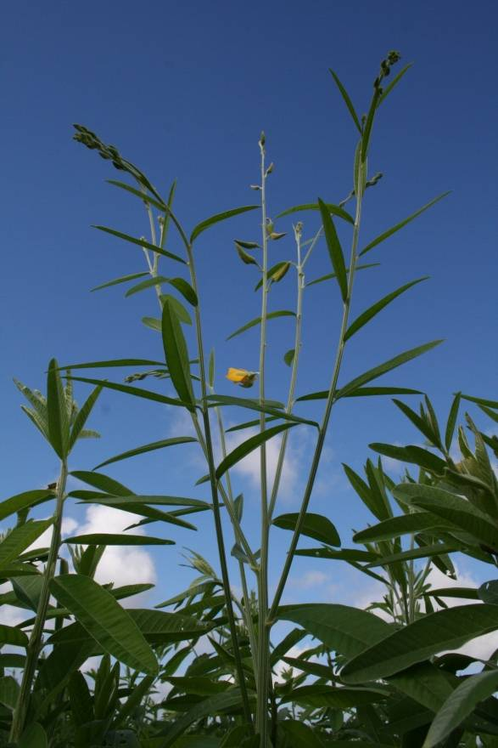
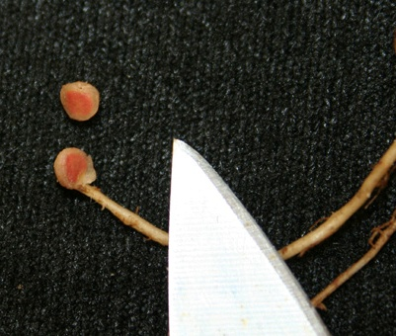
Objective: Nutrient Cycling
Add or conserve nitrogen
(Wagger, 1989; Shipley et al., 1992; Snapp, 2001)
Sunn hemp – a tropical legume
Deep-rooted cereals use nutrients in lower soil horizons
Rhizobia nodules
Notes:
Legumes like alfalfa form symbiotic relationships with soil bacteria Rhizobia. Rhizobia turn nitrogen from the atmosphere into a form that plants can use.

Slide 10
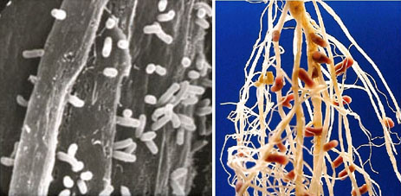
Rhizobium sp. on clover
Photo: K. Todar, Univ. Wisconsin
1 package of inoculant treats about
1,000 pounds of seed.
Notes:
Researchers have reported a density of 2 billion bacteria per gram of soil (E. Ingham).
Legumes do not release N into the soil while they are actively growing. Rather, the nitrogen is stored in their tissues and is released through the process of decomposition after the crop is terminated. Nitrogen is released from residues that remain on the surface at a lower rate than residues that are incorporated into the soil.

Slide 11
How to Estimate N from Cover Crops
1. Yield (lb/acre) = Total weight of dry sample (lb) X 43,560 sq ft
____________________________________ ________________
Area sampled (sq ft) 1 acre
2. Estimate Nitrogen
Total N (lb/acre) = Yield (from above) X amount of N as a decimal ( %N ÷ 100)
3. Nitrogen Content of Cover Crops – Use the table values to estimate N.
Cover Crop Group | Percent (%) N at Cover Crop Growth Stage
 | Before Flowering | Early Flowering | Early Seed Set | Mature Seed
Non – Woody Legumes | 3.5 – 4.0 | 3.0 – 3.5 | 2.0 | 1.5
Woody Legumes | 2.5 – 3.0 | 2.0 – 2.5 | 1.0 | 0.75
Cereal Grains and Others | 2.0 – 3.0 | 1.5 2.5 | < 1.0 | < 1.0
Adapted from Sarrantonio, 2001
Notes:
This approach is useful when estimating nitrogen credits to the subsequent crop. Keep in mind that nitrate in soil solution will continue to move downward with precipitation and irrigation, just as nitrate from conventional fertilizer moves.

Slide 12
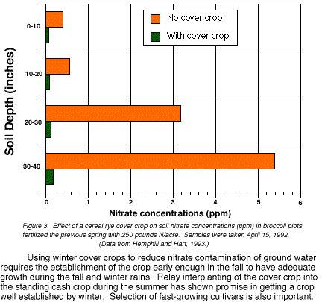
Cover Crops Retain N in the Soil
J. Luna, OSU, Corvallis
Notes:
This graph shows the movement of nitrate in the soil, facilitated by precipitation and irrigation. Notice that with a cover crop, there is very little nitrogen in the soil (green bars). That is because the nitrogen is in the plant tissues of the cover crop. The orange bars show the increase in soil nitrogen without a cover crop. The downward movement of nitrate is typical of what we see here on our sandy soils in FL.
These authors make the point that by decreasing the amount of time from cash crop termination and soil incorporation and cover crop establishment, the risk to water quality is reduced because the nitrogen in soil solution is more quickly used by the cover crops. They used a method called relay interplanting, in which cover crops are planted even before the final harvest, or immediately after harvest, leaving cash crop residue on the soil surface using a no-till drill.

Slide 13
Summer Cover Crops Homestead, FL 1998 | Seeding Rate | Harvest Weight 30 dap | Harvest Weight 90 dap | Total N
 | (lb/acre)
Sunn hemp | 20 | 10,030 a | 9,900 a | 248
Sorghum Sudan | 20 | 3,700 b | 3,700 b | 33
Aeschynomene | 20 | 3,100 bc | 4,500 b | 108
Sesbania | 20 | 1,600 c | 1,700 b | ---
P ≤ .05
Summer cover crops for tomato production in South Florida. Li, Bryan, Rao, Heckert, Olczyk. http://www.imok.ufl.edu/veghort/pubs/workshop/Bryan99.htm
Notes:
Table showing some typical biomass production rates observed by FL researchers.
DAP = days after planting. 90 days after planting is a bit long for most growers. Typically, covers are terminated at about 6 weeks, or 50-60 DAP.
These cover crops were seeded in July 15, and terminated Oct 15.
http://www.imok.ufl.edu/veghort/pubs/workshop/Bryan99.htm

Slide 14
Cover Crop Dry Wt, C:N and N, 2007
Cover Crop | Dry Wt (kg ha⁻¹) | C:N | Total N (kg ha⁻¹)
Pearl Millet | 5953 a | 29 bcd | 87 ab
Sorghum Sudangr. | 3064 b | 38 a | 35 d
Sunn Hemp | 3170 b | 16 f | 93 a
Velvet Bean | 118 c | --- | ---
Millet + Sunn Hemp | 4121 b | 23 de | 77 abc
Sunn Hemp + V Bean | 3660 b | 31 abc | 54 bcd
Treadwell, D.D., M.A. Alligood, C.A. Chase, M. Bhan. 2008. Soil nitrogen responses to increasing crop diversity and rotation in organic vegetable production systems. HortScience. 43:1107.
Notes:
In a 2-year USDA-funded trial, six vegetable production systems were tested to determine the effect of cover crop on crop quality, yeild, and pest management.
Grasses can be just as effective as legumes in returning N to the soil.
(the letters within columns signify differences among treatments. Results with the same letters are not significantly different at P = 0.05 according to Fisher’s protected Least Significant Difference.)

Slide 15
Objective: Increased Yield/Net $
In dry years, corn yields higher in conventional corn-cover crop rotations than just corn alone (Lotter et al., 2003)
Consistent use of covers enhances yield potential via increased aeration and water and nutrient holding capacity (Snapp et al., 2007)
Reduced fertilizer and pesticide costs
  (Hutchinson and McGiffen, 2000; Davis et al., 2001)
Notes:
Some examples of cover crops that improved production systems.

Slide 16
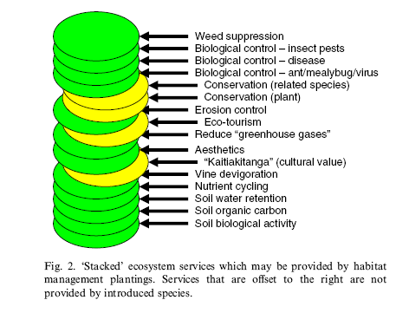
Ecosystem Services Research
Supporting
  Nutrient, water cycling
Provisioning
  Biochemicals
Regulating
  Climate, pests, water quality
Cultural
  Aesthetic, heritage
Fiedler, D. Landis and S. Wratten. 2008. Maximizing
ecosystem services from conservation biological
control: The role of habitat management.
Biological Control. 45:254-271
Notes:
In the farming system, cover crops contribute to the agro-ecosystem in many ways, sometimes in more ways than the farmer originally planned for.

Slide 17
Identify the Best Time and Place
Notes:
So just how do we get these benefits? Planning is key!

Slide 18
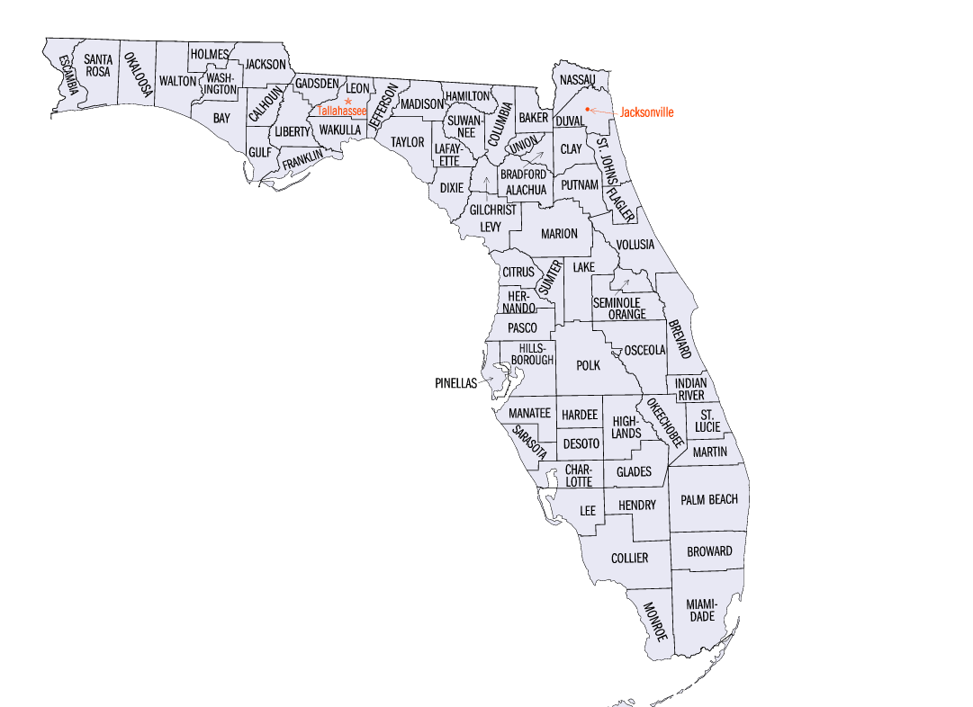
Cover Crops in Florida Vegetables
Suwannee Valley:
Winter cover crop rye →
Spring watermelon →
Summer greens →
OR
Winter cover crop rye →
Spring tomato →
Summer fallow →
Fall cucurbit
Hastings:
Winter cabbage →
Spring potato →
Summer cover crop sorghum
Hillsborough County:
Winter strawberry →
Spring water/muskmelon →
Summer cover crop sorghum
Notes:
Some examples of when vegetable producers are using cover crops in their rotations. Note predominantly monoculture grasses, and remind farmers that cover crops should be rotated, just like cash crops, to avoid build up of pathogens and harmful insects.
Suwannee:
Winter rye – tomato – summer fallow – fall cucurbit
Winter rye – spring watermelon – summer greens
Winter rye – spring watermelon – summer southern peas
Winter rye – spring green beans – summer fallow – fall pickling cukes
Hendry:
Winter tomato – spring tomato – summer sorghum – fall tomato
Winter bell pepper or sweet corn – spring snap beans (OCT – APR)
Hillsborough:
Winter strawberry – spring watermelon or muskmelon or squash – summer cover crop
Winter tomato or bell pepper – spring watermelon – summer cover crop

Slide 19
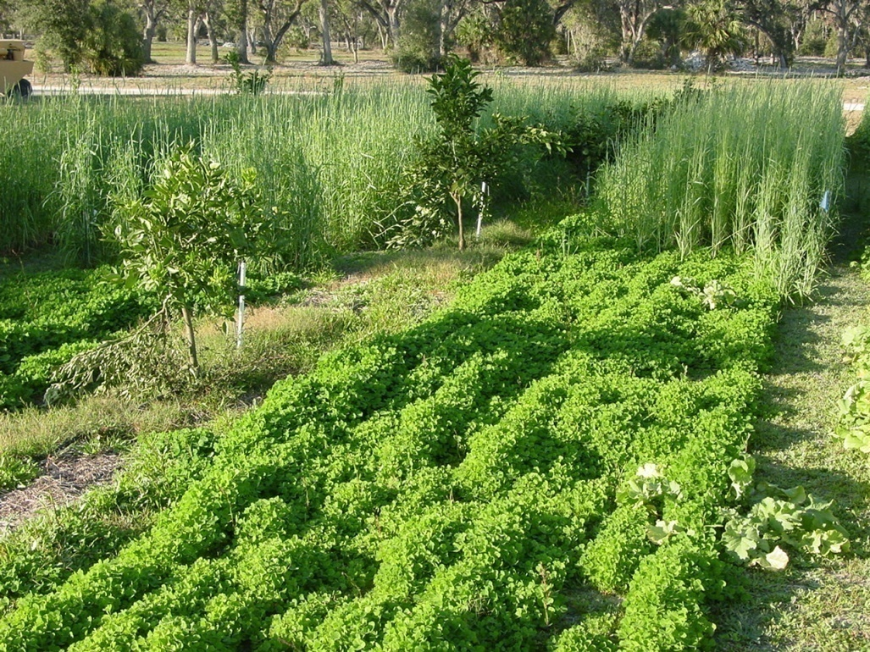
Living Mulches
Prevent sandblasting of transplants (Hochmuth et al., 2001.)
Suppress weeds in row middles
  (Chase et al., 2005)
  Supply nitrogen to crop
  (Scholberg et al., 2004)
Reduce insect pests vs. plastic mulch (Frank and Liburd, 2005)
Living mulches in citrus.
J. Scholberg, UF-IFAS.
Notes:
Living mulches are cover crops planted at the same time as other crops. A number of researchers have documented benefits of living mulches in perennial and annual cropping systems. This photograph shows cover crops planted to row middles of organic citrus at the UF-IFAS Plant Science Research and Education Unit in Citra, FL. This is different from relay intercropping, when the lifecycle of two crops overlaps for only a short time at harvest/planting.

Slide 20
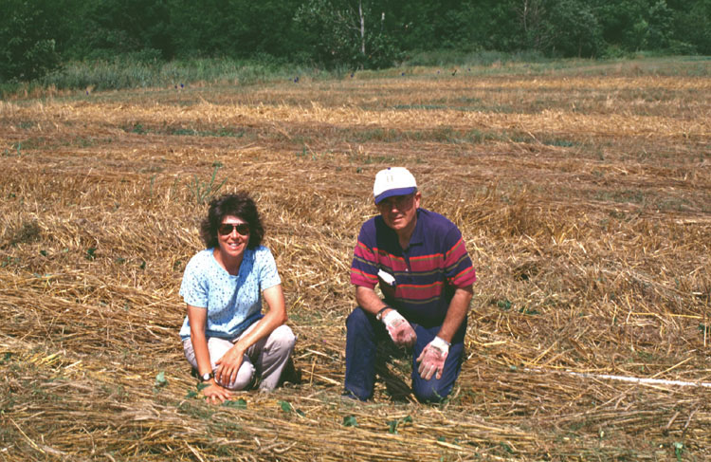
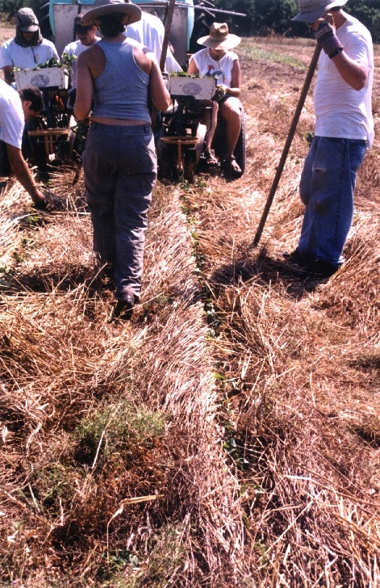
Reduced Tillage
D. Treadwell and Prof. Ron Morse, Virginia Tech in reduced-tillage sweetpotatoes.
Treadwell, D.D., et al. 2008. Nutrient Management With Cover Crops and Compost Affects Development and Yield in Organically Managed Sweetpotato Systems. HortScience. 43 (5):1423-1433
Treadwell, D. et al. 2007. Cover Crop Management Influences Weed Suppression in Organically Managed Sweetpotato Systems. Weed Technology 21:1039-1048.
Notes:
Reduced tillage is an emerging production system, especially for vegetables. Here, sweetpotatoes are shown tranplanted into a winter cover crop of hairy vetch and rye that was terminated with a roller-cripmer. This photo is from Treadwell’s graduate work in North Carolina.

Slide 21
Assess Equipment, Labor, and Other Costs

Slide 22
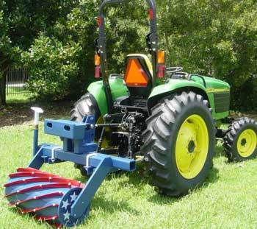
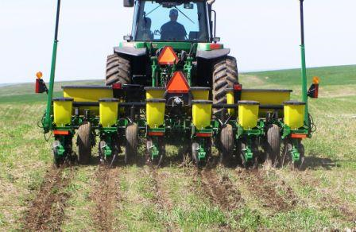
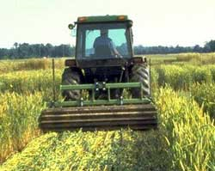
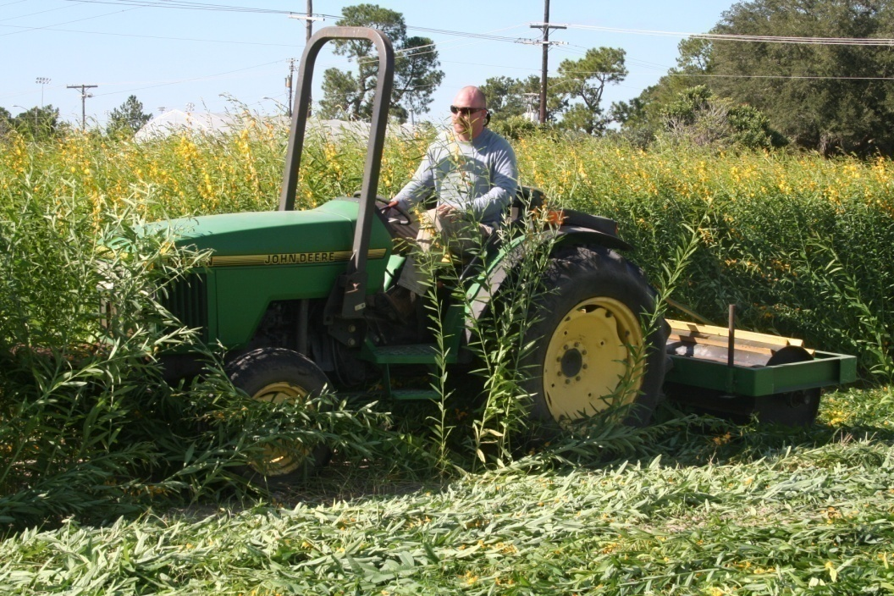
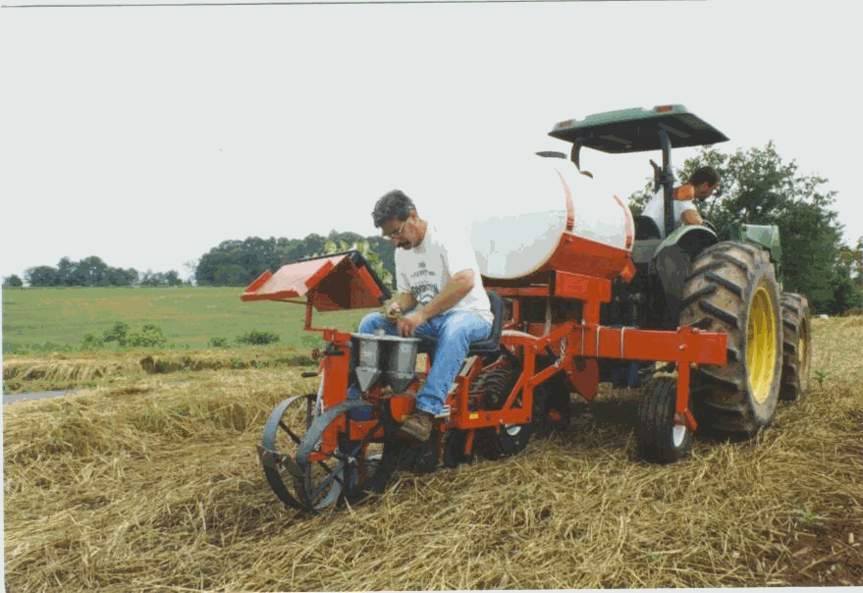
Costs: Increased Direct and Seasonal Costs
Notes:
Farmers and researchers everywhere are designing equipment to facilitate the integration of covers into their farming systems.
Captain America, Randy Raper, USDA ARS Soil Dynamics Lab, Auburn, AL (upper left)
The Alabama slammer: Alabama roller built by Dr. Wayne Reeves of USDA-ARS (upper middle)
North Dakota no till planter (upper right)
UF-IFAS roller crimper, Danielle Treadwell, Horticultural Sciences (Bottom left)
No-till vegetable transplanter

Slide 23
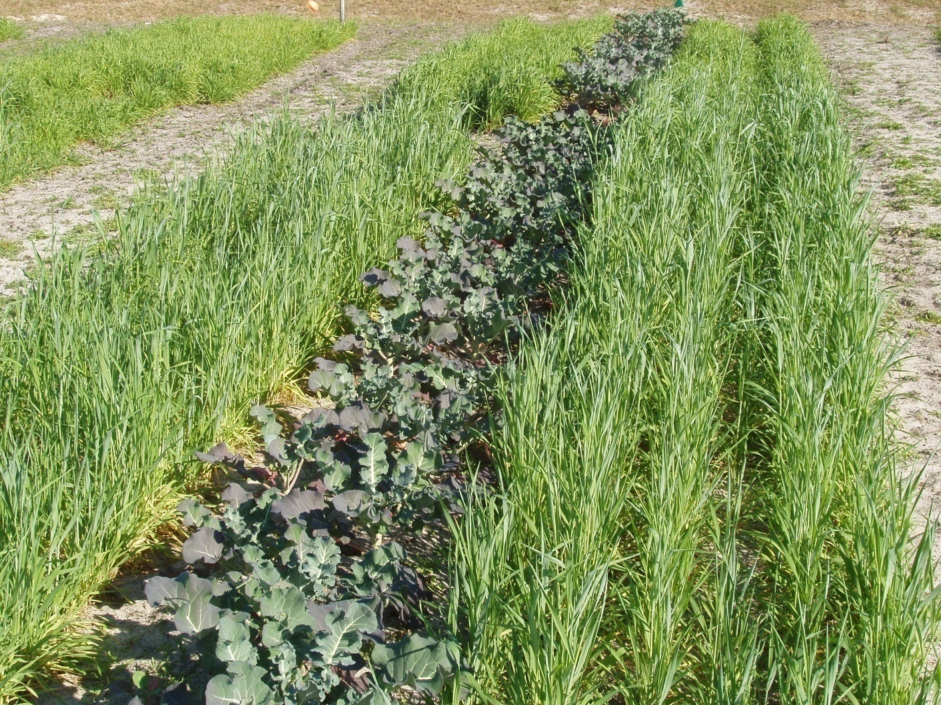
Costs: Potential for Reduced Income
Broccoli with a living mulch of winter rye.
Note the P deficiency in broccoli.
Notes:
At times, cover management can interfere with water and nutrient uptake in the income-producing crop, as illustrated here with rye and broccoli. Avoid negative impacts by ensuring adequate resources including light, nutrients and moisture are available for both cover crops and cash crops.

Slide 24
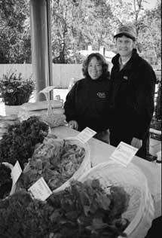
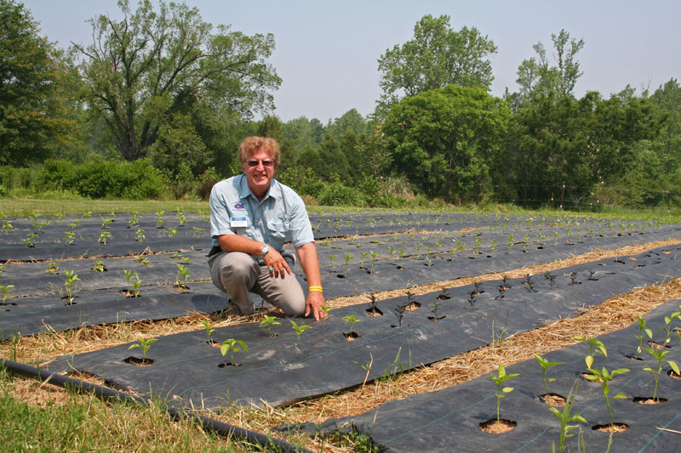
Costs: Slow Soil Warming
Photo by SSWAG
Robert Kluson, Sarasota Co. Extension, at Peregrine Farm, Chatham Co. , NC
May 2007. Bell peppers transplanted into winter hairy vetch and rye.
Notes:
Additional concerns about slow soil warming with crop residue, especially in spring crops planted into a winter cover were creatively resolved by Alex and Besty Hitt from NC by adding black landscape fabric over the top of cover residue. This increased soil temperature and facilitated crop establishment.

Slide 25
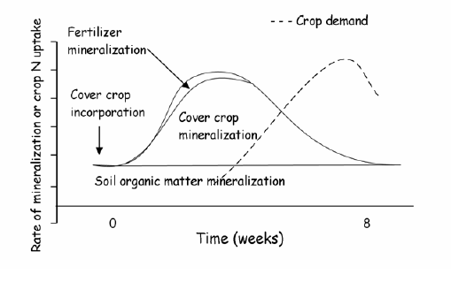
Timing of N mineralization from soil organic matter, cover crop residue, and organic fertilizer relative to crop demand.
Cost: Difficulty Predicting Nitrogen Mineralization
Gaskell et al., 2006
Notes:
Note that cover crop N mineralization can occur ahead of peak crop demand. Synchronizing plant available N and crop demand is one of the biggest challenges of depending on organic sources of fertility.

Slide 26

Other Costs of Cover Crops
Depletion of soil moisture
(Khimba et al., 2008)
Temporary decrease in nutrient availability (Cher et al., 2006)
Increased weed occurrence (Buhler 1992; Mohler and Calloway, 1992)
Increased labor and other costs (Triplett et al., 2002)
Allelopathic effects
(Singh et al., 2003; Summers et al., 2009)
Notes:
Other potential negative impacts of cover crops are listed here, but these can be avoided with good management practices.

Slide 27
Identify the Best (or suitable) Species

Slide 28
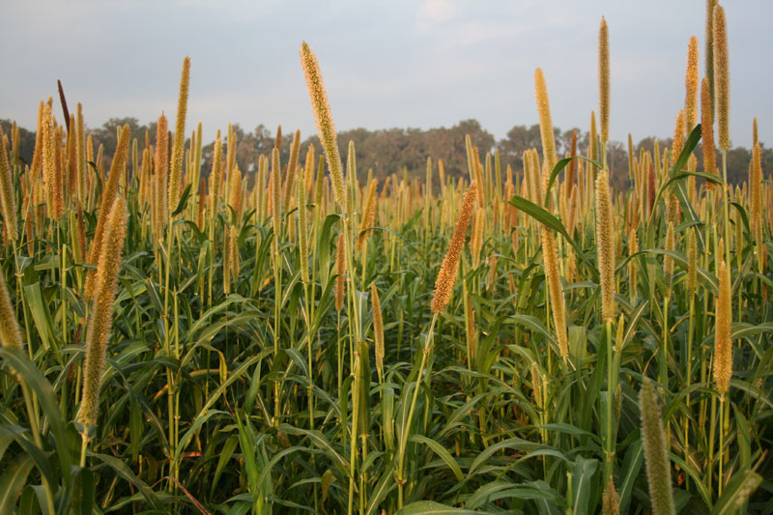
Monocultures
  Advantages
  Easy to manage
  Maximum support for a main objective
  Contingency plan easier to implement
  Disadvantages
  Low diversity reduces total number of benefits fulfilled
Photo Danielle Treadwell, UF-IFAS
Notes:
In the photo – Pearl Millett.

Slide 29
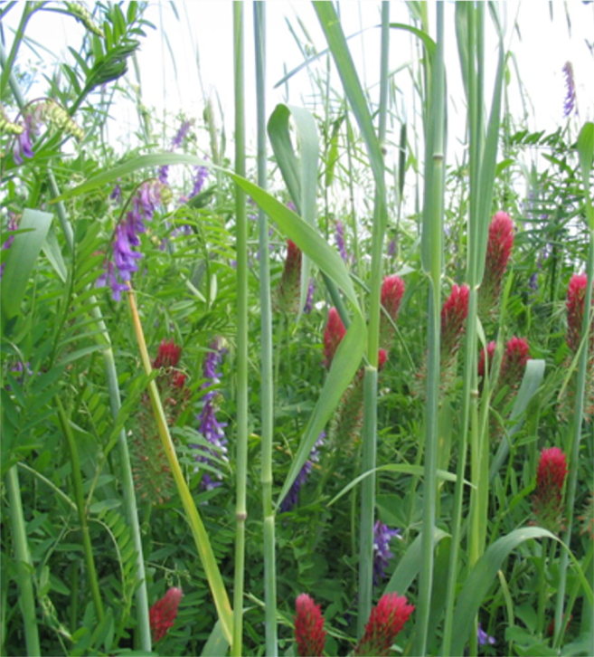
Polycultures
  Advantages
  Minimize risk
  Cereals provide support for climbing legumes
  Multiple objectives
  Disadvantages
  Compromise objectives
Photo by: Corey Cherr, UF Dept. Agronomy
Notes:
Special considerations for polycultures include coordinating timing of kill for N contribution. When cereals are mixed w/legumes, they may not both be ready for kill at the same time. Optimal kill time for N max N is midbloom.
Sole stands of some winter legume spp. Are slow to establish, this provides opportunities for weeds. Weeds can be alternate hosts to insects and diseases.

Slide 30
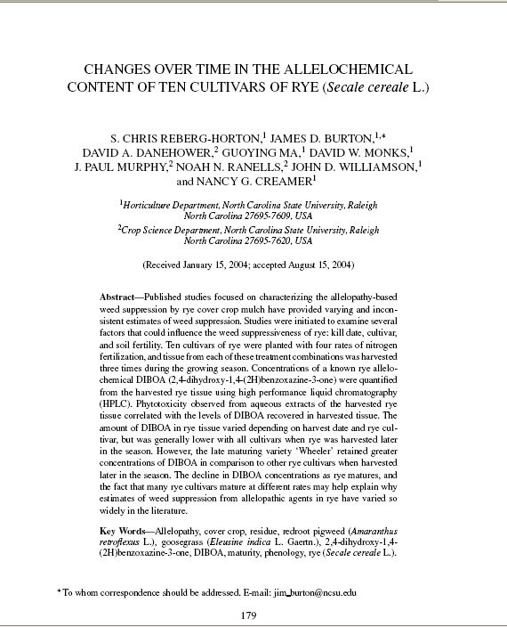
Species Selection – Germplasm
Few breeding programs in US for cover crops
  Cultivar selection a focus
    Jamriska, 1992;
    Krishnamurthy et al., 2002
    Zasada et al., 2007
    Reberg-Horton et al., 2005
  Selection criteria varies by objective
  Effort has been local, largely extension
Notes:
Many cover crops have been adapted as such but were originally selected for other purposes, especially cereal grains. Recently, a new effort has been made to select cultivars with characteristics to benefit the agroecosystem in some way – good root systems, allelopathic potential, nitrogen uptake, early flowering.

Slide 31
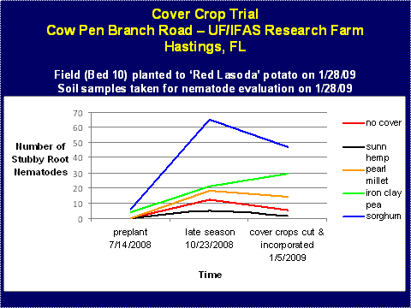
Selecting the best species is important!
Notes:
When selecting a cover crop for a specific objective such as high biomass production, a little research can prevent unintended negative consequences.
Dr. Amanda Gevens’ (formerly of UF’s Plant Pathology Dept., now at Michigan State) research on the effects of summer covers following conventional potato in Hastings. Note that the standard grower practice is sorghum (blue line). Stubby Root, the predominant nematode in this area, thrived under sorghum, while other cover species did a better job of suppressing populations.

Slide 32
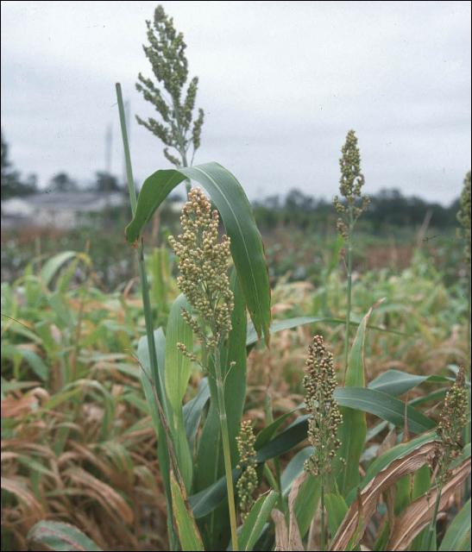
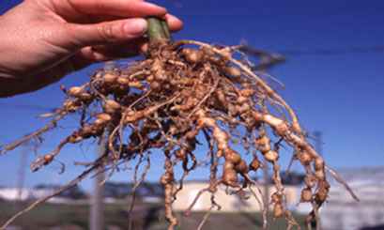
Species Selection – Benefits are Cultivar-Specific
Relationships between nematodes and sorghum and cowpea are cultivar-specific
Sorghum bicolor
Wang, UF-IFAS
Nematode galls USDA-ARS
Notes:
Lots of work on sorhgum as a non or poor host of nematodes. Predominately, the cover crop is incorporated into the soil prior to planting a crop. Due to the high C:N, SARE recommends chopping the residue prior to incorporation to reduce the potential for N immobilization.
Sorgolene is found in the root exudates of most sorghum species and has been shown to be a very potent allelotoxin that disrupts mitochondrial functions and inhibits photosynthesis.
Forage and grain sorghum = S. bicolor (L. (Moench)
Sudangrass – S. sudanense
Sorghum sudangrass = sudex, S. bicolor x S. sudanense (piper (staph)
Both produce forage/silage for livestock
Due to its rapid biomass production, sorghum-sudangrass is recommended as a cover crop to build up organic matter content in soil. Dry matter production can be as much as 8,000-10,000 lbs/acre/year. Also, it generally does not support populations of some key nematode pests, such as root-knot nematodes (Meloidogyne spp.). However, the ability to suppress nematodes is cultivar specific.

Slide 33
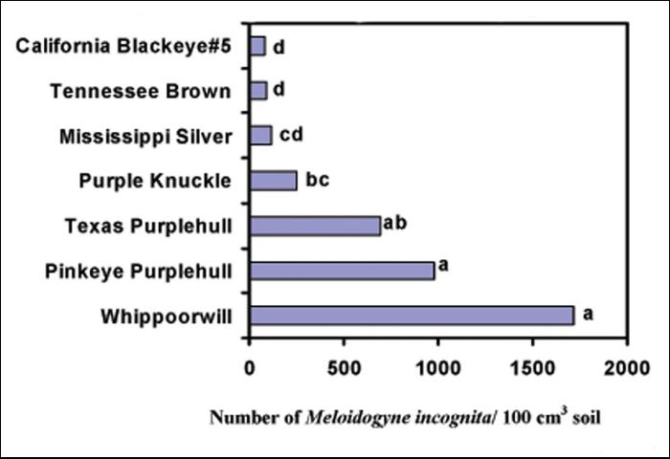
Nematode suppression by cowpea cultivars
Gallaher and McSorley, 1993
Notes:
EDIS pubs on this, and on sorhgum cultivars – show that cultivars do matter! Meloidogyne incognita = root knot nematode. The popular cowpea cultivar ‘Iron Clay’ or sometimes sold as ‘Iron and Clay’ is effective at suppressing nematodes.

Slide 34
Additional Resources
for Cover Crops

Slide 35
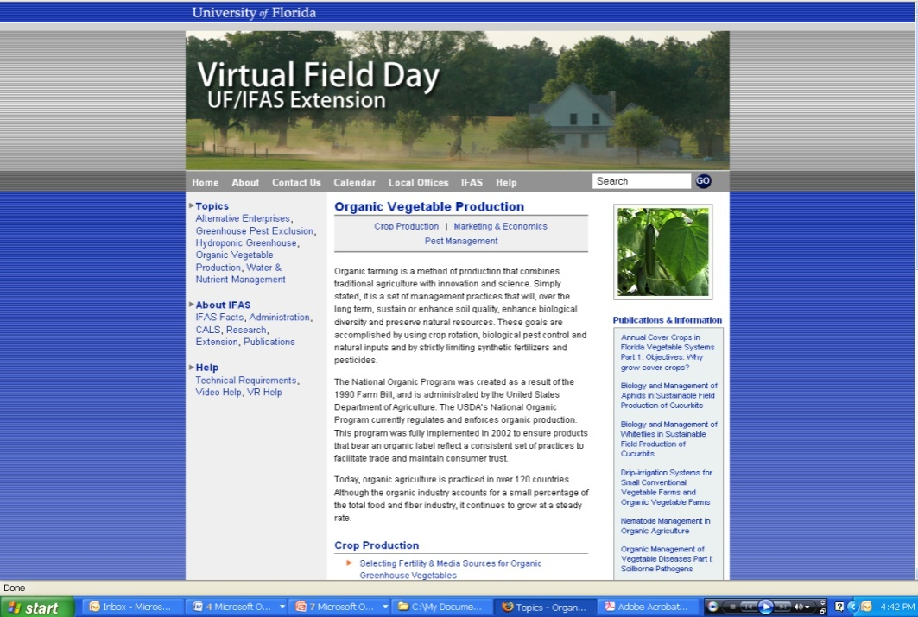
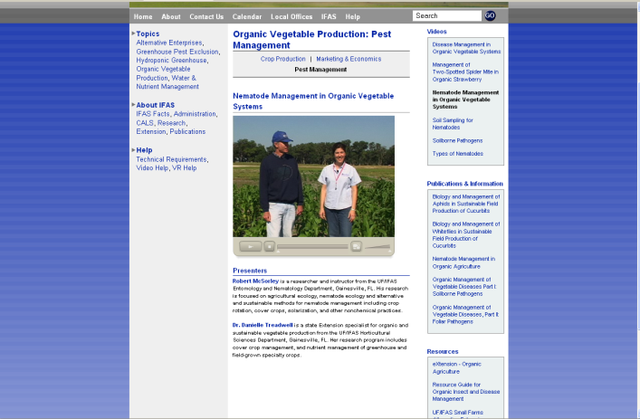
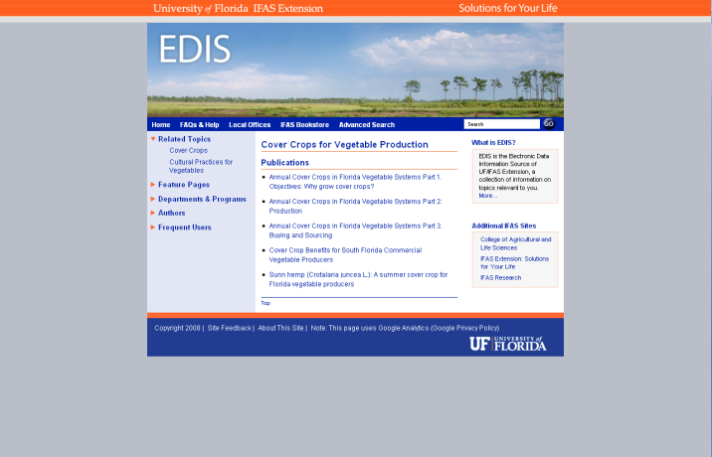
Cover Crops at UF-IFAS
Newsletter Articles in the Vegetarian
EDIS Fact Sheets (w/
embedded film clip)
Virtual Field Day Content
Notes:
A number of state and county extension faculty have experience working with cover crops. There are a number of publications on EDIS, as well as on UF-IFAS’s Virtual Field Day website.

Slide 36

Cover Crops on eXtension
Notes:
There are many additional resources on the web to assist farmers in designing a farm plan and rotation around their primary objectives. Although many of these publications and videos (including farmer case studies) are located in the Organic Agriculture resource area of eXtension (National Extension website), the principals are universal, and applicable to all growers.

Slide 37

Additional Resources
New Edition (3rd) 2007.
Available free PDF
  http://www.sare.org
Order for $20.00 + S&H
http://www2.ctahr.hawaii.edu/sustainag/Database.asp
Notes:
The SARE (Sustainable Agriculture Research and Education) handbook “Managing Cover Crops Profitably” is an excellent resource for any farm.
In addition, the University of Hawai’i maintains a searchable database of cover crops, featuring many tropical cover crop species that perform well in Florida but are not discussed in the SARE book.

Slide 38
For more information on cover crops:
Danielle Treadwell
UF-IFAS Horticultural Sciences
ddtreadw@ufl.edu
(352) 273-4775
Photo credits by Treadwell unless otherwise noted.
Copyright 2010 University of Florida
Notes:
Pearl millet in Citra, FL

