Slide 1
Growing Bell Peppers in Soilless Culture Under Open Shade Structures
R. C. Hochmuth, D. D. Treadwell, E. H. Simonne, L. B. Landrum, W. L. Laughlin, L. L. Davis
Notes:
Summary of work conducted at UF/IFAS North Florida Research and Education Center – Suwannee Valley near Live Oak, Florida.

Slide 2
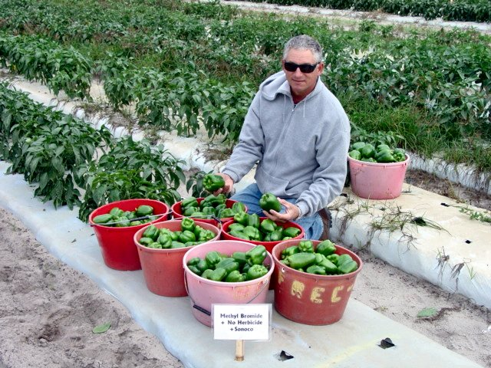
Florida Peppers
20,000 acres field grown
Available October – July
July – September
High temperatures
High humidity
Frequent rainfall
Pest pressure high
Greenhouse colored pepper one of top crops in Florida
Field and greenhouse production Jul-Sep very difficult
Notes:
Overview of all pepper production.

Slide 3
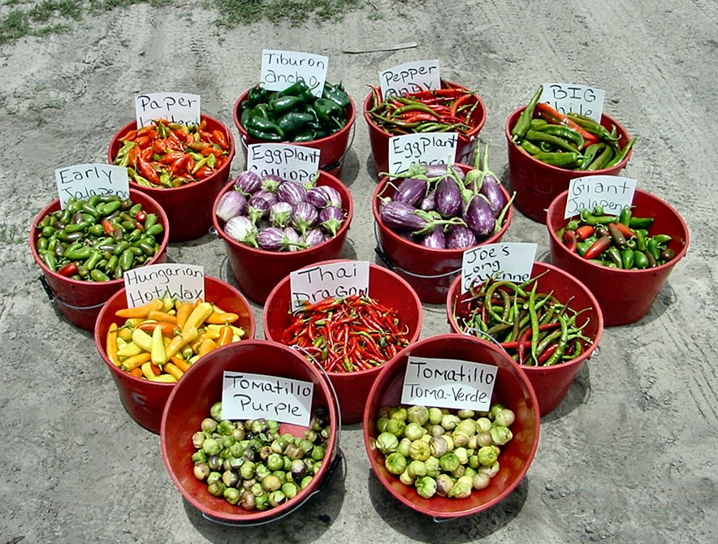
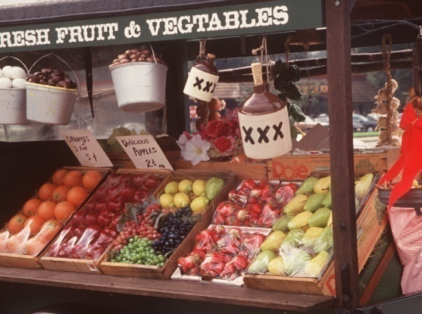
Summer Pepper Production
Large field acreage not competitive in summer.
However, small farmers…??
Small farmers
Direct market
Demand for local products
Seek to extend season for local markets
Notes:
Pepper production, in fields and greenhouses, us down in summer.

Slide 4
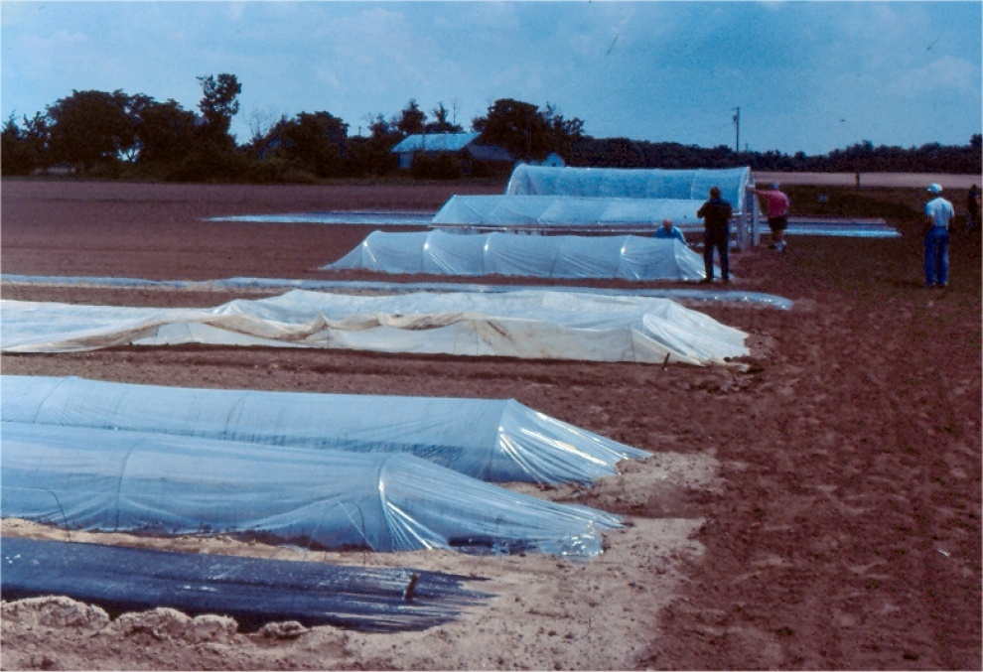
Small Farmers Likely to use Season Extension Practices
Transplants
Multiple varieties
Row covers
Plastic mulches
Low tunnels
High tunnels
Greenhouses
How about open shade structures??
Notes:
Are there techniques that may help us extend pepper season.

Slide 5
Materials & Methods
40 x 40 ft shade structure
10 ft high
50% polypropylene shade cloth
3 gallon plastic pots
Composted pine bark media
Heritage ‘VR’ pepper plants (TSWV resistant)
Standard hydroponic nutrient solution
Support system – fence posts and bamboo poles with string
Notes:
Setup for the trials at Live Oak.

Slide 6
Notes:
Soilless culture in nursery pots (3 gal).

Slide 7
Notes:
Peppers transplanted April 1 and grow quickly.

Slide 8
Notes:
Late spring growth and support system using metal fence posts in ground every 10 ft and bamboo stakes in every pot.

Slide 9
Notes:
Crop grown April 1 – Nov 9.
Plants about 8ft tall.

Slide 10
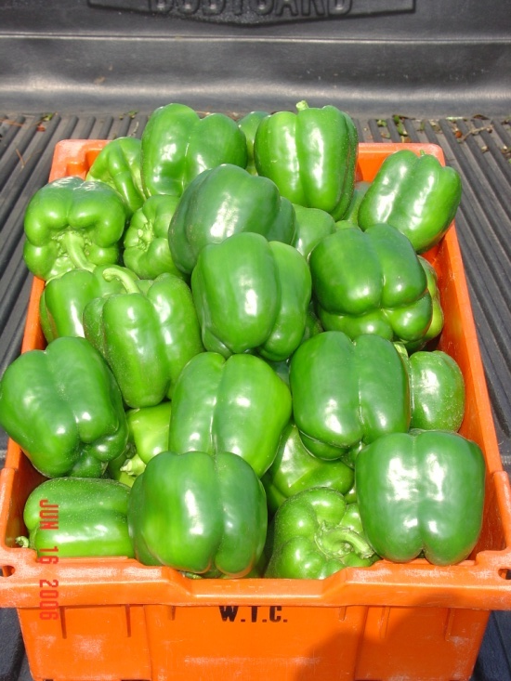
Harvest Results
Harvests June 16 – November 9, 2006
Total Marketable = 4,139 boxes/A
Fancy = 3,460 boxes/A
US No 1 = 477 boxes/A
US No 2 = 202 boxes/A
Notes:
Lots of Fancy fruit.
2-3 times yield of normal field season.
Very high quality pepper demand high prices.

Slide 11
Fruit Size
Harvest Dates | Average Fruit Width (in)^{z}
16 Jun | 3.67
23 Jun | 3.63
10 Jul | 3.54
27 Jul | 3.47
18 Aug | 3.00
12 Sep | 3.13
13 Oct | 3.35
9 Nov | 3.30
^{z} Average fruit width was determined by measuring 15 randomly selected fruits from the US Fancy category. Measurements were taken across the base of the fruit near the stem end, the widest part of the fruit.
Notes:
Size of fruit falls somewhat in hottest months but increases again in fall.

Slide 12
Hydroponic Peppers in a Shade House for Summer Production
Notes:
Simple structure covered with shade.
Usually 40% shade.

Slide 13
Large Scale Shade House Pepper
Notes:
Larger area in production ½ to 1 acre.

Slide 14
Conclusion
Open shade culture can serve to extend pepper fruit production into the summer in Florida
High quality fruit June-November
Plasticulture techniques make it possible
Shade cloth
Ground cover
Growing pots
Irrigation system
Polypropylene twine
ASP network
Notes:
Shade culture can extend season successfully.

Slide 15
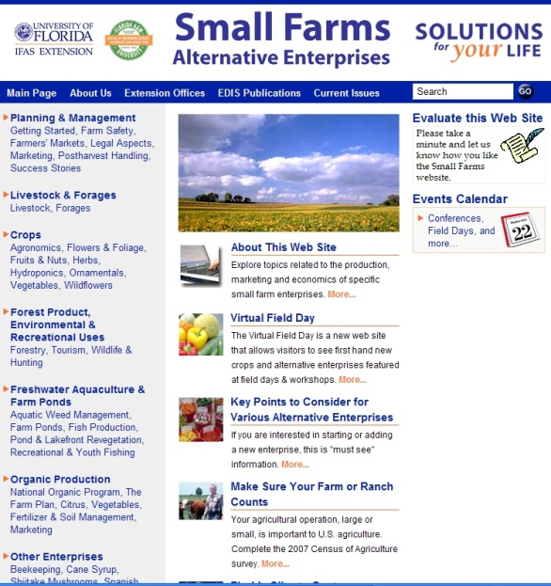
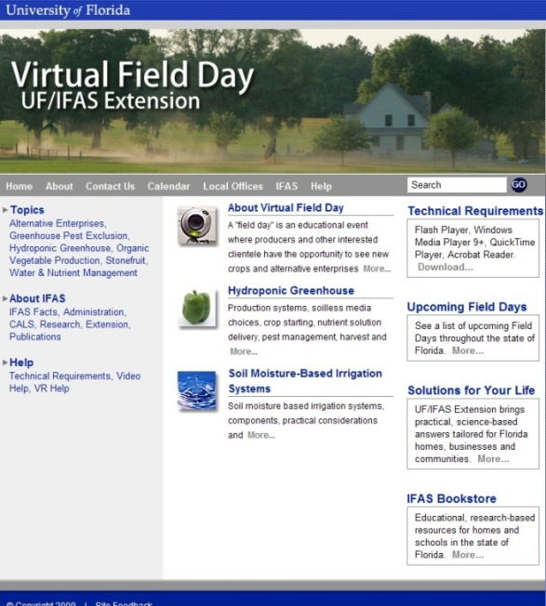
Thank You
For more information visit the Small Farms web at http://smallfarms.ifas.ufl.edu
Take a virtual field day tour by visiting the Virtual Field Day web at http://vfd.ifas.ufl.edu
This presentation brought to you by the
Small Farms/Alternative Enterprises Focus Team.

