Slide 1
MyPlate and Your Healthy Lifestyle

Slide 2
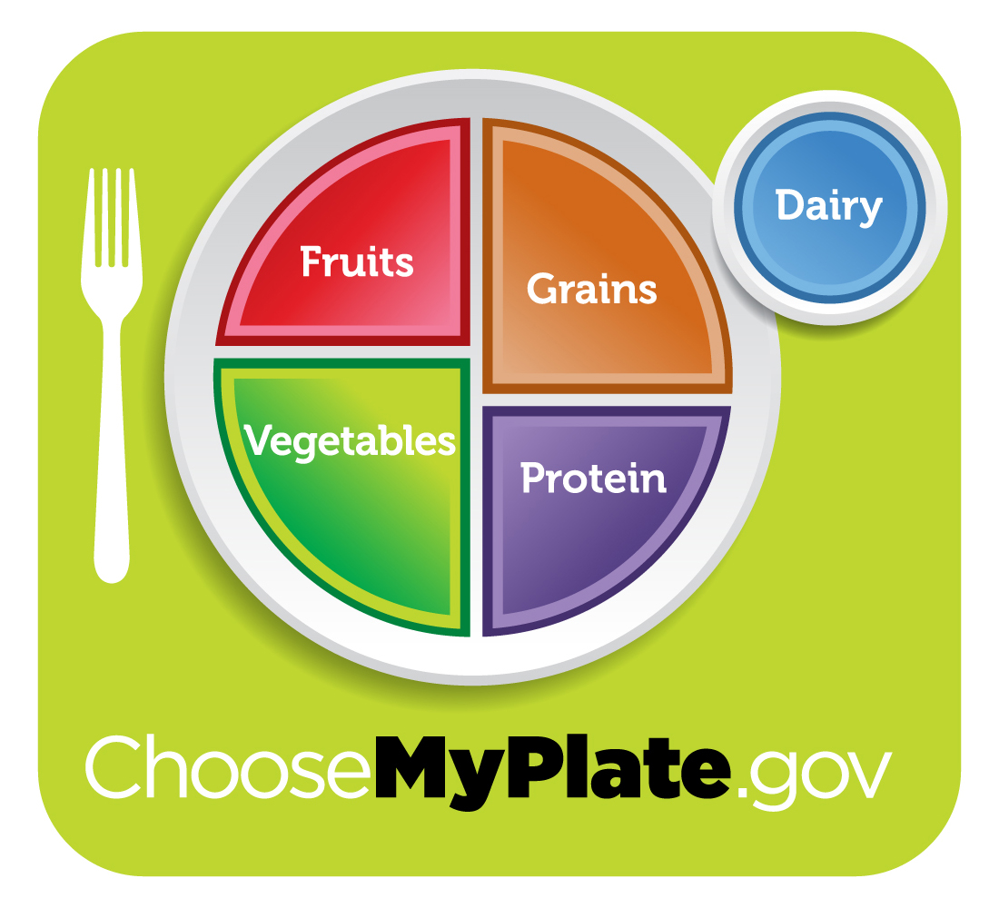
New Dietary Guidance Icon from the USDA

Slide 3
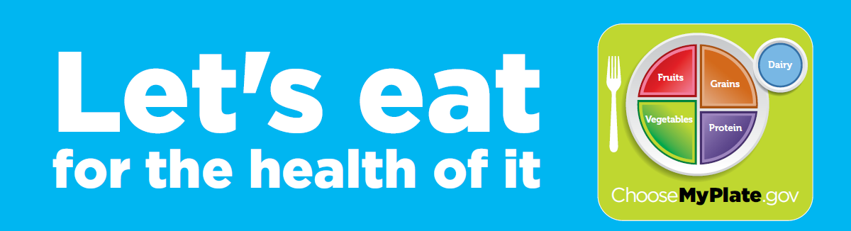
Key Lifestyle Messages
Build a healthy plate
Cut back on foods high in solid fats, added sugars, and salt
Eat the right amount of calories for you
Be physically active your way

Slide 4
Build a Healthy Plate
Make half your plate fruits and vegetables.
Switch to skim or 1% milk.
Make at least half your grains whole.
Vary your protein food choices.
Keep your food safe to eat.

Slide 5



Cut Back on Foods High in Solid Fats, Added Sugars, and Salt
Choose foods and drinks with little or no added sugars.
Look out for salt (sodium) in foods you buy – it all adds up.
Eat fewer foods that are high in solid fats.

Slide 6

Eat the Right Amount of Calories for You
Enjoy your food, but eat less.
Cook more often at home.
When eating out, choose lower calorie menu options.
Write down what you eat to keep track of how much you eat.
If you drink alcoholic beverages, do so sensibly.

Slide 7

Be Physically Active Your Way
Pick activities that you like.
Start slowly, at least 10 minutes at a time.
Every bit adds up.
Health benefits increase as you spend more time being active.

Slide 8
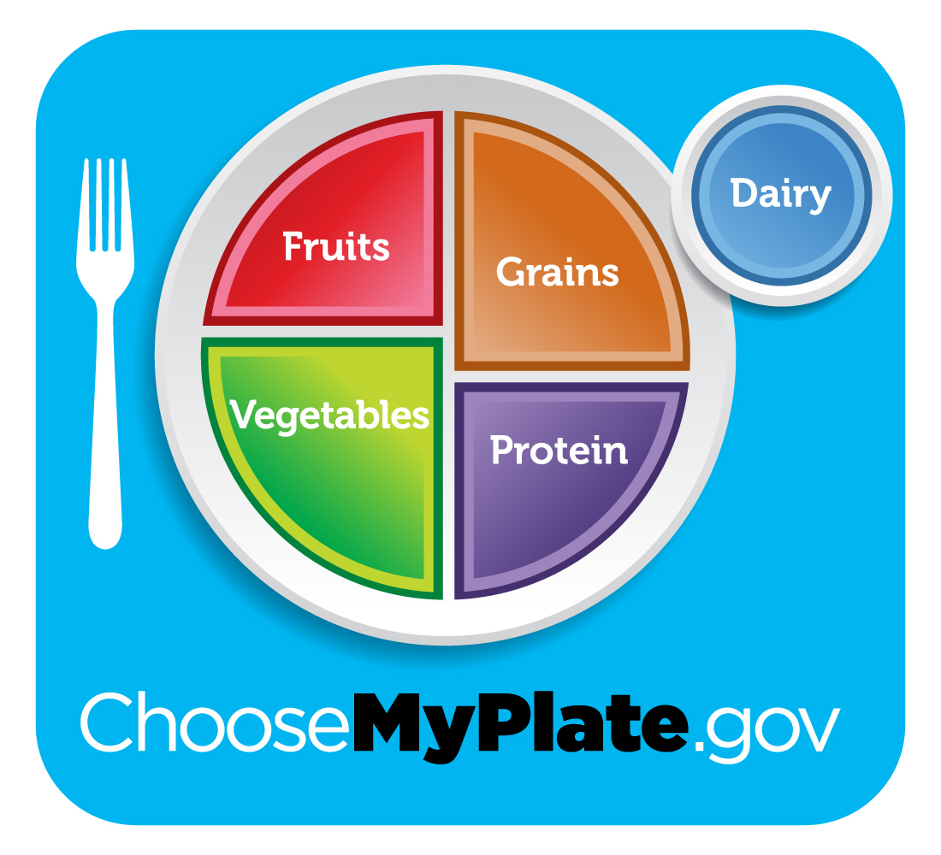
Food Choices within the Food Groups

Slide 9
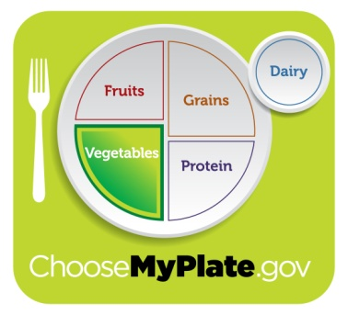
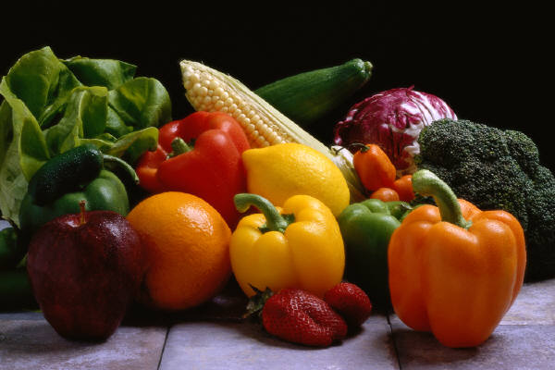
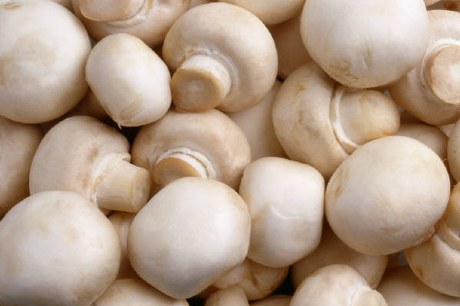
Vary Your Veggies
Includes weekly recommendations for:
  Dark green vegetables
  Orange and red vegetables
  Legumes
  Starchy vegetables
  Other vegetables

Slide 10
Vary Your Veggies
Buy fresh veggies in season.
Select high potassium veggies.
Use more fresh or frozen, less canned (except low sodium).
Have salad with dinner often.
Add veggies to casseroles, pasta sauce, quick breads, etc.
Select fast food salad rather than fries.
Choose dark salad greens over iceberg.

Slide 11
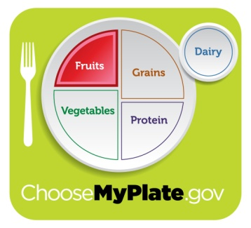
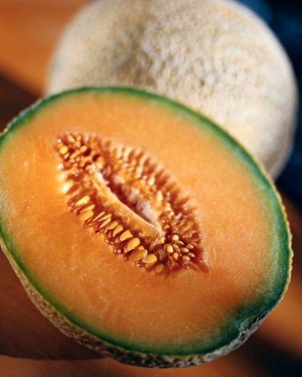
Focus on Fruits
Use fruits in salads, toppings, desserts, and for snacks.
Keep dried fruit handy for snacks.
Put fruit on cereal, pancakes, and waffles.
Include canned and frozen fruits.
Select fruits and juices high in potassium.
Buy in season.
Choose fruit more often than juice.

Slide 12
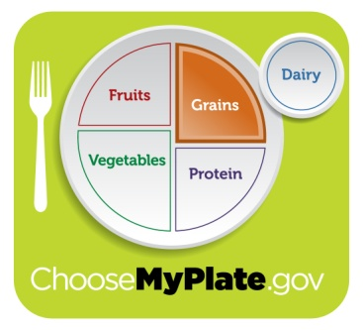
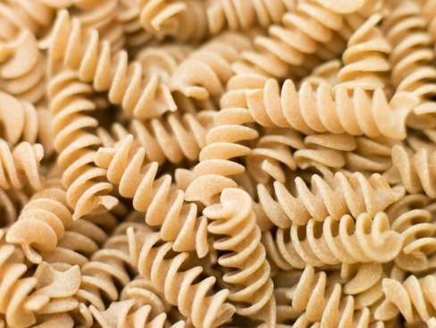
Make Half Your Grains Whole
Check ingredient lists on labels.
Look at dietary fiber on Nutrition Facts.
Select 100% whole grain breads and cereals.
Substitute whole grains for refined in recipes (start with half).
Be adventurous; try quinoa, bulgur, kasha, and other grains.
Add whole grains to mixed dishes.

Slide 13
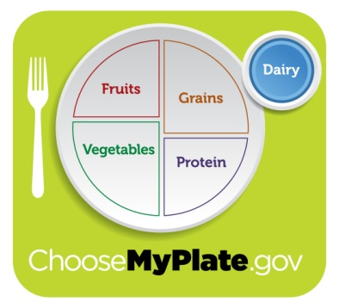

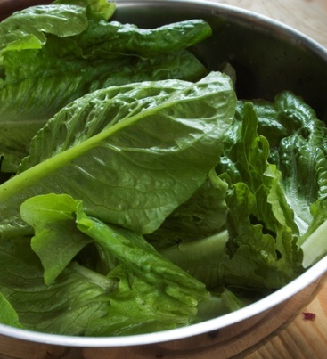
Get Your
Calcium-Rich Foods
Drink fat-free or low-fat milk with meals and snacks.
Choose low-fat cheeses.
Use milk to make hot cereals.
Have low-fat yogurt as a snack.
Use lactose-free products if needed.
Select non-dairy high-calcium foods and beverages if desired.

Slide 14
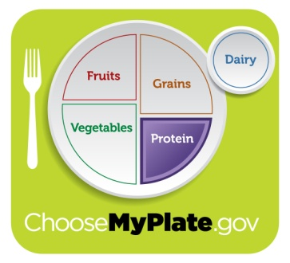
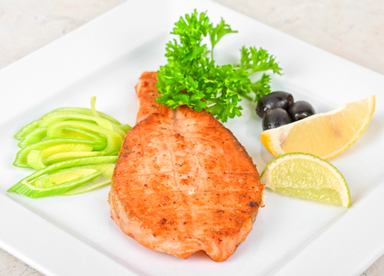
Go Lean With Protein
Select leanest cuts of meat.
Trim fat and remove skin from poultry.
Prepare with no added fat.
Eat beans in place of meats often.
Select omega-3 fatty acid-rich fish more often
Include nuts in snacks, salads, and main dishes.

Slide 15

Oils: Tips for Healthy Choices
Use vegetable oils rather than solid fats.
Substitute nuts for meat or cheese as snack or in a meal.
Use Nutrition Facts to select foods low in saturated fat, trans fat and cholesterol.
Select foods prepared with little or no fat or oil.
Select lean or low-fat foods most often.

Slide 16
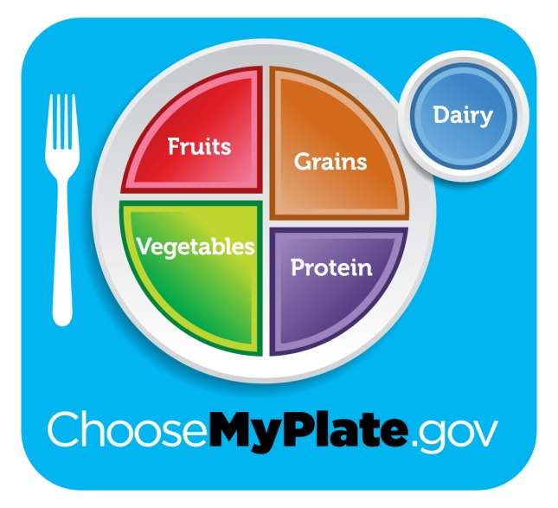
Using MyPlate in Your Life
Estimate your daily calorie needs.
  Use chart in handout or go to ChooseMyPlate.gov.
  Your personal calorie needs may be more or less.
Build your eating plan.
Follow recommendations to make healthy choices within each food group.
16

Slide 17
Estimate Daily Calorie Needs
This chart gives an estimate of calorie needs for specific age and gender groups. Calorie ranges are based on physical activity level.
CALORIES
Activity Level: | Sedentary | Moderate | Active
FEMALES
31-50 years | 1,800 | 2,000 | 2,200
51-60 years | 1,600 | 1,800 | 2,200
61+ years | 1,600 | 1,800 | 2,000
MALES
36-40 years | 2,400 | 2,600 | 2,800
41-45 years | 2,200 | 2,400 | 2,800
46-55 years | 2,200 | 2,400 | 2,600
56-60 years | 2,200 | 2,400 | 2,600
61-65 years | 2,000 | 2,400 | 2,600
66-75 years | 2,000 | 2,200 | 2,600
76+ years | 2,000 | 2,200 | 2,400

Slide 18
Daily Amount of Food from Each Food Group
Calorie level | 1600 | 1800 | 2000 | 2200
Fruits | 1½ cups | 1½ cups | 2 cups | 2 cups
Vegetables | 2 cups | 2½ cups | 2½ cups | 3 cups
Grains | 5 oz-eq | 6 oz-eq | 6 oz-eq | 7 oz-eq
Protein Foods | 5 oz-eq | 5 oz-eq | 5½ oz-eq | 6 oz-eq
Dairy | 3 cups | 3 cups | 3 cups | 3 cups
Oils | 5 tsp | 5½ tsp | 6 tsp | 6½ tsp
18

Slide 19
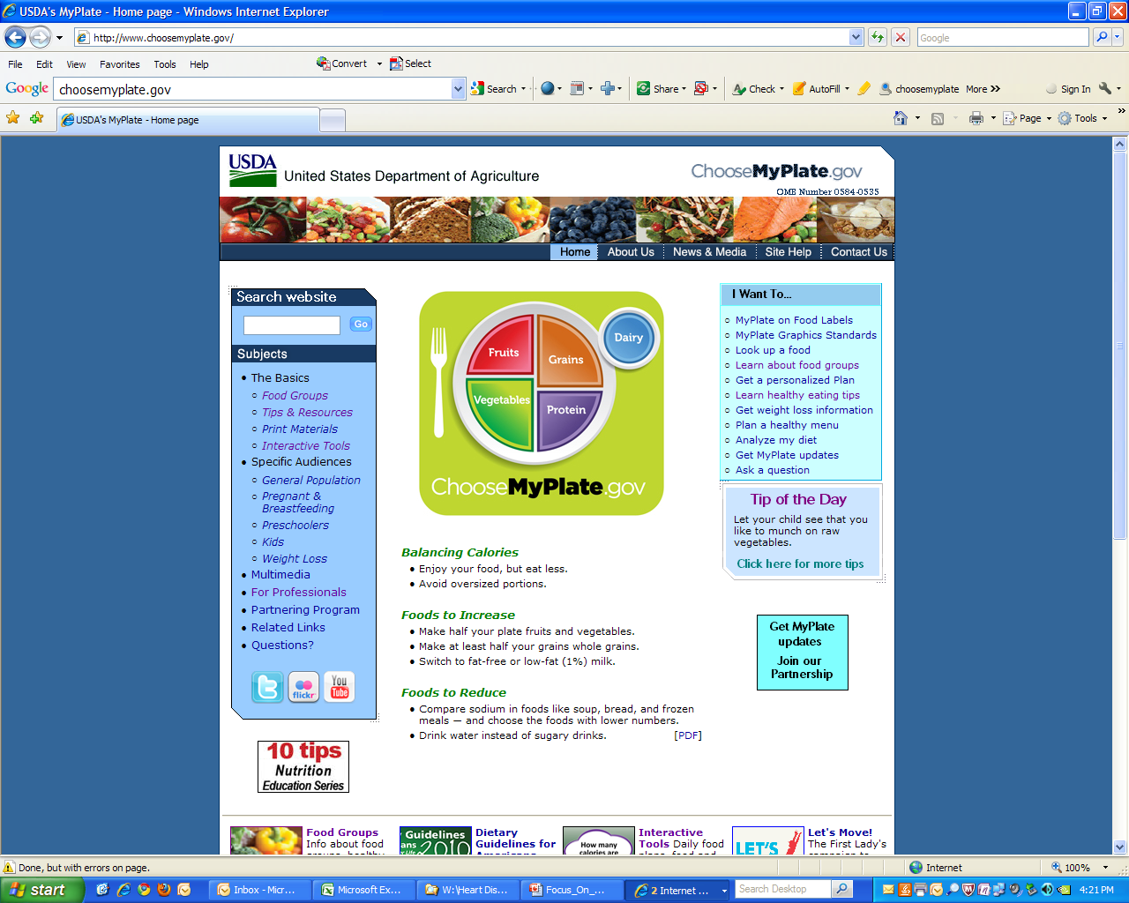

Slide 20
Resources
ChooseMyPlate.gov - official website of USDA’s food guidance system
www.nutrition.gov - federal portal to reliable nutrition and health websites
www.nal.usda.gov/fnic - nutrition information and resources for consumers and professionals
edis.ifas.ufl.edu – UF IFAS downloadable publications
Solutionsforyourlife.ufl.edu - UF IFAS Extension website – information and resources in all program areas
20

Slide 21

Increasing Physical Activity
Let’s try Chair Dancing!!

Slide 22
Slide set developed by:
Linda B. Bobroff, Ph.D., RD
Department of Family, Youth and Community Sciences
UF IFAS Extension
August 2011

