Slide 1
Young Farmers educational series IRRIGATION and nutrient management
Lincoln Zotarelli, Ph.D.
Assistant Professor, Horticultural Sciences Dept.
Gainesville, FL – lzota@ufl.edu
Hastings, FL, November 27, 2012

Slide 2
Objectives
To promote adoption of efficient irrigation technologies and management practices for irrigation and fertilization
To promote the use of information currently available including
evapotranspiration network related tools
improved irrigation scheduling
Increase public awareness of IFAS irrigation/fertilization research and extension efforts

Slide 3
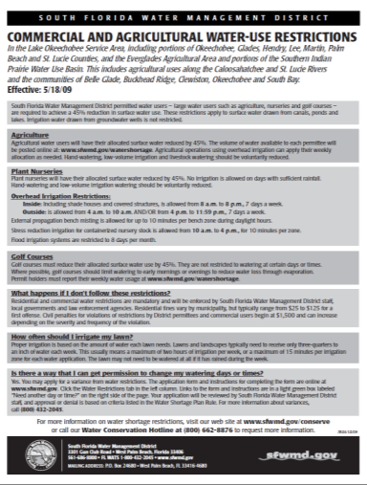
We have been forced to produce more with less resources…
https://my.sfwmd.gov/portal/page/portal/pg_grp_sfwmd_weather/pg_sfwmd_weather_losawatershort
Notes:
Recently, Agricultural operation have been dealing with restrictions such as water use restrictions,
Like this one in South West Florida…
Or dealing with fertilizer prices, like in 2008.

Slide 4
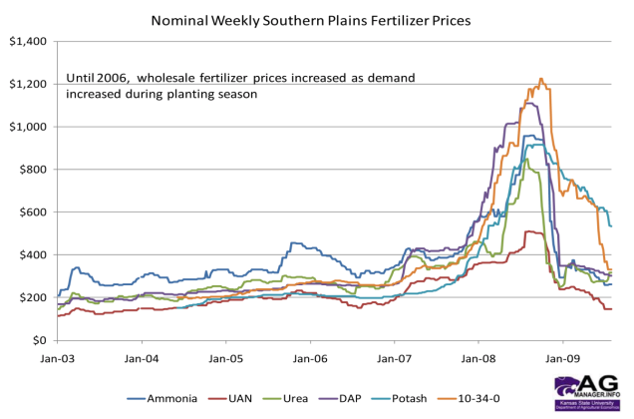
We have been forced to produce more with less resources…
Boland (2009) AgMRC Reneable Energy Newsletter – Kansas St. Univ.
https://my.sfwmd.gov/portal/page/portal/pg_grp_sfwmd_weather/pg_sfwmd_weather_losawatershort
Notes:
Recently, Agricultural operation have been dealing with restrictions such as water use restrictions,
Like this one in South West Florida…
Or dealing with fertilizer prices, like in 2008.

Slide 5
We have been forced to produce more with less resources…
In other words, we have been forced to increase efficiency to keep agriculture competitive
Boland (2009) AgMRC Reneable Energy Newsletter – Kansas St. Univ.
https://my.sfwmd.gov/portal/page/portal/pg_grp_sfwmd_weather/pg_sfwmd_weather_losawatershort
Notes:
Recently, Agricultural operation have been dealing with restrictions such as water use restrictions,
Like this one in South West Florida…
Or dealing with fertilizer prices, like in 2008.

Slide 6
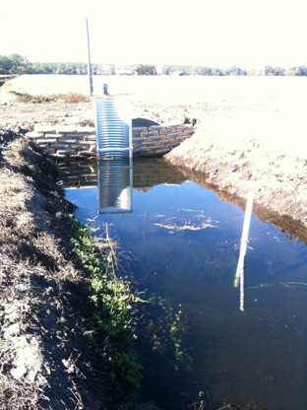
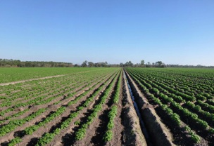
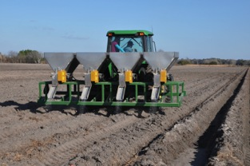
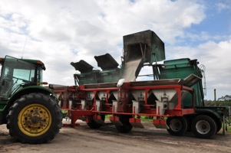
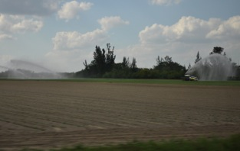
Irrigation and nutrient management “an example"

Slide 7
Water management and vegetable production
Two irrigation strategies
Fixed irrigation – 2 hours continuously
Equivalent to 79.6 gal/100ft/day
At the end of the season applied 16.2 in or 5,970 gal/100ft
Controlled irrigation – TARGET WAS TO WET THE TOP 12-16” OF SOIL
5 possible irrigation windows controlled
by soil moisture sensors set at soil field capacity
Equivalent to 33.2 gal/100ft/day
At the end of the season applied 6.7in or 2,492 gal/100ft
Source: Zotarelli et al 2008. Scientia Horticulturae

Slide 8
Water management and vegetable production
Irrigation time
8am
10am
12pm
2pm
4pm
Fixed Time Irrigation
Soil Moisture Sensor
N-rates of 75, 150 and 225 lb/ac weekly fertigation with calcium nitrate
Source: Zotarelli et al 2008. Scientia Horticulturae

Slide 9
225 lbN/ac
150 lbN/ac
75 lbN/ac
Controlled irrigation
Controlled irrigation
2h fixed irrigation

Slide 10
75 lbN/ac
225 lbN/ac
Controlled irrigation
75 lbN/ac
Controlled irrigation
2h fixed irrigation

Slide 11
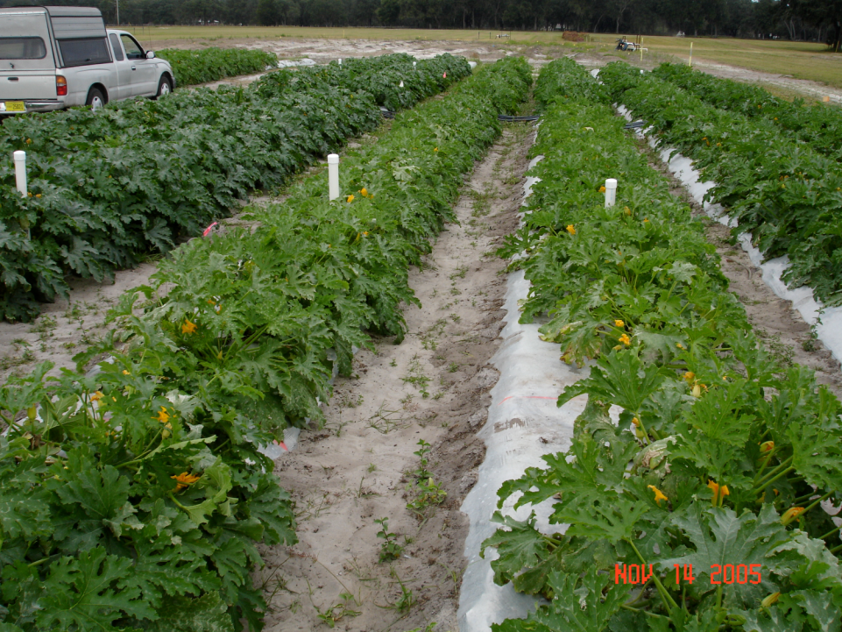
150 lbN/ac
Controlled irrigation
75 lbN/ac
2h fixed irrigation
150 lbN/ac
2h fixed irrigation
75 lbN/ac
Controlled irrigation

Slide 12
Zucchini plant N accumulation

Slide 13
Zucchini daily N uptake

Slide 14
Irrigation vs. N-fertilization on zucchini
 | 75 lbN/ac | 150 lbN/ac | 225 lbN/ac | Average
 | Zucchini marketable yield (lb/ac)
Controlled irrigation – up to 5 irrig. windows/day | 22,389 | 25,422 | 26,135 | 24,649 A
Fixed irrigation of 2h/day | 15,525 | 19,535 | 19,891 | 18,316 B
Average | 19,955 B | 22,478 A | 23,013 A
† Means within columns/lines followed by the same lowercase letters are not significantly different (P ≤ 0.05) according to Duncan’s multiple range test.

Slide 15
Irrigation vs. N-fertilization on zucchini
 | 75 lbN/ac | 150 lbN/ac | 225 lbN/ac | Average
 | Zucchini marketable yield (lb/ac)
Controlled irrigation – up to 5 irrig. windows/day | 22,389 | 25,422 | 26,135 | 24,649 A
Fixed irrigation of 2h/day | 15,525 | 19,535 | 19,891 | 18,316 B
Average | 19,955 B | 22,478 A | 23,013 A
100%
74%
84%
100%
102%

Slide 16
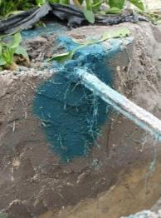
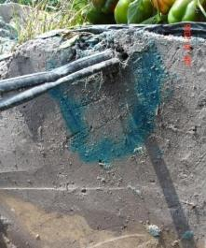
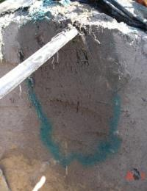
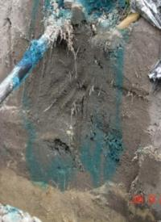
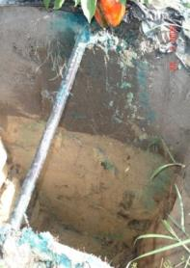
Effect of irrigation on solute displacement
(injecting dye in fertigation lines)
24 hrs
3 days
7 days
soil sensor based
irrigation
16in
fixed time irrigation schedule
+38 in

Slide 17
Keeping
water and nutrients in the plant root zone

Slide 18
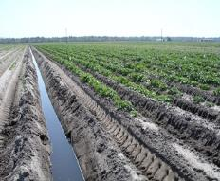
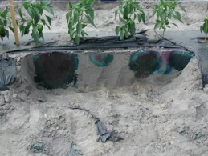
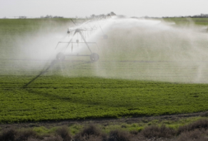
What can we do to improve water use efficiency of irrigation systems in Florida?
Seepage
Microirrigation
Sprinkler

Slide 19
What can we do to improve water use efficiency of irrigation systems in Florida?
Seepage
Microirrigation
Sprinkler
General guidelines:
Proper irrigation design
Determine and record operation values and water consumption
Check system uniformity
Irrigation system maintenance (documented maintenance)
Record flow rate, pressure delivered by the pump, energy consumption, etc.
Resources: Mobile Irrigation Lab (MIL) – free of charge, provide irrigation systems evaluation with recommendation with system upgrades, irrigation scheduling, maintenance items. Contact local NRCS District Conservationist.

Slide 20
Microirrigation systems
Advantages:
Delivers water right to the plant;
Frequent, small applications;
Low volume required;
Don’t wet the entire soil surface or volume;
Perfect match with plasticulture (additional soil water conservation, up to 30%)
Proper timing
WHAT CAN BE DONE TO IMPROVE IT?
Improve irrigation scheduling based on ET information and system capacity

Slide 21
What do you need to know to prepare a irrigation scheduling plan?
1. crop requirements and critical period
2. cultural practices adopted
3. soil type
4. capabilities of the irrigation system

Slide 22
1. Crop requirements and critical periods

Slide 23
Timing is Everything!

Slide 24
Basic principles
Rainfall is rarely uniformly distributed
Soil moisture deficiency occurring early in the crop cycle may delay maturity and yields
Shortages later in the season often lower quality and yields
Over-irrigation, especially late in the season, can reduce quality and postharvest life of the crop

Slide 25
Critical periods of water need by crops
Crop | Critical period
Beans: lima | Pollination and pod development
: snap | Pod development
Broccoli | Head development
Cabbage | Head development
Carrots | Root enlargement
Corn | Silking and tasseling, ear development
Cucumbers | Flowering and fruit development
Egg plant | Flowering and fruit development
Lettuce | Head development
Onions | Bulb enlargement
Peppers | Flowering and fruit development
Potatoes | Tuber set and tuber enlargement

Slide 26
Plant factors and cultural practices that affect the crop irrigation requirements
Crop species
Canopy size and shape
Plant population
Rooting depth
Stage of growth and development of the crop
Cultivation, mulching, weeds

Slide 27
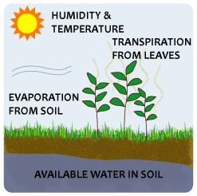
Irrigation Requirement
I = irrigation
ETc = crop evapotranspiration
P = precipitation
All terms are expressed as inches of water.
Notes:
Lysimeter method is considered to be the standard methods for all other methods. The calculation seems very simple, however, the environmental factors that control the ET process are complicated and need to be carefully considered. These environmental parameters are extremely difficult to interpret over humid environment, while hazard weathers are frequent.

Slide 28
Evapotranspiration during the day
inch/h
inch/day
0.028
0.024
0.020
0.016
0.012
0.008
0.004
0.00
0.28
0.24
0.20
0.16
0.12
0.08
0.04
0.00

Slide 29
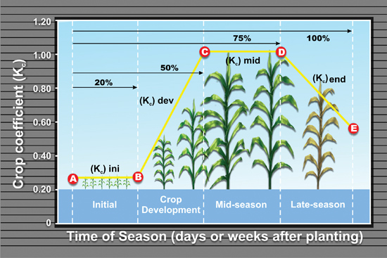
Crop Evapotranspiration
ET provides reference measure of water use based on plant water demand
Scalable for specific crop, growth stage, climate, and season of year
ET_{c} = ET_{o} * K_{c}

Slide 30
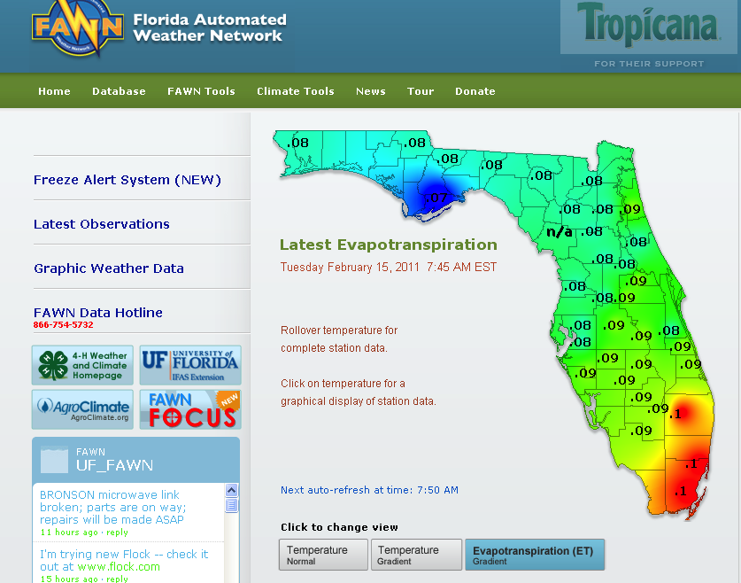
FAWN weather stations

Slide 31
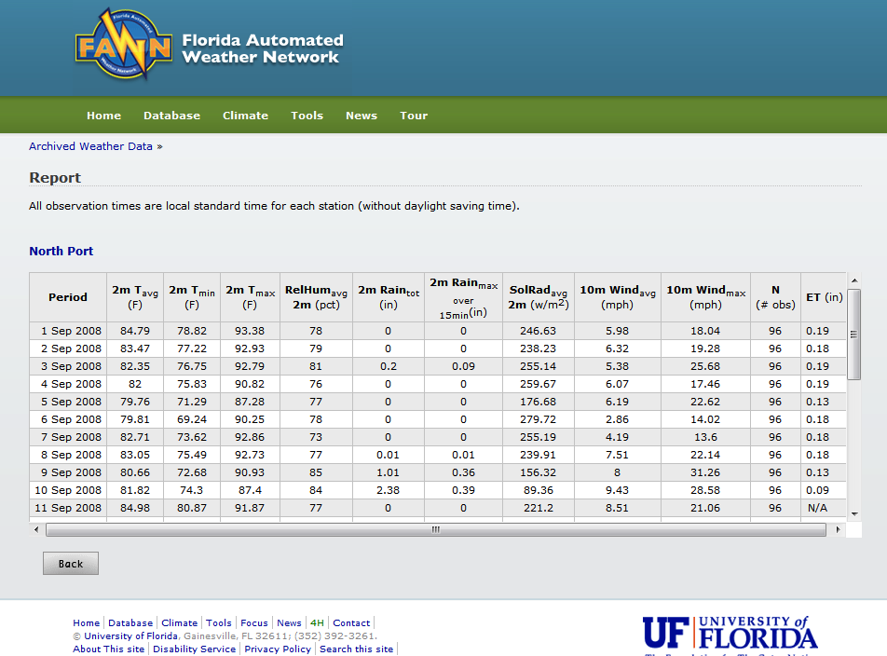

Slide 32
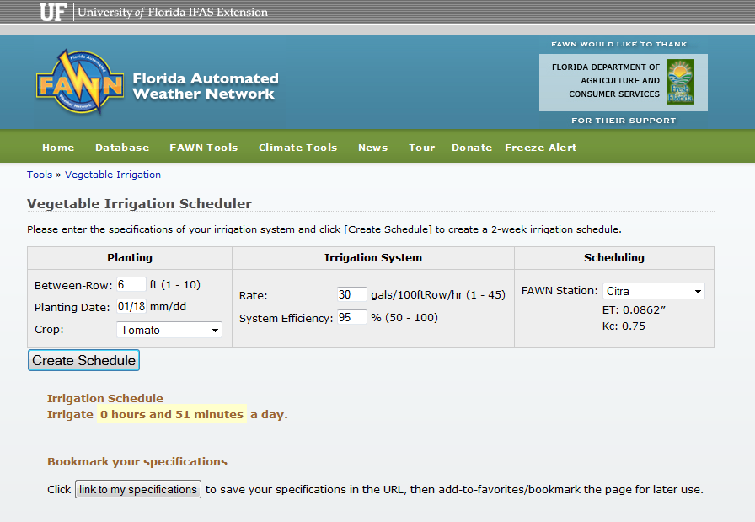
FAWN – Vegetable Irrigation Scheduler
http://fawn.ifas.ufl.edu/tools/irrigation/vegetable/

Slide 33
2. Soil type and characteristics

Slide 34
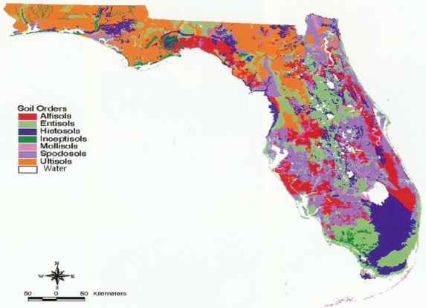
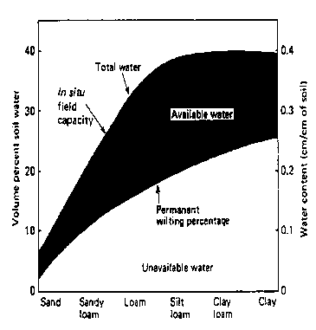
Effect of soil texture and soil tension on soil water availability
Kramer and Boyer (1995)
Notes:
At this point I want to focus my talk in two important aspects of the vegetable production… Irrigation and Fertilizer.
Our research program have been focusing on an essential part of the vegetable production systems

Slide 35
Actual soil moisture on sandy soils
Saturation
Field Capacity
Wilting Point
VWC > 30%
VWC > 0.3 in³/in³
-1 cbar
-0.001 MPa
VWC approx. 6%
VWC > 0.06 in³/in³
-1500 cbar
-1.5 MPa
VWC approx. 12%
VWC > 0.12 in³/in³
-10 cbar
-0.01 MPa

Slide 36
Pillar - Irrigation schedule
Have a target irrigation volume based on weather demand and crop stage of growth.
Target for drip (example):
- small plants: 2 x 30 min/day (20-25 gal/100ft/day)
- large plants: 3 x 1hr/day (70-80 gal/100ft/day)
Fine tune schedule and monitor soil moisture (SWT or VWC)
Know the contribution of rainfall
Keep irrigation records

Slide 37
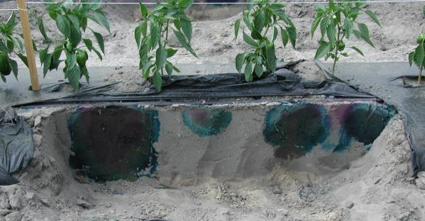
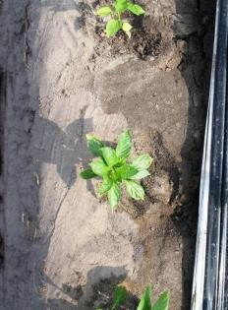
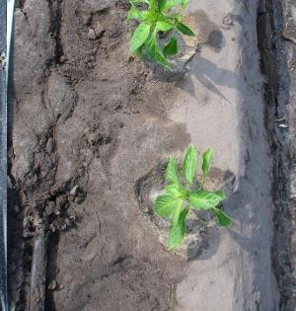
Maintenance is Critical for Efficient Irrigation
Photo: M. Dukes
dry soil
at side of the bed
wet soil
drip tape at
center of the bed
Photo: L. Zotarelli

Slide 38
Seepage irrigation and alternatives
Problems:
High volume required to raise water table;
Lack of soil moisture uniformity at root zone;
Possible alternatives to improve soil moisture distribution
Tile drainage systems
Sub-surface drip irrigation to raise water table

Slide 39
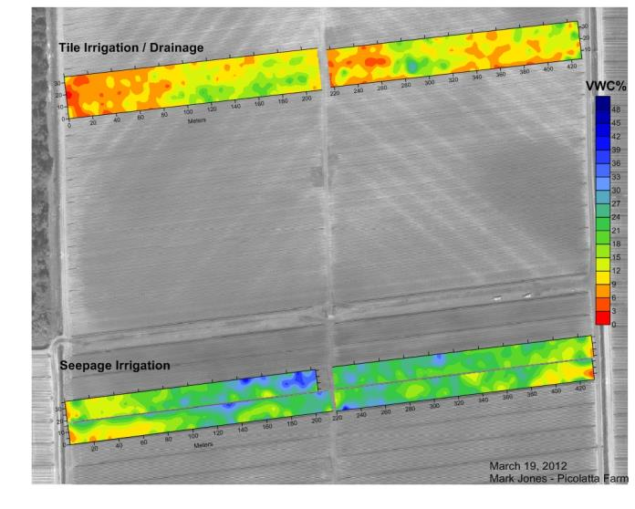
Tile Drainage

Slide 40
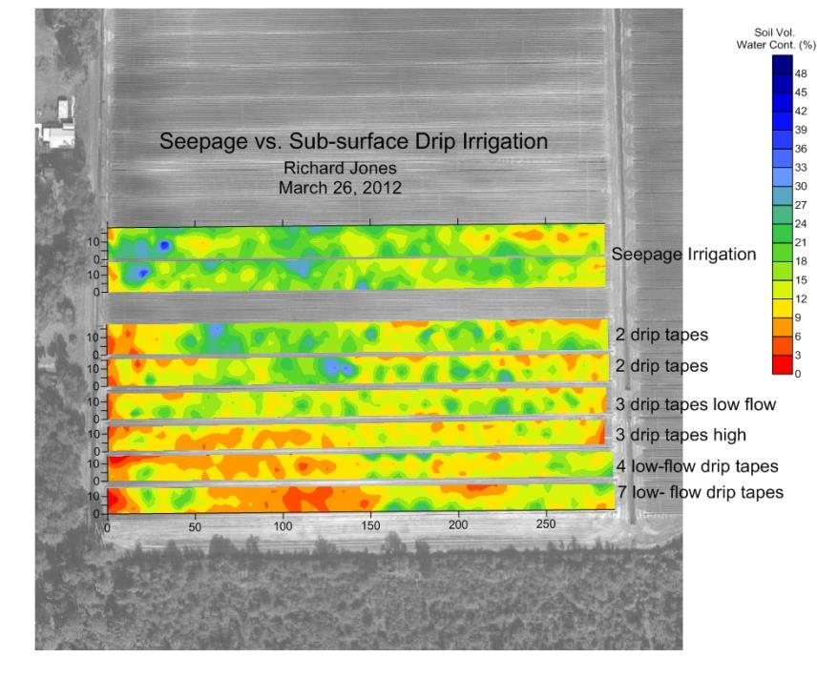
Sub-surface drip

Slide 41
How to make your irrigation system more efficient
Maintenance
Scheduling
Applying the right amount of water
Applying water at the right time

Slide 42
What are the barriers and incentives for implementation and proper maintenance of irrigation systems?
Barriers
Economic investment
Lack of information about the system, correct management and maintenance
Available Incentives
Cost-Share Programs for Water Conservation – qualified growers are expected to contribute a portion of total project cost
Water Conservation Programs administered by USDA: e.g. Environmental Quality Incentives Program (EQIP)
State and Regional Water Conservation Programs: e.g. BMP Cost-Share Program (FDASC); FARMS Program (SWFWMD); Water Protection and Sustainability Cost-Share Program (SJRWMD)

