Slide 1
Nutritive Sweeteners: Sugars and Sugar Alcohols

Slide 2
Did you know?
Americans consume 22 tsp. of added sugar each day!
Teenagers (ages 12-18) consume 28 tsp. (476 calories!) of added sugars each day - accounting for 21% of their total calorie intake.
A 12-ounce can of sugar-sweetened soda contains about 150 calories and 9 tsp. of sugar. Diet (low calorie) soda contains no sugar.

Slide 3
Trends in Intake
Sugar intake in the United States has increased by >40 fold since the American Revolution
Consumption of added sugars decreased from 1999-2000 to 2007-2008 (NHANES data)
100 g/day added sugar intake in 1999-2000
77 g/day added sugar intake in 2007-2008
On average, adults in the US consume 14.6% of energy (calories) from added sugars

Slide 4
Recommended Daily Allowance
130 g/day of carbohydrate is needed = glucose requirement
That’s 520 kcals....
43% of a 1200 kcal diet
35% of a 1500 kcal diet
26% of a 2000 kcal diet

Slide 5
Dietary Guidelines for Americans
Recommendation to limit the intake of foods that contain added sugar.
Guidelines do not distinguish between sucrose (table sugar) or other added sugar sources.
Added sugars contribute about 15 % of the total energy (calories) in American diets - the major food sources of added sugars are soda, energy drinks, sports drinks.

Slide 6
American Heart Association (AHA)
Limit the amount of added sugars in your diet
Focus on all added sugars, not just one type, such as high fructose corn syrup
Women: limit to no more than 100 calories per day from added sugar (~6 teaspoons of sugar)
Men: limit to no more than 150 calories per day from added sugar (~9 teaspoons of sugar)

Slide 7
Sugars added to food and beverages
Added sugar is defined as not naturally occurring, but is not distinguished on Nutrition Facts Label
Can be identified by reading ingredient list on food label
Examples include: anhydrous dextrose, lactose, brown sugar, malt syrup, maltose, corn syrup, molasses, nectars, fructose, honey, raw sugar, sucrose, invert sugar, etc.

Slide 8
Safety and Quality in Foods
Sugars are added to foods to:
Inhibit microbial growth by binding water in jams and jellies
Add texture, flavor, and color to baked goods
Support the growth of yeast for leavening or fermentation
Contribute volume in ice cream, baked goods, and jams
Enhance the creamy consistency of frozen desserts
Enhance the crystallization of confectionary products
Help to maintain the natural color, texture, and shape of preserved fruits

Slide 9
Nutritive Sweeteners
Sugars provide energy as carbohydrates at 4 calories per gram (kcal/g)
Examples: glucose, fructose, agave nectar, honey, high fructose corn syrup, corn syrup, sucrose, lactose
Sugar alcohols provide from 0 to 2.6 kcal/g
Examples: erythritol, xylitol, mannitol, sorbitol

Slide 10
Glucose
Monosaccharide (single sugar molecule)
The main source of energy for the body and is needed by brain cells
Glucose is produced when starch is digested
Makes up exactly 1/2 of the sugar in sucrose and nearly 1/2 of the sugar in high fructose corn syrup

Slide 11
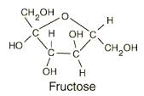
Fructose
Monosaccharide (single sugar molecule)
Found in fruits, honey, and root vegetables
Added to foods and beverages in the form of crystalline fructose
Makes up 1/2 the sugar in sucrose and a bit more that ½ of the sugar in high fructose corn syrup

Slide 12
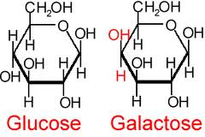
Lactose
Disaccharide (2 sugar units)
Found in milk and dairy foods
Added to many foods

Slide 13
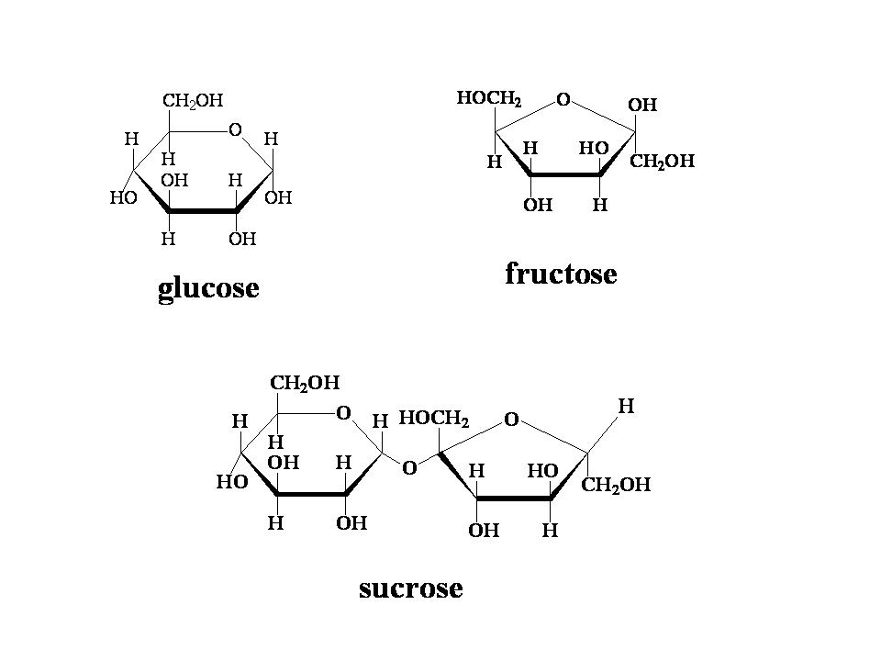
Sucrose
aka table sugar
Disaccharide (2 sugar units)
Includes raw sugar, granulated sugar, brown sugar, confectioner's sugar
Sources - sugar cane and sugar beet

Slide 14
High Fructose Corn Syrup (HFCS)
HFCS - introduced to the food and beverage industry as a liquid alternative to sucrose in the late 1960s
Produced from corn syrup, which is typically 100% glucose
Syrup undergoes enzymatic processing to increase fructose content
55% Fructose:45% Glucose

Slide 15
Agave Nectar
Sugar from the Agave tequiliana (tequila) plant
Contains fructose, glucose and some fructans (oligosaccharides - fiber)
Agave nectar is about 1½ times sweeter than sucrose due to its fructose content

Slide 17
Glycemic Index of Sugars
Using white bread as a control at 100
Glucose 149
Fructose 16
Sucrose 65
Lee & Wolever. Eur J Clin Nutr. 1998;52(12):924-8.

Slide 18
Glycemic Index and Health
High Glycemic Index - risk factor for the development of type 2 diabetes and cardiovascular disease.
Low Glycemic Index – may protect against the development of obesity and may improve HbA1c in those with diabetes

Slide 19
Safety
“The Food and Drug Administration (FDA) has examined numerous sugars, including glucose, dextrose, fructose, sucrose, high fructose corn syrup, lactose, and maltose, and determined that they are “generally recognized as safe” (GRAS).
According to the FDA, sugars for use in foods have a proven track record of safety based either on a history of use or on published scientific evidence, and can be used in food products without further FDA approval.”
Background on Carbohydrates & Sugars from the International
Food Information Council (IFIC)

Slide 20
HFCS vs. Sucrose
Controversy + Speculation + Confusion
Scientific consensus - no metabolic or endocrine response differences between consuming HFCS vs. sucrose related to obesity or any other adverse health outcome.
Rippe & Angelopoulos. 2013. Sucrose, High-Fructose Corn Syrup, and Fructose, Their Metabolism and Potential Health Effects: What Do We Really Know? Adv Nutr, 4, 236-245.

Slide 21
Sorbitol
2.6 kcal per gram
50%-70% as sweet as sucrose
noncariogenic
a laxative effect from a daily load of 50 g

Slide 22
Mannitol
50%-70% as sweet as sucrose
low-energy sweetener at 1.6 kcal per gram
cooling effect to mask bitter taste
non-cariogenic
laxative effect from a daily load of 20 g

Slide 23
Xylitol
As sweet as sucrose and anticariogenic (2.4 kcal/g)
60%-80% as sweet as sucrose and anticariogenic (0.2 kcal/g)
Erythritol

Slide 24
Disaccharide polyols
Isomalt – 45% to 65% as sweet as sucrose (2 kcal/g)
Lactitol – 30%-40% as sweet as sucrose(2 kcal/g)
Maltitol – 90% as sweet as sucrose (2.1 kcal/g)
Isomaltulose – 50% as sweet as sucrose; used as a slow release carbohydrate source (4 kcal/g)
Trehalose – 45% as sweet as sucrose (3.6 kcal/g)

Slide 25
Conclusions
Decreasing intake of added sugars is recommended to improve health.
This may be best achieved by decreasing intake of beverages with added sugars.
Current research indicates that there is no difference between health impact of the added sugars, sucrose or HFCS.

Slide 26
Key References
U.S. Department of Agriculture and U.S. Department of Health and Human Services. Dietary Guidelines for Americans, 2010. 7th Edition, Washington, DC: U.S. Government Printing Office, December 2010.
Position of the Academy of Nutrition and Dietetics: Use of Nutritive and Nonnutritive SweetenersJ Acad Nutr Diet. 2012;112:739-758.
Rippe & Angelopoulos. 2013. Sucrose, High-Fructose Corn Syrup, and Fructose, Their Metabolism and Potential Health Effects: What Do We Really Know? Adv Nutr, 4, 236-245.
Background on Carbohydrates & Sugars from the International Food Information Council (IFIC)

Slide 27
Credits
This presentation adapted for XXXXX county and presented by:
Xxxxxxxx
Xxxxxxxx County Cooperative Extension Office
Xxxxxxxx phone number/address/email
This presentation prepared by:
Wendy J. Dahl PhD RD
Assistant Professor, FSHN
Extension Specialist
University of Florida
wdahl@ufl.edu

